Slide 1


Jewish Art: Menorah
Rabbi Chaim Metzger
cmetzger@torontotorah.com

Slide 2
Menorah’s Blueprint
What was Menorah made out of? What did it look like?
  Torah
  Second Temple
  Archeology
When is it used as a Jewish Symbol?
Can you make one for yourself?

Slide 3
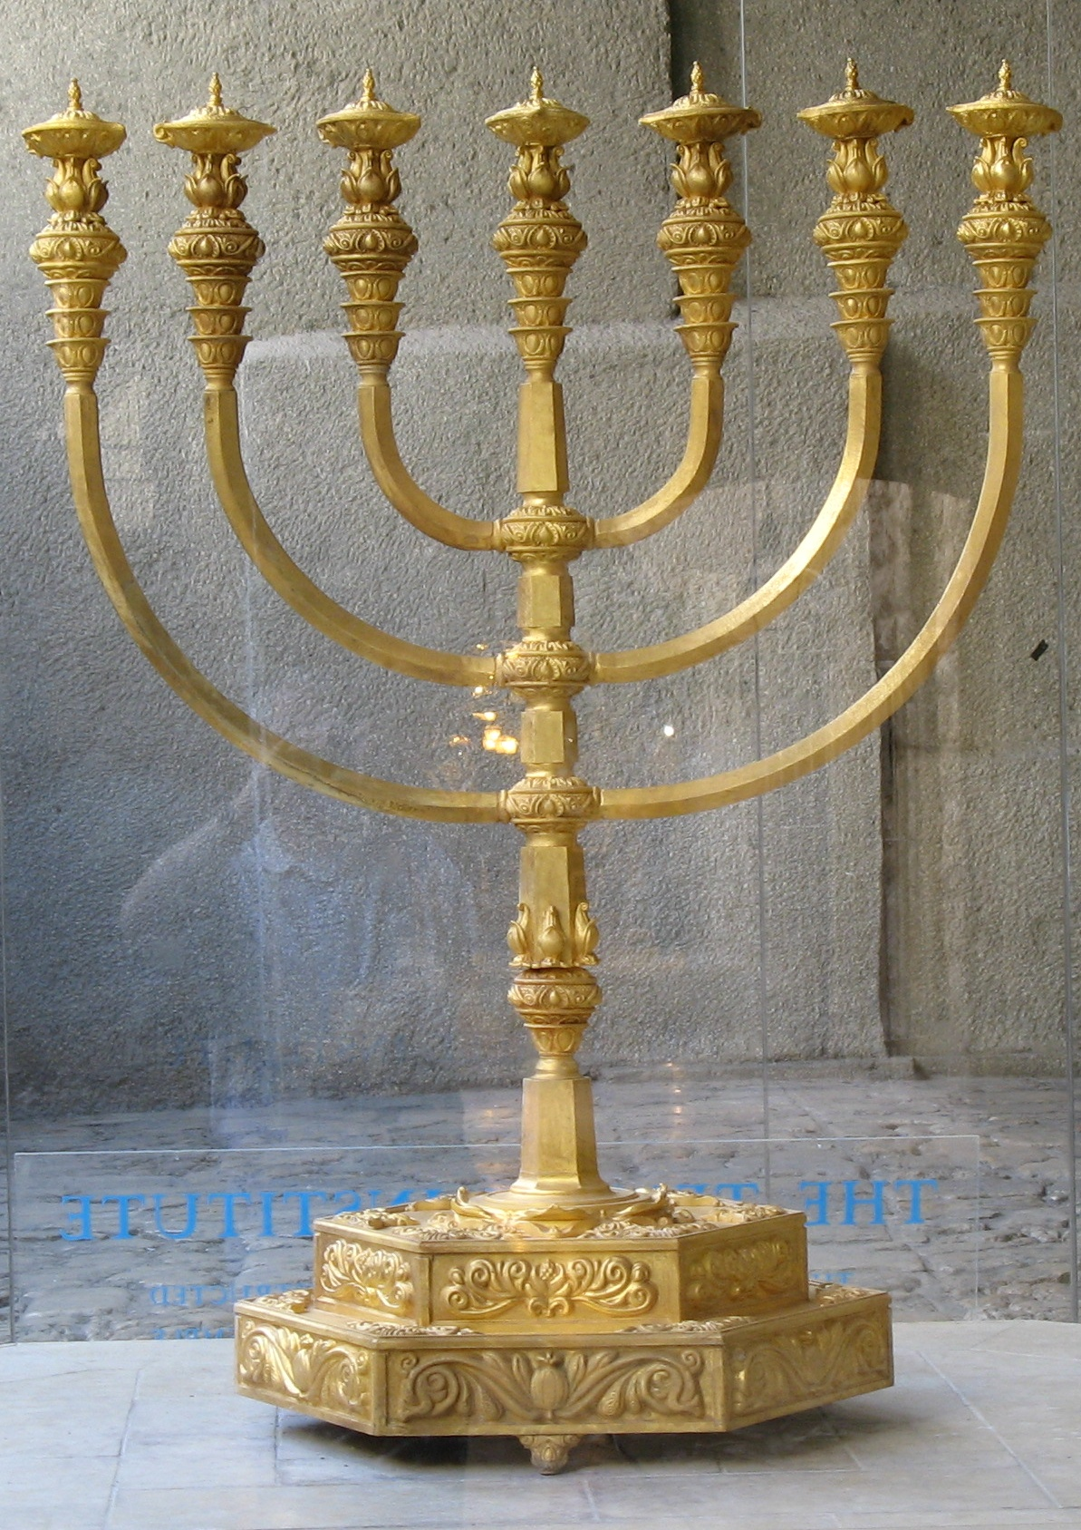
What did the Menorah look like?
Menorah By Machon HaMikdash
Can be found in the Rova in Jewish Quarter

Slide 4
Menorah (Shemot 25:21-40)
31 And thou shalt make a candlestick of pure gold: of beaten work shall the candlestick be made, even its base, and its shaft; its cups, its knops, and its flowers, shall be of one piece with it. 32 And there shall be six branches going out of the sides thereof: three branches of the candlestick out of the one side thereof, and three branches of the candle-stick out of the other side thereof; 33 three cups made like almond-blossoms in one branch, a knop and a flower; and three cups made like almond-blossoms in the other branch, a knop and a flower; so for the six branches going out of the candlestick. 34 And in the candlestick four cups made like almond-blossoms, the knops thereof, and the flowers thereof. 35 And a knop under two branches of one piece with it, and a knop under two branches of one piece with it, and a knop under two branches of one piece with it, for the six branches going out of the candlestick. 36 Their knops and their branches shall be of one piece with it; the whole of it one beaten work of pure gold. 37 And thou shalt make the lamps thereof, seven; and they shall light the lamps thereof, to give light over against it. 38 And the tongs thereof, and the snuffdishes thereof, shall be of pure gold. 39 Of a talent of pure gold shall it be made, with all these vessels. 40 And see that thou make them after their pattern, which is being shown thee in the mount. {S} (JPS 1917)
(לא) וְעָשִׂ֥יתָ מְנֹרַ֖ת זָהָ֣ב טָה֑וֹר מִקְשָׁ֞ה תֵּעָשֶׂ֤ה הַמְּנוֹרָה֙ יְרֵכָ֣הּ וְקָנָ֔הּ גְּבִיעֶ֛יהָ כַּפְתֹּרֶ֥יהָ וּפְרָחֶ֖יהָ מִמֶּ֥נָּה יִהְיֽוּ: (לב) וְשִׁשָּׁ֣ה קָנִ֔ים יֹצְאִ֖ים מִצִּדֶּ֑יהָ שְׁלֹשָׁ֣ה׀ קְנֵ֣י מְנֹרָ֗ה מִצִּדָּהּ֙ הָאֶחָ֔ד וּשְׁלֹשָׁה֙ קְנֵ֣י מְנֹרָ֔ה מִצִּדָּ֖הּ הַשֵּׁנִֽי: (לג) שְׁלֹשָׁ֣ה גְ֠בִעִים מְֽשֻׁקָּדִ֞ים בַּקָּנֶ֣ה הָאֶחָד֘ כַּפְתֹּ֣ר וָפֶרַח֒ וּשְׁלֹשָׁ֣ה גְבִעִ֗ים מְשֻׁקָּדִ֛ים בַּקָּנֶ֥ה הָאֶחָ֖ד כַּפְתֹּ֣ר וָפָ֑רַח כֵּ֚ן לְשֵׁ֣שֶׁת הַקָּנִ֔ים הַיֹּצְאִ֖ים מִן־ הַמְּנֹרָֽה: (לד) וּבַמְּנֹרָ֖ה אַרְבָּעָ֣ה גְבִעִ֑ים מְשֻׁקָּדִ֔ים כַּפְתֹּרֶ֖יהָ וּפְרָחֶֽיהָ: (לה) וְכַפְתֹּ֡ר תַּחַת֩ שְׁנֵ֨י הַקָּנִ֜ים מִמֶּ֗נָּה וְכַפְתֹּר֙ תַּ֣חַת שְׁנֵ֤י הַקָּנִים֙ מִמֶּ֔נָּה וְכַפְתֹּ֕ר תַּחַת־שְׁנֵ֥י הַקָּנִ֖ים מִמֶּ֑נָּה לְשֵׁ֙שֶׁת֙ הַקָּנִ֔ים הַיֹּצְאִ֖ים מִן־הַמְּנֹרָֽה: (לו) כַּפְתֹּרֵיהֶ֥ם וּקְנֹתָ֖ם מִמֶּ֣נָּה יִהְי֑וּ כֻּלָּ֛הּ מִקְשָׁ֥ה אַחַ֖ת זָהָ֥ב טָהֽוֹר: (לז) וְעָשִׂ֥יתָ אֶת־נֵרֹתֶ֖יהָ שִׁבְעָ֑ה וְהֶֽעֱלָה֙ אֶת־נֵ֣רֹתֶ֔יהָ וְהֵאִ֖יר עַל־עֵ֥בֶר פָּנֶֽיהָ: (לח) וּמַלְקָחֶ֥יהָ וּמַחְתֹּתֶ֖יהָ זָהָ֥ב טָהֽוֹר: (לט) כִּכָּ֛ר זָהָ֥ב טָה֖וֹר יַעֲשֶׂ֣ה אֹתָ֑הּ אֵ֥ת כָּל־הַכֵּלִ֖ים הָאֵֽלֶּה: (מ) וּרְאֵ֖ה וַעֲשֵׂ֑ה בְּתַ֨בְנִיתָ֔ם אֲשֶׁר־אַתָּ֥ה מָרְאֶ֖ה בָּהָֽר:

Slide 5
Now this is how the lampstand was made: it was hammered work of gold, hammered from base to petal. According to the pattern that the LORD had shown Moses, so was the lampstand made.
Bamidbar (8:4)
וְזֶ֨ה מַעֲשֵׂ֤ה הַמְּנֹרָה֙ מִקְשָׁ֣ה זָהָ֔ב עַד־יְרֵכָ֥הּ עַד־פִּרְחָ֖הּ מִקְשָׁ֣ה הִ֑וא כַּמַּרְאֶ֗ה אֲשֶׁ֨ר הֶרְאָ֤ה יְקוָק֙ אֶת־מֹשֶׁ֔ה כֵּ֥ן עָשָׂ֖ה אֶת־הַמְּנֹרָֽה׃

Slide 6
Summary of verses
Made of one piece of pure Gold
7 branches
Uses Oil
Has cups, flowers adorning it

Slide 7
Dimension of Menorah Menachot 28b
Shmuel says in the name of a certain elder: The height of the Candelabrum was eighteen handbreadths. The base and the flower that was upon the base were a height of three handbreadths; and two handbreadths above that were bare; and there was above that one handbreadth, which had a goblet, knob, and flower on it. And two handbreadths above that were bare, and there was above that one handbreadth that had a knob.
And two branches emerge from the knob, one toward this direction and one toward that direction, and they extend and rise up to the height of the Candelabrum. And one handbreadth above that was bare, and there was above that one handbreadth that had a knob. And two branches emerge from the knob, one toward this direction and one toward that direction, and they extend and rise up to the height of the Candelabrum. And one handbreadth above that was bare, and there was above that one handbreadth that had a knob. And two branches emerge from the knob, one toward this direction and one toward that direction, and they extend and rise up to the height of the Candelabrum. And two handbreadths above that were bare. There then remained there three handbreadths in which there were three goblets, and a knob, and a flower.
And the goblets of the Candelabrum, to what are they similar? They were like Alexandrian goblets, which are long and narrow. The knobs, to what are they similar? They were like the shape of the apples of the Cherethites. The flowers, to what are they similar? They were like the ornaments that are etched in columns. And there are found to be a total of twenty-two goblets, eleven knobs, and nine flowers on the Candelabrum.
אמר שמואל משמיה דסבא גובהה של מנורה שמנה עשר טפחים הרגלים והפרח ג' טפחים וטפחיים חלק וטפח שבו גביע וכפתור ופרח וטפחיים חלק וטפח כפתור ושני קנים יוצאין ממנו אחד אילך ואחד אילך ונמשכין ועולין כנגד גובהה של מנורה וטפח חלק וטפח כפתור ושני קנים יוצאין ממנו אחד אילך ואחד אילך נמשכין ועולין כנגד גובהה של מנורה וטפח חלק וטפח כפתור ושני קנים יוצאין ממנו אחד אילך ואחד אילך ונמשכין ועולין כנגד גובהה של מנורה וטפחיים חלק נשתיירו שם ג' טפחים שבהן ג' גביעין וכפתור ופרח וגביעין למה הן דומין כמין כוסות אלכסנדריים כפתורים למה הן דומין כמין תפוחי הכרתיים פרחים למה הן דומין כמין פרחי העמודין ונמצאו גביעין עשרים ושנים כפתורים אחד עשר פרחים תשעה

Slide 8
Straight versus Curved Branches
Rashi: Shemot 25:32
Rabbi Avraham Ibn Ezra 25:32
יצאים מצדיה. לְכָאן וּלְכָאן בַּאֲלַכְסוֹן, נִמְשָׁכִים וְעוֹלִין עַד כְּנֶגֶד גָּבְהָהּ שֶׁל מְנוֹרָה שֶׁהוּא קָנֶה הָאֶמְצָעִי, וְיוֹצְאִין מִתּוֹךְ קָנֶה הָאֶמְצָעִי זֶה לְמַעְלָה מִזֶּה, הַתַּחְתּוֹן אָרֹךְ, וְשֶׁל מַעְלָה קָצָר הֵימֶנּוּ, וְהָעֶלְיוֹן קָצָר הֵימֶנּוּ, לְפִי שֶׁהָיָה גֹּבַהּ רָאשֵׁיהֶן שָׁוֶה לְגָבְהוֹ שֶׁל קָנֶה הָאֶמְצָעִי, הַשְּׁבִיעִי, שֶׁמִּמֶּנּוּ יוֹצְאִים הַשִּׁשָּׁה קָנִים:
[AND SIX BRANCHES] SHALL GO OUT OF ITS SIDE — on each side slantwise extending on high up to the level of the candlestick proper, i. e. of the middle branch. They came out from the middle branch, one above the other — the lowest being the longest, that above it being shorter than it, and the upper one even shorter than that, for the height of their tops was to be the same as the height of the middle branch — the seventh, the central one, from which the other six branches came out.
(Pentateuch with Rashi's commentary by M. Rosenbaum and A.M. Silbermann, 1929-1934)
וששה. טעם קנים. עגולים ארוכים חלולים:
AND THERE SHALL BE SIX BRANCHES. Kanim (branches)²⁵⁴Literally, reeds. Hence I.E.’s comments. refers to a round, long, and hollow object.²⁵⁵
Ibn Ezra's commentary on the Pentateuch, tran. and annot. by H. Norman Strickman and Arthur M. Silver. Menorah Pub., 1988-2004

Slide 9
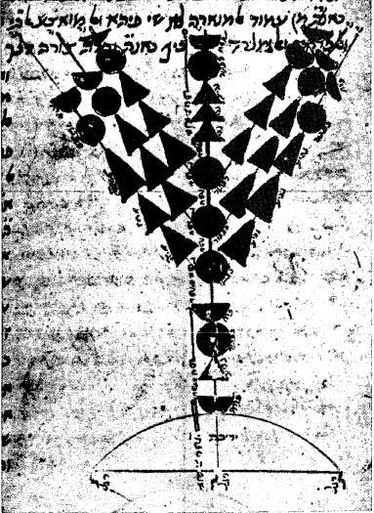
Rambam’s Diagram
Found in Cairo Geniza, in Rambam’s own hand
Popularized by Chabad
  Rabbi Menachem Mendel Schneerson

Slide 10
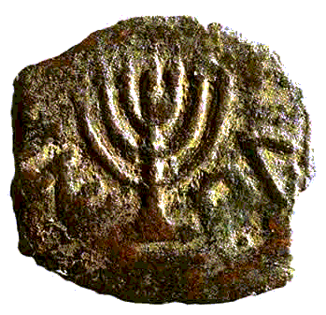
Archeology
Coin of Antigonus II Mattathia, Last Hasmonean king 40-37 BCE
Diagram from The Menorah: Evolving into the Most Important Jewish Symbol by Rachel Hachlili

Slide 11
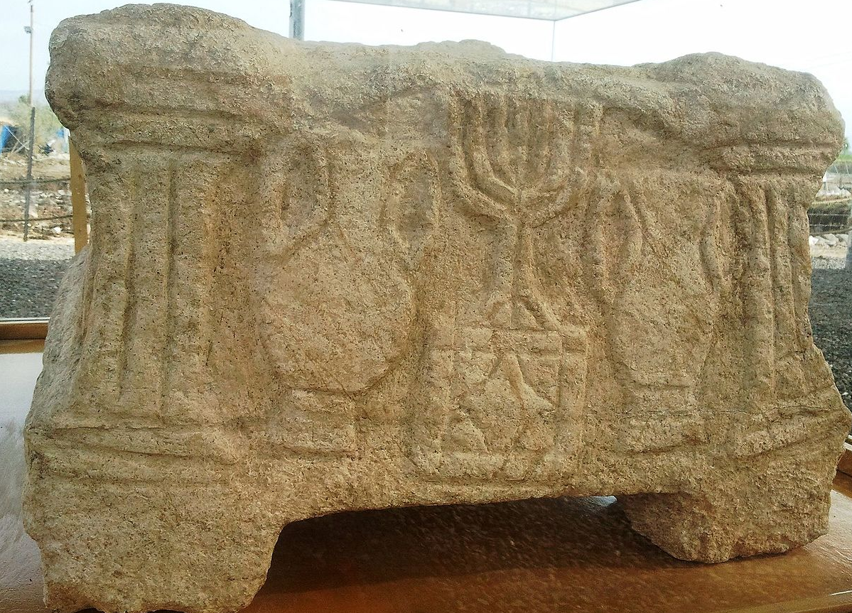
Magdala
Near Tiberias
1st century CE

Slide 12
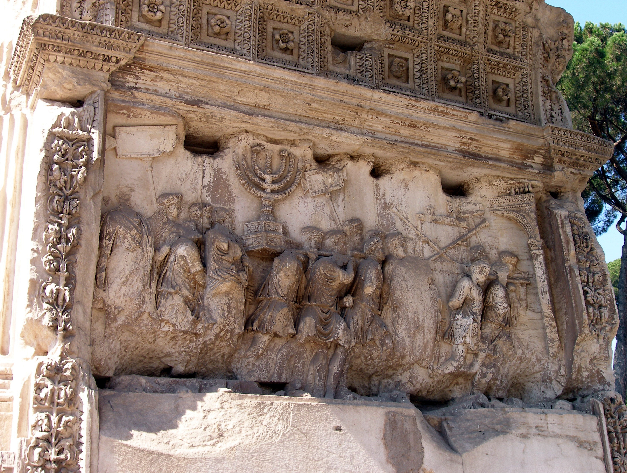
Arch of Titus
Constructed 81 CE

Slide 14
Professor Steven Fine on the Menorah
https://www.yu.edu/cis/activities/arch-of-titus

Slide 15
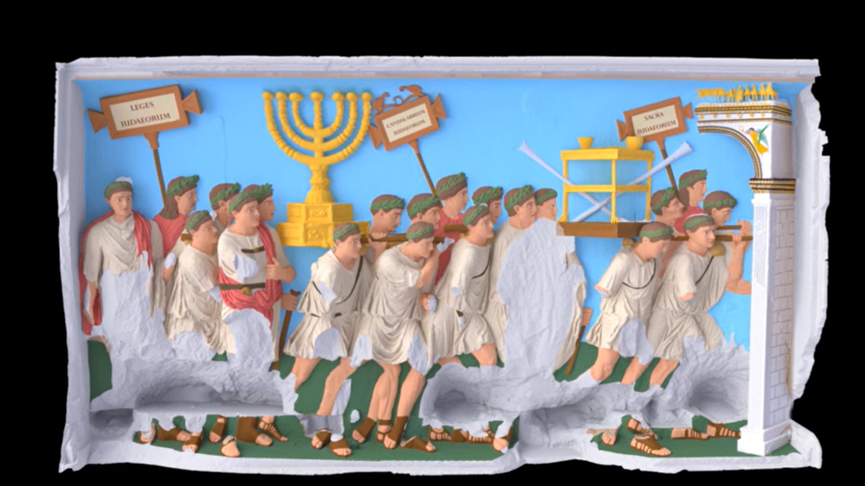

Slide 16
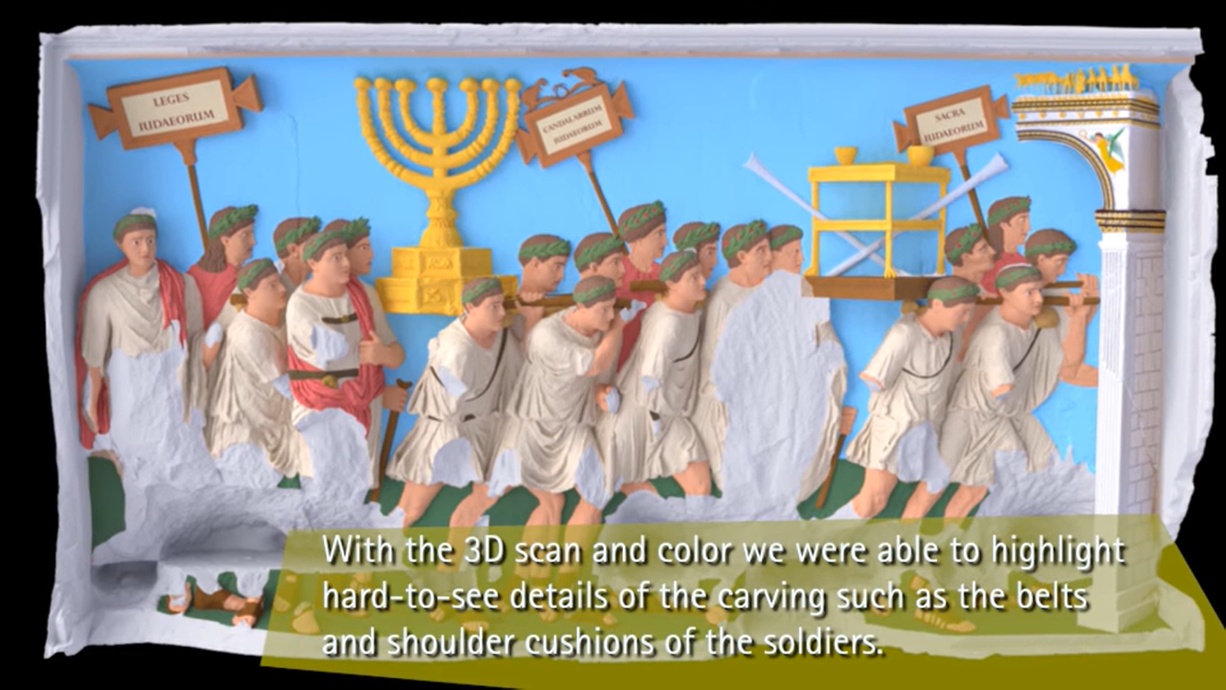

Slide 17
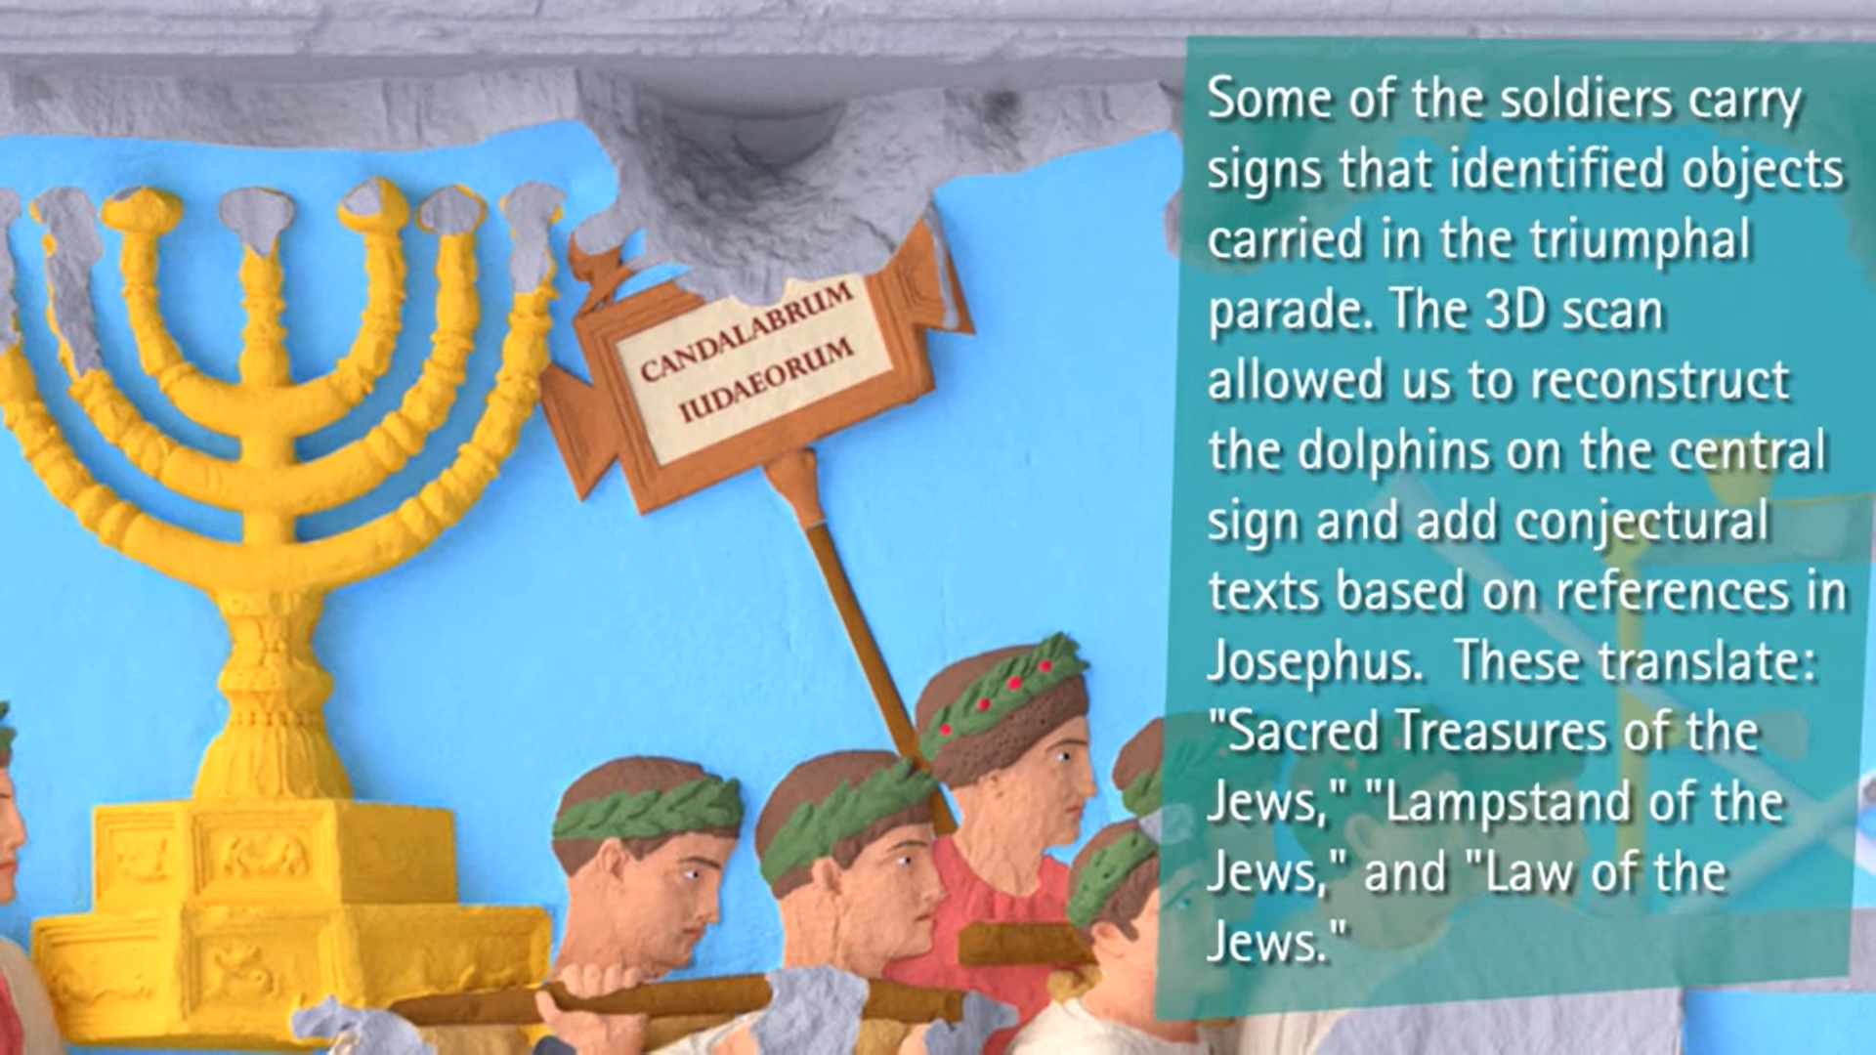

Slide 18
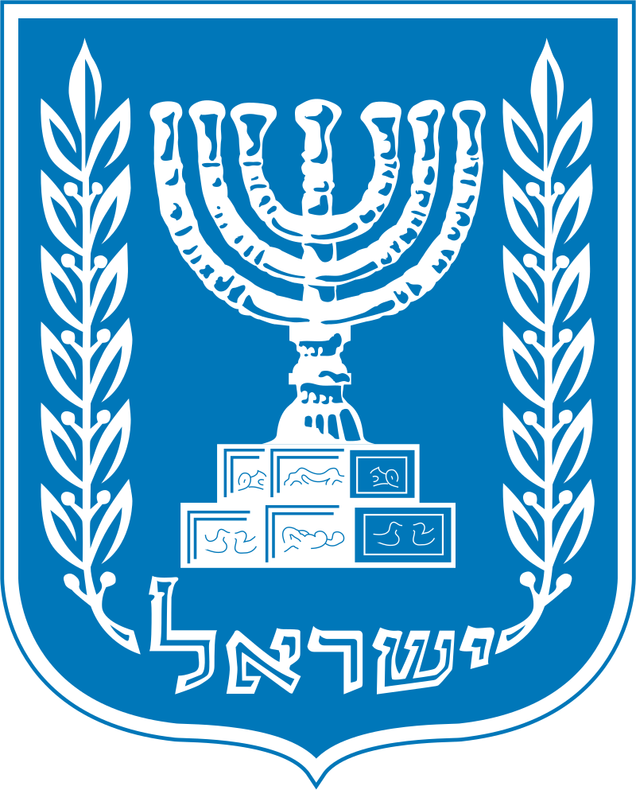
Emblem of Israel

Slide 19
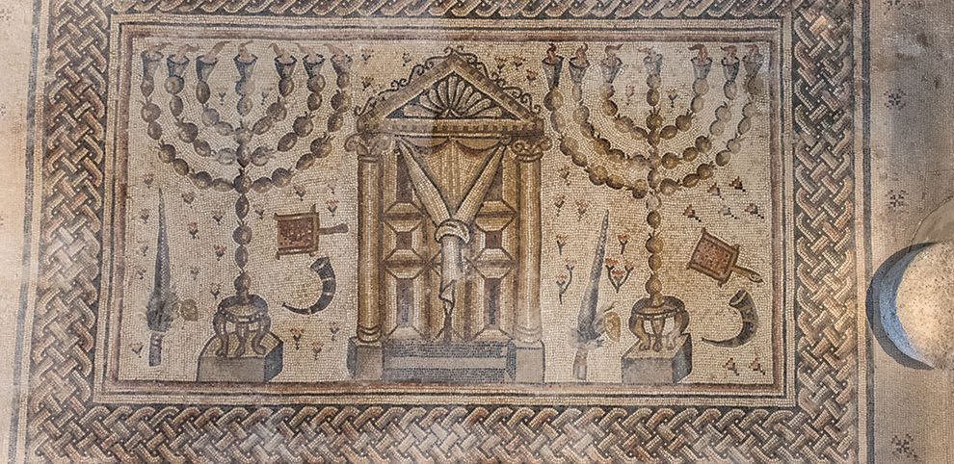
Menorah Flanking Aron
Hammat Tiberias Mosaic
4th century

Slide 20
Can you make a Menorah? (Rosh Hashannah 24b)
As it is taught in a baraita: A person may not construct a house in the exact form of the Sanctuary, nor a portico in the exact form of the Entrance Hall of the Sanctuary, nor a courtyard corresponding to the Temple courtyard, nor a table corresponding to the table in the Temple, nor a candelabrum corresponding to the candelabrum in the Temple. However, one may fashion a candelabrum of five or of six or of eight lamps. But one may not fashion a candelabrum with seven lamps even if he constructs it from other kinds of metal rather than gold, as in exigent circumstances the candelabrum in the Temple may be fashioned from other metals.
Rabbi Yosei bar Yehuda says: Also, one may not fashion a candelabrum of wood, in the manner that the kings of the Hasmonean monarchy fashioned it. When they first purified the Temple they had to prepare the candelabrum out of wood, as no other material was available. Since this candelabrum is fit for the Temple, it is prohibited to fashion one of this kind for oneself.
כִּדְתַנְיָא לֹא יַעֲשֶׂה אָדָם בַּיִת תַּבְנִית הֵיכָל אַכְסַדְרָה תַּבְנִית אוּלָם חָצֵר כְּנֶגֶד עֲזָרָה שֻׁלְחָן כְּנֶגֶד שֻׁלְחָן מְנוֹרָה כְּנֶגֶד מְנוֹרָה אֲבָל עוֹשֶׂה שֶׁל חֲמִשָּׁה וְשֶׁל שִׁשָּׁה וְשֶׁל שְׁמוֹנָה וְשֶׁל שִׁבְעָה לֹא יַעֲשֶׂה אֲפִילּוּ שֶׁל שְׁאָר מִינֵי מַתָּכוֹת רַבִּי יוֹסֵי בַּר יְהוּדָה אוֹמֵר אַף שֶׁל עֵץ לֹא יַעֲשֶׂה כְּדֶרֶךְ שֶׁעָשׂוּ מַלְכֵי בֵּית חַשְׁמוֹנַאי

Slide 21
The other Sages said to Rabbi Yosei bar Yehuda: From there you seek to bring a proof?
There the branches of the candelabrum were comprised of spits [shippudin] of iron and they covered them with tin. Later, when they grew richer and could afford a candelabrum of higher-quality material, they fashioned them from silver. When they grew even richer, they fashioned them from gold. Still, Abaye proves from this baraita that the prohibition against forming an image applies only to items that can be reconstructed in an accurate manner. (William Davidson Translation)
אָמְרוּ לוֹ מִשָּׁם רְאָיָיה שַׁפּוּדִין שֶׁל בַּרְזֶל הָיוּ וְחִיפּוּם בְּבַעַץ הֶעֱשִׁירוּ עֲשָׂאוּם שֶׁל כֶּסֶף חָזְרוּ הֶעֱשִׁירוּ עֲשָׂאוּם שֶׁל זָהָב

Slide 22
Other leniencies
Prohibition is for functional Menorah
2-D
No base
Non-linear – done in circle or square
Uses electric lights or candles, not oil lamps

Slide 23
Why did Menorah Become THE Jewish Symbol?
The qualities of the menorah that led to its preferred status as the most important symbol of Judaism are: light, form, cult and symbol—these are the incentives for the prominence of the menorah as the dominant Jewish symbolism:
Light—the main ritual significance was realized in illumination.
Form—The form of the menorah is unique, unusual, and easily recognizable.
Cult—The menorah was used in the daily ritual, first in the Temple and later in the synagogue. Each day a lamp was lit; on the seventh day, the Sabbath, all seven lamps were kindled.
Symbol—The seven arms of the menorah represented the seven days of the week and the seven planets, and the menorah functioned as a daily and weekly ritual calendar. The menorah as a symbol characterized a place as a Jewish site or worship setting, or a tomb as belonging to a Jew. It served to remind the Jewish people of the Jerusalem Temple rituals where the menorah was the most important of the Temple vessels.
Rachel Hachlili p19

Slide 24
Summary of Menorah
Shape and materials
Straight or curved branches
Tripod or square base
Dimensions
Can you place one in shul?
Why did Menorah catch on as a symbol?

Slide 25
