Slide 1
By Rabbi Chaim Metzger
cmetzger@torontotorah.com

Slide 2
What did the Luchot Look Like?
Rabbi Chaim Metzger
cmetzger@torontotorah.com

Slide 3
Direction
What was their shape?
Size?
Color?
Text?
Made of?

Slide 4
Moses Breaking the Tablets of the Law
Artist Rembrandt
Year 1659
Location Gemäldegalerie, Berlin

Slide 5
Ten Commandments
Movie 1956

Slide 6
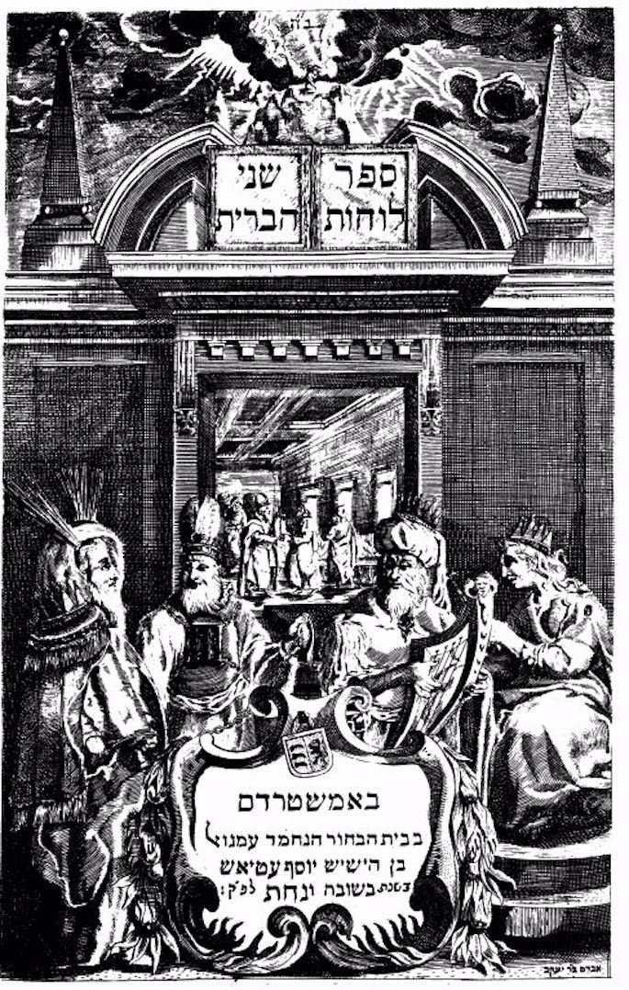
Book Shnei Luchot HaBrit
Amsterdam
1698

Slide 7
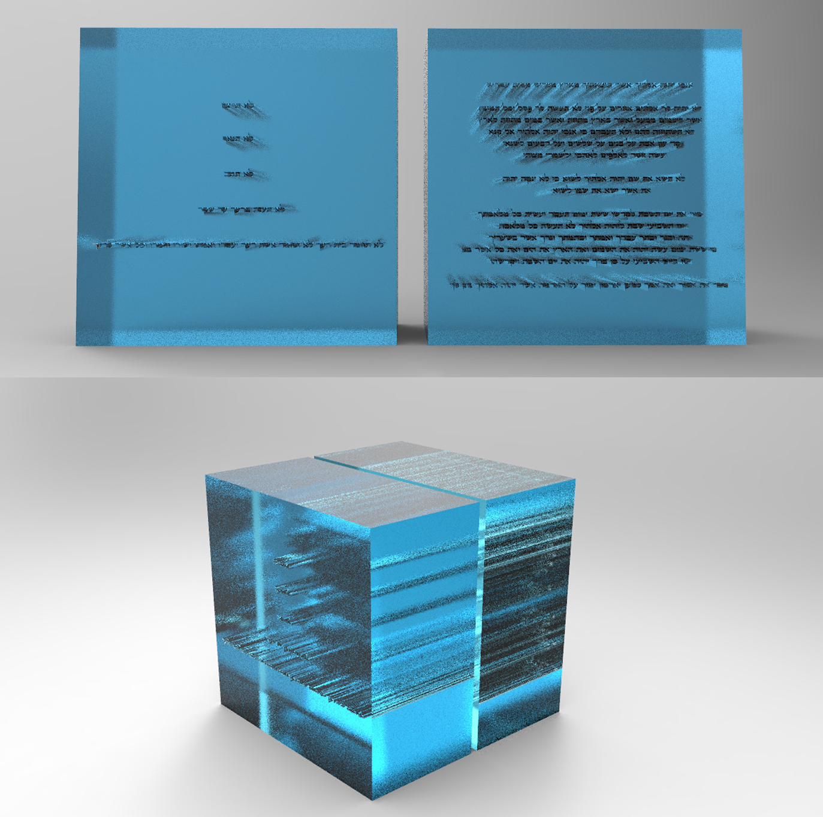
alon greenstein - alon greenstein & adi greenstein jewelry studio jerusalem

Slide 8
From the Verses
When He finished speaking with him on Mount Sinai, He gave Moses the two tablets of the Pact, stone tablets inscribed with the finger of God. Exodus.31.18
The tablets were God’s work, and the writing was God’s writing, incised upon the tablets. Exodus.32.16
וְהַ֨לֻּחֹ֔ת מַעֲשֵׂ֥ה אֱלֹהִ֖ים הֵ֑מָּה וְהַמִּכְתָּ֗ב מִכְתַּ֤ב אֱלֹהִים֙ ה֔וּא חָר֖וּת עַל־הַלֻּחֹֽת׃
וַיִּתֵּ֣ן אֶל־מֹשֶׁ֗ה כְּכַלֹּתוֹ֙ לְדַבֵּ֤ר אִתּוֹ֙ בְּהַ֣ר סִינַ֔י שְׁנֵ֖י לֻחֹ֣ת הָעֵדֻ֑ת לֻחֹ֣ת אֶ֔בֶן כְּתֻבִ֖ים בְּאֶצְבַּ֥ע אֱלֹהִֽים׃

Slide 9
Shape of Luchot
Symbol of the chief Rabbinate of Israel from it’s founding until 2015
Current symbol

Slide 10
Source for Rounding
What were the luchot made of?
We were taught that it was from the dew above that flowed down from ancient holy times. When it flowed to the holy orchards [Gan Eden], G-d took two cups of it and they solidified/froze and became two precious stones. G-d breathed on them and they became the two luchot.
מִמַּה אִתְעָבִידוּ. תָּאנָא, מֵהַהוּא טַלָּא עִלָּאָה, דְּנָגִיד מֵעַתִּיקָא קַדִּישָׁא. וְכַד נָגִיד וְאִתְמְשַׁךְ לַחֲקַל דְּתַפּוּחִין קַדִּישִׁין, נָטַל קוּדְשָׁא בְּרִיךְ הוּא תְּרֵין כִּפּוֹרֵי מִנַּיְיהוּ, וְאִתְגְּלִידוּ, וְאִתְעָבִידוּ תְּרֵין אַבְנִין יַקִּירִין. נָשַׁב בְּהוּ, וְאִתְפָּשָׁטוּ לִתְרֵין לוּחִין.
תרגום: ממה נעשו [הלוחות]? שנינו, מאותו הטל העליון הנמשך מעתיקא קדישא. וכאשר נוזל ונמשך לשדה התפוחים הקדושים, לקח הקב"ה שתי כוסות מהם, ונקפאו ונעשו שתי אבנים יקרות. נשב בהם והתפשטו להיות שני לוחות.
— זוהר יתרו: [פד,ב]

Slide 11
Size of Luchot
And as for the tablets, their length was six handbreadths, their width was six handbreadths, and their thickness was three handbreadths. (Baba Bathra 14a William Davidson translation)
The length of each one of the tablets was six handbreadths, and their width was six handbreadths. (Yerushalmi Shekalim 16a WDT)
וְהַלּוּחוֹת אׇרְכָּן שִׁשָּׁה וְרׇחְבָּן שִׁשָּׁה וְעׇבְיָין שְׁלֹשָׁה
הַלּוּחוֹת הָיוּ כָּל־אֶחָד וְאֶחָד אָרְכָּן שִׁשָּׁה טְפָחִים וְרָחְבָּן שְׁלֹשָׁה.
R’ Moshe Feinstein ^{[20]} | 3.54 in. (9.00 cm)
R’ Chaim Noeh ^{[21]} | 3.15 in. (8 cm)
Chazon Ish^{[22]} | 4 in. (10.16 cm)

Slide 12
Mesha Inscription
Material Basalt
Writing Moabite language
Created c. 840 BC
Discovered 1868–70
Present location Louvre
a meter tall, 60 cm wide, 60 cm thick, bearing a surviving inscription of 34 lines

Slide 13
How many on each? (Yerushalmi Shekalim 16b)
How were the tablets written?
Rabbi Ḥanina ben Gamliel says: Five on this tablet and five on that tablet. This is as it is written: “And He wrote them upon two tablets of stone” (Deuteronomy 4:13), i.e., five of the Ten Commandments on this tablet and five on that tablet.
But the Rabbis say: All of the Ten Commandments were written on this tablet and the same ten were written on that tablet. This is as it is written: “And He declared unto you His covenant, which He commanded you to perform, even the ten words” (Deuteronomy 4:13). This teaches that there were ten on this tablet and ten on that tablet.
Rabbi Shimon ben Yoḥai says: Twenty on this tablet and twenty on that tablet, as it is written: “And He wrote them upon two tablets of stone” (Deuteronomy 4:13). This teaches that there were twenty on this tablet and twenty on that tablet.
Rabbi Simai said: Forty on this tablet and forty on that tablet, as it is written: “On the one side and on the other were they written” (Exodus 32:15), as a cube [tatroga]. (William Davidson Translation)
כֵּיצד הָיוּ הַלּוּחוֹת כְּתוּבִים.
רִבִּי חֲנַנְיָה בֶּן גַּמְלִיאֵל אוֹמֵר. חֲמִשָּׁה עַל לוּחַ זֶה וַחֲמִשָּׁה עַל לוּחַ זֶה. הָדָא הוּא דִּכְתִיב וַֽיִּכְתְּבֵ֔ם עַל־שְׁנֵי֖ לוּחוֹת אֲבָנִֽים: חֲמִשָּׁה עַל לוּחַ זֶה וַחֲמִשָּׁה עַל לוּחַ זֶה.
וְרַבָּנִן אָֽמְרִין. עֲשָׂרָה עַל לוּחַ זֶה וַעֲשָׂרָה עַל לוּחַ זֶה. הָדָא הוּא דִּכְתִיב וַיַּגֵּ֨ד לָכֶ֜ם אֶת־בְּרִית֗וֹ אֲשֶׁ֨ר צִוָּ֤ה אֶתְכֶם֙ לַעֲשׂ֔וֹת עֲשֶׂרֶ֭ת הַדְּבָרִ֑ים. עֲשָׂרָה עַל לוּחַ זֶה וַעֲשָׂרָה עַל לוּחַ זֶה.
רִבִּי שִׁמְעוֹן בֶּן יוֹחַי אָמַר. עֶשְׂרִים עַל לוּחַ זֶה וְעֶשְׂרִים עַל לוּחַ זֶה. דִּכְתִיב וַֽיִּכְתְּבֵ֔ם עַל־שְׁנֵי֖ לוּחוֹת אֲבָנִֽים: עֶשְׂרִים עַל לוּחַ זֶה וְעֶשְׂרִים עַל לוּחַ זֶה.
רִבִּי סִימַאי אָמַר. אַרְבָּעִים עַל לוּחַ זֶה ןְאַרְבָּעִים עַל לוּחַ זֶה. מִזֶּ֥ה וּמִזֶּ֖ה הֵ֥ם כְּתוּבִים. טֶטְרַגוֹנָה.

Slide 14
What was written on the Luchot?
Ḥananya, nephew of Rabbi Yehoshua, says: Between each and every statement that was written on the tablets, its precise details and the explanation of its letters were written as well, as it is written: “Filled with beryl [tarshish]” (Song of Songs 5:14). Tarshish is the name of a sea, or more likely, an area of the Mediterranean. The verse is indicating that the Torah is filled with all of these details, like the great sea is filled with waves.
When Rabbi Shimon ben Lakish would reach this verse, “Filled with beryl,” he would say: The parable that Ḥananya, nephew of Rabbi Yehoshua, taught me is appropriate. Just as between one large wave and another large wave there are smaller waves in this sea, so too, the precise details and the explanations of the letters of the Torah were written between each and every commandment.
חֲנַנְיָה בֶּן אֲחִי רִבִּי יְהוֹשֻׁעַ אוֹמֵר. בֵּין כָל־דִּיבּוּר וְדִיבּוּר דִּיקְדּוּקֶיהָ וְאוֹתוֹתֶיהָ שֶׁלְתּוֹרָה. מְמוּלָּאִים בַּתַּרְשִׁ֑ישׁ. כְּיַמָּא רַבָּא.
רִבִּי שִׁמְעוֹן בֶּן לָקִישׁ כַּד הֲוֵי מַטֵּי הָדֵין קִרְייָא הֲוָה אֲמַר. יָפֶה לִימְּדֵנִי חֲנַנְיָה בֶּן אֲחִי רִבִּי יְהוֹשֻׁעַ. מַה הַיָּם הַזֶּה בֵּין גַּל גָּדוֹל לְגַל [גָּדוֹל] גַּלִּים קְטַנִּים כָּךְ בֵּין כָּל־דִּיבֵּר וְדִיבֵּר דִּיקְדּוּקֶיהָ וְאוֹתוֹתֶיהָ שֶׁלְתּוֹרָה.

Slide 15
What were they made out of? (Shemot 34:1)
The LORD said to Moses: “Carve two tablets of stone like the first, and I will inscribe upon the tablets the words that were on the first tablets, which you shattered.
Rashi - HEW THEE — He showed him a quarry of sapphire in his tent and said to him: The chips (פסל = פסלת) shall be thine (לך). It was from this that Moses became so rich (cf. Midrash Tanchuma 3:9:29; Leviticus Rabbah 32:2).
וַיֹּ֤אמֶר יְהוָה֙ אֶל־מֹשֶׁ֔ה פְּסָל־לְךָ֛ שְׁנֵֽי־לֻחֹ֥ת אֲבָנִ֖ים כָּרִאשֹׁנִ֑ים וְכָתַבְתִּי֙ עַל־הַלֻּחֹ֔ת אֶת־הַדְּבָרִ֔ים אֲשֶׁ֥ר הָי֛וּ עַל־הַלֻּחֹ֥ת הָרִאשֹׁנִ֖ים אֲשֶׁ֥ר שִׁבַּֽרְתָּ׃
רש"י - פסל לך. הֶרְאָהוּ מַחְצַב סַנְפִּירִינוֹן מִתּוֹךְ אָהֳלוֹ וְאָמַר לוֹ הַפְּסֹלֶת יִהְיֶה שֶׁלְּךָ; מִשָּׁם נִתְעַשֵּׁר מֹשֶׁה הַרְבֵּה (תנחומא):

Slide 16
What is Sapir/sanpiryon?
Sapphire
Lapus Lazuli

Slide 17
Floating letters
Consequently, how could the prophets establish new forms for the letters? And furthermore, didn’t Rav Ḥisda say: The letters mem and samekh in the tablets of the covenant given at Sinai stood by way of a miracle?
Megilla 2b-3a William Davidson Translation
הָאָמַר רַב חִסְדָּא מֵם וְסָמֶךְ שֶׁבַּלּוּחוֹת בְּנֵס הָיוּ עוֹמְדִין

Slide 18
Or Maybe
Rabbi Levi said: those who say the Torah was written in Ktav Ivri the Ayin stood miraculously. According to the opinion that the Torah was given in Ktav Ashuri the Samech stood miraculously.
Yerushalmi Megillah 1:9
תלמוד ירושלמי מסכת מגילה פרק א הלכה ט
אמר רבי לוי מאן דאמר לרעץ ניתנה התורה עי"ן מעשה ניסים. מאן דאמר אשורי ניתנה התורה סמ"ך מעשה ניסים

Slide 19
What script?
Mar Zutra or, as some say, Mar 'Ukba said: Originally the Torah was given to Israel in Hebrew characters and in the sacred [Hebrew] language; later, in the times of Ezra, the Torah was given in Ashurith script and Aramaic language. [Finally], they selected for Israel the Ashurith script and Hebrew language, leaving the Hebrew characters and Aramaic language for the hedyototh. Who are meant by the 'hedyototh'? — R. Hisda answers: The Cutheans. And what is meant by Hebrew characters? — R. Hisda said: The libuna'ah script.
Sanhedrin 21b-22a Soncino Talmud Translation
אמר מר זוטרא ]רב חסדא, בכת״י והרבה ראשונים, דק״ס[ ואיתימא מר עוקבא בתחלה ניתנה תורה לישראל בכתב עברי (של בני עבר הנהר) ולשון הקודש חזרה וניתנה להם בימי עזרא [כיון שעלו בני הגולה ניתנה להם — כתי״נע וי׳׳ג בכת״י תימני: בימי עזרא ניתנה להם] בכתב אשורית ולשון ארמי ביררו להן לישראל [י״ג: ביררו להם. וי׳׳ג ביררו להם ישראל], כתב אשורית ולשון הקודשוהניחו להדיוטות כתב עברית ולשון ארמי. מאן הדיוטות אמר רב חסדא כותאי, מאי כתב עברית אמר רב חסדא כתב ליבונאה.
(תורה שלמה)

Slide 20
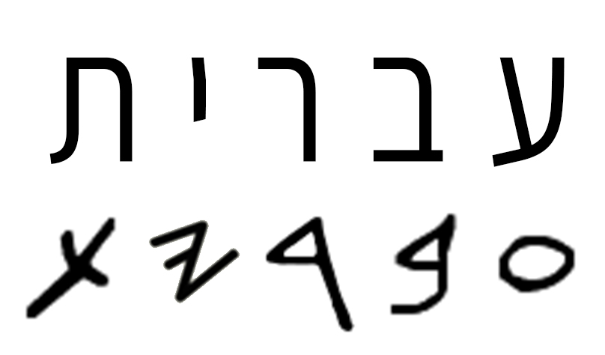
Ktav Ashuri – Modern Block script
Ktav Ivri /רעץ – Paleo Hebrew

Slide 21
Summary
Most likely were square but long tradition of them being round
Made out of a stone - Sapphire or Lapus Lazuli
Size – 6x6x3 Tefachim or 6x3 Tefachim
How many on each?
5,10,20,40
Either just Ten Commandments or whole Torah
Script may have been Block Print or Paleo Hebrew

