Slide 1
Hamsa and Tree of Life
Rabbi Chaim Metzger
cmetzger@torontotorah.com

Slide 2
First Jewish appearance of Hamsa
The letter ה (hay) is a great segulah wherever it is to be found, or in practice – in writing, or in potential – in a drawing or by saying it, or by drawing a palm of a hand with five fingers made out of some sort of metal, which is then hung about a child or anything else in the world so that nothing bad will happen to it, specifically to remove negative effects from stubbornness of the heart or Ayin Hara.
Ayumah kiNigdalot (Rabbi Yitzchak Unkinirah 16th century Istanbul)
:"שיש ב-הא סגולה גדולה שבכל מקום שתמצא, או בפועל - בכתב, או בכח - בציור או באמירה, או - בציור כף אחת בחמישה אצבעות מאיזה מתכת שתהיה, ויתלו על הנער או על איזה דבר שבעולם לא ישלטו המקרים עליו ובפרט להסיר שרירות לב ועין הרע"
איומה כנגדלות
במאה ה-16 הרב יצחק עונקיניירה
מצוטט על ידי הרב אברהם ראובן הכהן סופר בספרו ילקוט הראובני והחיד"א הבן איש חי

Slide 3
Where did Hamsa Come from?
Shalom Sabar, "The Judaization of the Khamsa The Motif of the Magic Hand in the Thought and Folklore of the Jews in the Lands of Islam

Slide 4
Justifications for Hamsa
5 is protected against Ayin Hara Because…
ה can be used as G-d’s name
Five fingers of Cohanim when they bless
Fish which were created on the fifth day are impervious to evil eye (Chida Petach Aynayim Berachot 20b)
Yosef’s blessings בן פורת יוסף בן פורת has 5 words

Slide 5
Can you make a Hamsa?
Practice is to make them, despite unclear origin as is the case with many other segulot, so don’t cast aspersion on our ancestors.
See Zodiac/Mazalot
Other decorations in synagogues

Slide 6
What is the Etz (ha)Chaim?
Tree of life
Wood poles inside Sefer Torah
Kabbalah

Slide 7
THE Tree of Life
The LORD God planted a garden in Eden, in the east, and placed there the man whom He had formed. And from the ground the LORD God caused to grow every tree that was pleasing to the sight and good for food, with the tree of life in the middle of the garden, and the tree of knowledge of good and bad. (Breishit 2:8-9 JPS 1985)
22) And the LORD God said, “Now that the man has become like one of us, knowing good and bad, what if he should stretch out his hand and take also from the tree of life and eat, and live forever!” (23) So the LORD God banished him from the garden of Eden, to till the soil from which he was taken. (24) He drove the man out, and stationed east of the garden of Eden the cherubim and the fiery ever-turning sword, to guard the way to the tree of life. (Breishit 3:22-24)
בראשית פרשת בראשית פרק ב פסוק ח - ט
(ח) וַיִּטַּ֞ע יְקֹוָ֧ק אֱלֹהִ֛ים גַּן־בְּעֵ֖דֶן מִקֶּ֑דֶם וַיָּ֣שֶׂם שָׁ֔ם אֶת־הָֽאָדָ֖ם אֲשֶׁ֥ר יָצָֽר: (ט) וַיַּצְמַ֞ח יְקֹוָ֤ק אֱלֹהִים֙ מִן־הָ֣אֲדָמָ֔ה כָּל־עֵ֛ץ נֶחְמָ֥ד לְמַרְאֶ֖ה וְט֣וֹב לְמַאֲכָ֑ל וְעֵ֤ץ הַֽחַיִּים֙ בְּת֣וֹךְ הַגָּ֔ן וְעֵ֕ץ הַדַּ֖עַת ט֥וֹב וָרָֽע:
בראשית פרשת בראשית פרק ג פסוק כב - כד
(כב) וַיֹּ֣אמֶר׀ יְקֹוָ֣ק אֱלֹהִ֗ים הֵ֤ן הָֽאָדָם֙ הָיָה֙ כְּאַחַ֣ד מִמֶּ֔נּוּ לָדַ֖עַת ט֣וֹב וָרָ֑ע וְעַתָּ֣ה׀ פֶּן־יִשְׁלַ֣ח יָד֗וֹ וְלָקַח֙ גַּ֚ם מֵעֵ֣ץ הַֽחַיִּ֔ים וְאָכַ֖ל וָחַ֥י לְעֹלָֽם: (כג) וַֽיְשַׁלְּחֵ֛הוּ יְקֹוָ֥ק אֱלֹהִ֖ים מִגַּן־עֵ֑דֶן לַֽעֲבֹד֙ אֶת־הָ֣אֲדָמָ֔ה אֲשֶׁ֥ר לֻקַּ֖ח מִשָּֽׁם: (כד) וַיְגָ֖רֶשׁ אֶת־הָֽאָדָ֑ם וַיַּשְׁכֵּן֩ מִקֶּ֨דֶם לְגַן־עֵ֜דֶן אֶת־הַכְּרֻבִ֗ים וְאֵ֨ת לַ֤הַט הַחֶ֙רֶב֙ הַמִּתְהַפֶּ֔כֶת לִשְׁמֹ֕ר אֶת־ דֶּ֖רֶךְ עֵ֥ץ הַֽחַיִּֽים:

Slide 8
Kabbalistic Etz Chaim
In Kabbalah, the Etz Ḥayim symbol (Etz Ha-Hayim, The Tree of Life") is a mystical symbol used to understand the nature of God and the manner in which He created the world.
The term Etz Ḥayim is also the title of one of the most important works in Jewish mysticism, written by Ḥayim Vital in the course of twenty years following the death of his master, Isaac Luria, in 1572, presenting and explicating Luria's systematic reconceptualization and expansion of the insights of the Zohar and other earlier mystical sources.
Vital's Etz Chaim is the foundational work for the later Lurianic Kabbalah, which soon became the mainstream form of Kabbalah amongst both Sephardi and Ashkenazi Jewry up to the modern period. This massive multi-volumed work circulated only in manuscript form amongst mystics for over 100 years, and was first published in 1782. (Wikipedia)

Slide 9
Ancient Parallels
Epic of Gilgamesh –
Gilgamech searches for eternal life from plant of eternity
Greek and Egyptian myth
Tree that grants the gods their continued immortality

Slide 10
Etz Chaim in Mishlei
Her ways are pleasant ways, And all her paths, peaceful. She is a tree of life to those who grasp her, And whoever holds on to her is happy. (3:17-18 JPS 1985)
The fruit of the righteous is a tree of life; A wise man captivates people. (11:30)
Hope deferred sickens the heart, But desire realized is a tree of life. (13:12)
A healing tongue is a tree of life, But a devious one makes for a broken spirit. (15:4)
משלי פרק ג פסוק יז - יח
(יז) דְּרָכֶ֥יהָ דַרְכֵי־נֹ֑עַם וְֽכָל־נְתִ֖יבֹתֶ֣יהָ שָׁלֽוֹם: (יח) עֵץ־חַיִּ֣ים הִ֭יא לַמַּחֲזִיקִ֣ים בָּ֑הּ וְֽתֹמְכֶ֥יהָ מְאֻשָּֽׁר:
משלי פרק יא פסוק ל
(ל) פְּֽרִי־צַ֭דִּיק עֵ֣ץ חַיִּ֑ים וְלֹקֵ֖חַ נְפָשׁ֣וֹת חָכָֽם:
משלי פרק יג פסוק יב
(יב) תּוֹחֶ֣לֶת מְ֭מֻשָּׁכָה מַחֲלָה־לֵ֑ב וְעֵ֥ץ חַ֝יִּ֗ים תַּאֲוָ֥ה בָאָֽה:
משלי פרק טו פסוק ד
(ד) מַרְפֵּ֣א לָ֭שׁוֹן עֵ֣ץ חַיִּ֑ים וְסֶ֥לֶף בָּ֝֗הּ שֶׁ֣בֶר בְּרֽוּחַ:

Slide 11
Taanit 7a
Rav Naḥman bar Yitzḥak said: Why are Torah matters likened to a tree, as it is stated: “It is a tree of life to them who lay hold upon it” (Proverbs 3:18)? This verse comes to tell you that just as a small piece of wood can ignite a large piece, so too, minor Torah scholars can sharpen great Torah scholars and enable them to advance in their studies. And this is what Rabbi Ḥanina said: I have learned much from my teachers and even more from my friends, but from my students I have learned more than from all of them. (William Davidson Translation)
אָמַר רַב נַחְמָן בַּר יִצְחָק לָמָּה נִמְשְׁלוּ דִּבְרֵי תוֹרָה כְּעֵץ שֶׁנֶּאֱמַר עֵץ חַיִּים הִיא לַמַּחֲזִיקִים בָּהּ לוֹמַר לָךְ מָה עֵץ קָטָן מַדְלִיק אֶת הַגָּדוֹל אַף תַּלְמִידֵי חֲכָמִים קְטַנִּים מְחַדְּדִים אֶת הַגְּדוֹלִים וְהַיְינוּ דְּאָמַר רַבִּי חֲנִינָא הַרְבֵּה לָמַדְתִּי מֵרַבּוֹתַי וּמֵחֲבֵירַי יוֹתֵר מֵרַבּוֹתַי וּמִתַּלְמִידַי יוֹתֵר מִכּוּלָּן

Slide 12
Bava Metzia 85a
Rabbi Yehuda HaNasi read the verse about him: “The fruit of the righteous is a tree of life; and he that is wise wins souls” (Proverbs 11:30). The Gemara explains, with regard to the phrase “the fruit of the righteous,” that this is referring to Rabbi Yosei, son of Rabbi Elazar, son of Rabbi Shimon, who was the son of a righteous individual and became a great scholar in his own right. When the verse states: “And he that is wise wins souls,” this is referring to Rabbi Shimon ben Isi ben Lakonya, who successfully helped Rabbi Yosei reach his potential. (William Davidson Translation)
קרי עליה (משלי יא, ל) פרי צדיק עץ חיים ולוקח נפשות חכם פרי צדיק עץ חיים זה ר' יוסי בר' אלעזר בר' שמעון ולוקח נפשות חכם זה ר' שמעון בן איסי בן לקוניא

Slide 13
Brachot 32b
The Gemara raises an objection: Is that so? Didn’t Rabbi Ḥiyya bar Abba say that Rabbi Yoḥanan said: Anyone who prolongs his prayer and expects it to be answered, will ultimately come to heartache, as it will not be answered. As it is stated: “Hope deferred makes the heart sick” (Proverbs 13:12). And what is the remedy for one afflicted with that illness? He should engage in Torah study, as it is stated: “But desire fulfilled is the tree of life” (Proverbs 13:12), and tree of life is nothing other than Torah, as it is stated: “It is a tree of life to those who hold fast to it, and those who support it are joyous” (Proverbs 3:18). This is not difficult. This, Rabbi Ḥiyya bar Abba’s statement that one will suffer heartache refers to one who prolongs his prayer and expects it to be answered; that, Rabbi Ḥanin’s statement that one who prolongs his prayer is praiseworthy refers to one who prolongs his prayer and does not expect it to be answered. (William Davidson Translation)
אִינִי?! וְהָא אָמַר רַבִּי חִיָּיא בַּר אַבָּא אָמַר רַבִּי יוֹחָנָן: כָּל הַמַּאֲרִיךְ בִּתְפִילָּתוֹ וּמְעַיֵּין בָּהּ — סוֹף בָּא לִידֵי כְּאֵב לֵב, שֶׁנֶּאֱמַר: ״תּוֹחֶלֶת מְמֻשָּׁכָה מַחֲלָה לֵב״. מַאי תַּקַּנְתֵּיהּ — יַעֲסוֹק בַּתּוֹרָה, שֶׁנֶּאֱמַר: ״וְעֵץ חַיִּים תַּאֲוָה בָאָה״, וְאֵין עֵץ חַיִּים אֶלָּא תּוֹרָה, שֶׁנֶּאֱמַר: ״עֵץ חַיִּים הִיא לַמַּחֲזִיקִים בָּהּ״. לָא קַשְׁיָא, הָא דְּמַאֲרֵיךְ וּמְעַיֵּין בַּהּ. הָא דְּמַאֲרֵיךְ וְלָא מְעַיֵּין בַּהּ

Slide 14
Arakhin 15b
Rabbi Ḥama, son of Rabbi Ḥanina says: What is the remedy for those who speak malicious speech? If he is a Torah scholar, let him study Torah, as it is stated: “A soothing tongue is a tree of life, but its perverseness is a broken spirit” (Proverbs 15:4). And the word “tongue” means nothing other than malicious speech, as it is stated: “Their tongue is a sharpened arrow; it speaks deceit” (Jeremiah 9:7). And the word “tree” means nothing other than Torah, as it is stated: “It is a tree of life to them that lay hold of it” (Proverbs 3:18). And if he is an ignoramus, let him humble his mind, as it is stated: “Its perverseness is a broken spirit” (Proverbs 15:4). In other words, one who perverts his tongue with malicious speech should remedy his behavior by cultivating a broken and humble spirit. (William Davidson Translation)
אמר רבי חמא בר' חנינא מה תקנתו של מספרי לשון הרע אם תלמיד חכם הוא יעסוק בתורה שנא' (משלי טו, ד) מרפא לשון עץ חיים ואין לשון אלא לשון הרע שנאמר חץ שחוט לשונם ואין עץ אלא תורה שנאמר (משלי ג, יח) עץ חיים היא למחזיקים בה ואם עם הארץ הוא ישפיל דעתו שנאמר (משלי טו, ד) וסלף בה שבר רוח

Slide 15
Can you make an Etz Chaim?
He who plants a tree near the altar, or anywhere in the entire Court, whether a bare tree or a fruit tree, although he did it to adorn the Temple and beautify it, even such as he shall be striped; for, it is said: "Thou shalt not plant thee an Asherah of any kind of tree beside the altar of the Lord thy God" (Deut. 16.21), because this is the custom of idolaters; they plant trees beside the altar of the idol so as to attract the people to congregate there.
It is forbidden to make wooden entrance-passages in the Temple, such as are made in courtyards, the wood being built in and not planted, and the removal from the forbidden appearing to be overmuch, notwithstanding, because it is said: "Any kind of tree"(Ibid.). But all corridors and cornices which were protruding from the walls of the Temple were of stone, not of wood.
Rambam, Mishneh Torah, Avodah Zarah 6:9-10 translated by Simon Glazer, 1927
הַנּוֹטֵעַ אִילָן אֵצֶל הַמִּזְבֵּחַ אוֹ בְּכָל הָעֲזָרָה בֵּין אִילַן סְרָק בֵּין אִילַן מַאֲכָל אַף עַל פִּי שֶׁעֲשָׂאוֹ לְנוֹי לַמִּקְדָּשׁ וְיֹפִי לוֹ הֲרֵי זֶה לוֹקֶה שֶׁנֶּאֱמַר (דברים טז כא) "לֹא תִטַּע לְךָ אֲשֵׁרָה כָּל עֵץ אֵצֶל מִזְבַּח ה' אֱלֹהֶיךָ". מִפְּנֵי שֶׁהָיָה זֶה דֶּרֶךְ עוֹבְדֵי כּוֹכָבִים נוֹטְעִין אִילָנוֹת בְּצַד מִזְבֵּחַ שֶׁלָּהּ כְּדֵי שֶׁיִּתְקַבְּצוּ שָׁם הָעָם:
לַעֲשׂוֹת אַכְסַדְרָאוֹת שֶׁל עֵץ בַּמִּקְדָּשׁ כְּדֶרֶךְ שֶׁעוֹשִׂין בַּחֲצֵרוֹת, אַף עַל פִּי שֶׁהוּא בְּבִנְיָן וְאֵינוֹ עֵץ נָטוּעַ הַרְחָקָה יְתֵרָה הִיא שֶׁנֶּאֱמַר (דברים טז כא) "כָּל עֵץ". אֶלָּא כָּל הָאַכְסַדְרָאוֹת וְהַסְּבָכוֹת הַיּוֹצְאוֹת מִן הַכְּתָלִים שֶׁהָיוּ בַּמִּקְדָּשׁ שֶׁל אֶבֶן הָיוּ לֹא שֶׁל עֵץ:

Slide 16
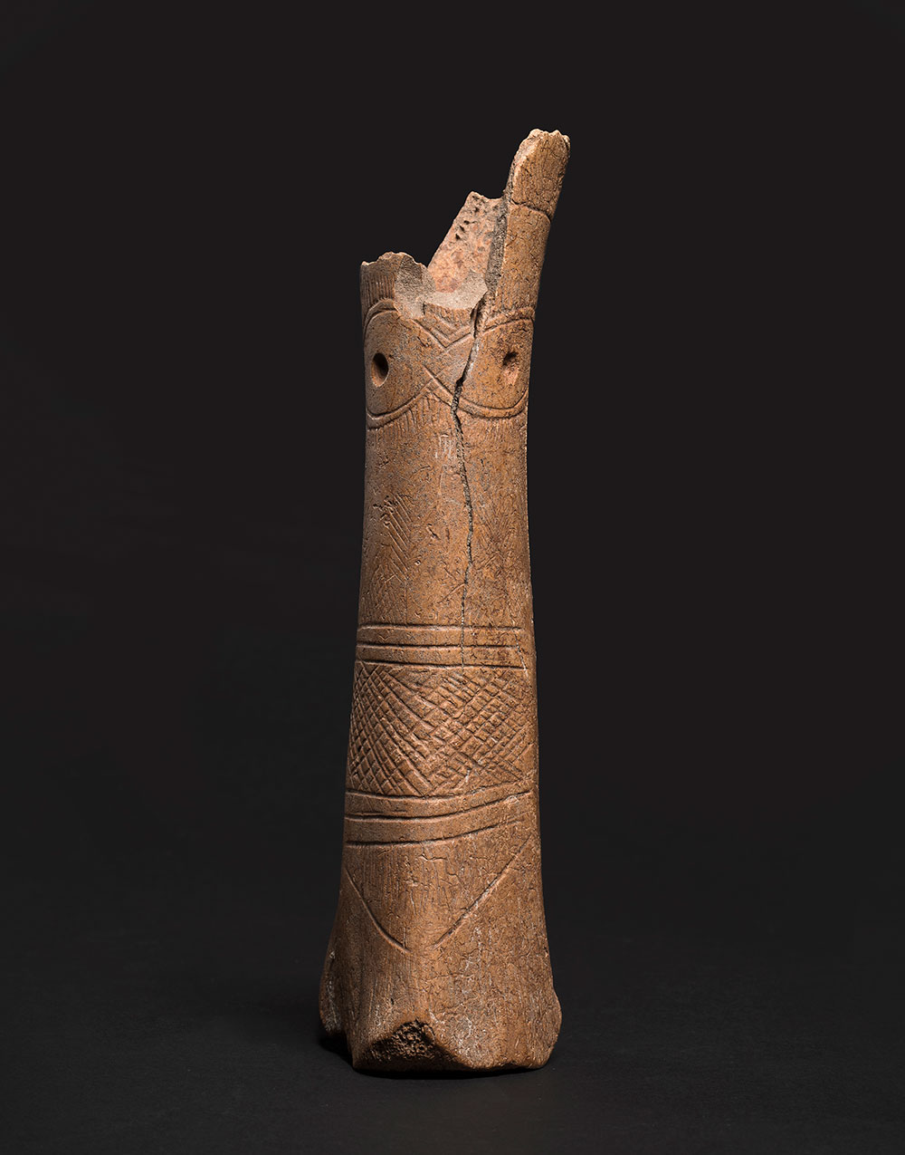
Asherah
Wooden cultic stand/idol
Also known as Ishtar, Goddess of Fertility
Neve Yam culture, Wadi Rabba culture, late Neolithic period, 7,500 years ago, Etched into Bone
Collection of the Israel Antiquities Authority, Photo © The Israel Museum, Jerusalem, Laura Lachman

Slide 17
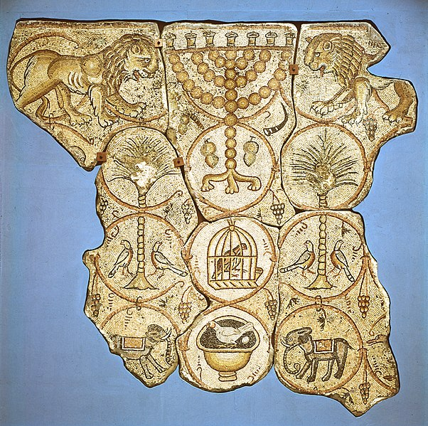
Depictions in Art
Ma’on Synagogue
The Maon Synagogue is a 6th-century synagogue and archaeological site located in the Negev Desert near Kibbutz Nirim and Kibbutz Nir Oz. (Wikipedia)

Slide 18
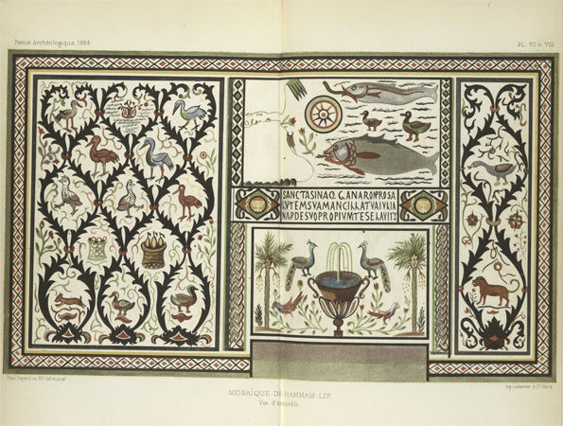
Synagogue Hammam-Lif Tunisia
5th century CE

Slide 19
Why Palm Tree?
The righteous bloom like a date-palm; they thrive like a cedar in Lebanon; (Tehillim 92:13 JPS 1985)
Just like a date palm if it uprooted it has no replacement, similarly the righteous have no replacement when they pass away, as it says (Iyov 28:12) ‘But where can wisdom be found; Where is the source of understanding?’
(Bamidbar Rabbah 3:1)
צַ֭דִּיק כַּתָּמָ֣ר יִפְרָ֑ח כְּאֶ֖רֶז בַּלְּבָנ֣וֹן יִשְׂגֶּֽה׃
מַה תְּמָרָה אִם נֶעֶקְרָה אֵין לָהּ חִלּוּפִים כָּךְ הֵם הַצַּדִּיקִים אֵין לָהֶם חִלּוּפִים בְּשָׁעָה שֶׁמֵּתִים, שֶׁנֶּאֱמַר (איוב כח, יב): וְהַחָכְמָה מֵאַיִן תִּמָּצֵא וְאֵי זֶה מְקוֹם בִּינָה.

Slide 20
Summary
3 types of Tree of life
Tree of Life from Gan Eden
Kabbistic Tree of Life
Torah as the metaphorical elixir of Life
Can you make one?
Not in Beit HaMikdash
Yes in Synagogue, not worshipped

Slide 21
Next week we continue with Sun, Moon, Stars

