Slide 1
Cherubs and Griffons
Rabbi Chaim Metzger
cmetzger@torontotorah.com

Slide 2
What are Cherubs and Griffins?
What did they look like?
What do they represent?
Can you make depictions of them?
Where are they used?

Slide 3
Aren’t Cherubs Angels?
Supernatural Beings in Judaism Angels Video
Supernatural Beings in Judaism Angels Audio

Slide 4
Cherubs in Tanakh
91 times
Garden of Eden
In the Mishkan, particularly the Aron haKodesh, Ark of the Covenant
Ezekiel – Heavenly Chariot

Slide 5
Garden of Eden
Genesis 3:24
He drove the man out, and stationed east of the garden of Eden the cherubim and the fiery ever-turning sword, to guard the way to the tree of life.
בראשית פרק ג פסוק כד
(כד) וַיְגָ֖רֶשׁ אֶת־הָֽאָדָ֑ם וַיַּשְׁכֵּן֩ מִקֶּ֨דֶם לְגַן־עֵ֜דֶן אֶת־הַכְּרֻבִ֗ים וְאֵ֨ת לַ֤הַט הַחֶ֙רֶב֙ הַמִּתְהַפֶּ֔כֶת לִשְׁמֹ֕ר אֶת־דֶּ֖רֶךְ עֵ֥ץ הַֽחַיִּֽים:

Slide 6
Cherubs over the Aron
Make two cherubim of gold—make them of hammered work—at the two ends of the cover. Make one cherub at one end and the other cherub at the other end; of one piece with the cover shall you make the cherubim at its two ends. The cherubim shall have their wings spread out above, shielding the cover with their wings. They shall confront each other, the faces of the cherubim being turned toward the cover. (Shemot 25:18-20 JPS 1985)
שמות פרשת תרומה פרק כה יח-כ
וְעָשִׂ֛יתָ שְׁנַ֥יִם כְּרֻבִ֖ים זָהָ֑ב מִקְשָׁה֙ תַּעֲשֶׂ֣ה אֹתָ֔ם מִשְּׁנֵ֖י קְצ֥וֹת הַכַּפֹּֽרֶת׃
וַ֠עֲשֵׂ֠ה כְּר֨וּב אֶחָ֤ד מִקָּצָה֙ מִזֶּ֔ה וּכְרוּב־אֶחָ֥ד מִקָּצָ֖ה מִזֶּ֑ה מִן־הַכַּפֹּ֛רֶת תַּעֲשׂ֥וּ אֶת־הַכְּרֻבִ֖ים עַל־שְׁנֵ֥י קְצוֹתָֽיו׃
וְהָי֣וּ הַכְּרֻבִים֩ פֹּרְשֵׂ֨י כְנָפַ֜יִם לְמַ֗עְלָה סֹכְכִ֤ים בְּכַנְפֵיהֶם֙ עַל־הַכַּפֹּ֔רֶת וּפְנֵיהֶ֖ם אִ֣ישׁ אֶל־אָחִ֑יו אֶל־הַכַּפֹּ֔רֶת יִהְי֖וּ פְּנֵ֥י הַכְּרֻבִֽים:

Slide 7
Use in the Mikdash
From Machon HaMikdash

Slide 8
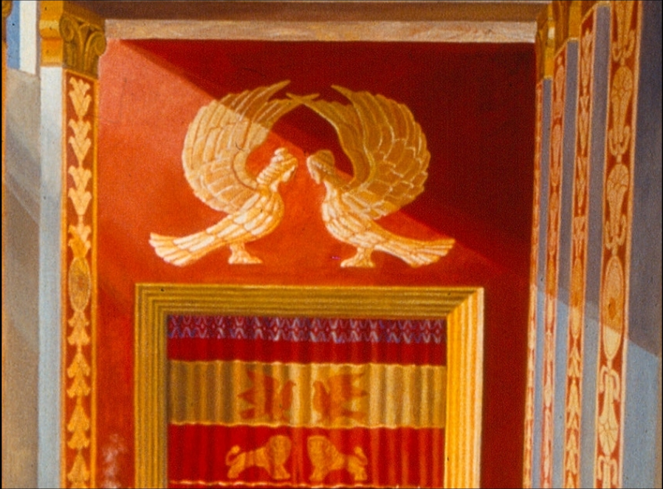
On Parochet – curtain to Holy of Holies

Slide 9
Cherubs in Heaven? Ezekiel Chapter 10
I looked, and on the expanse over the heads of the cherubs, there was something like a sapphire stone; an appearance resembling a throne could be seen over them. He spoke to the man clothed in linen and said, “Step inside the wheelwork, under the cherubs, and fill your hands with glowing coals from among the cherubs, and scatter them over the city.” And he went in as I looked on. Now the cherubs were standing on the south side of the House when the man entered, and the cloud filled the inner court. But when the Presence of the LORD moved from the cherubs to the platform of the House, the House was filled with the cloud, and the court was filled with the radiance of the Presence of the LORD. The sound of the cherubs’ wings could be heard as far as the outer court, like the voice of El Shaddai when He speaks. When He commanded the man dressed in linen: “Take fire from among the cherubs within the wheelwork,” he went in and stood beside a wheel. And a cherub stretched out his hand among the cherubs to the fire that was among the cherubs; he took some and put it into the hands of him who was clothed in linen, who took it and went out. The cherubs appeared to have the form of a man’s hand under their wings. I could see that there were four wheels beside the cherubs, one wheel beside each of the cherubs; as for the appearance of the wheels, they gleamed like the beryl stone. In appearance, the four had the same form, as if there were two wheels cutting through each other.

Slide 10
Cherubs in Heaven? Ezekiel Chapter 10
And when they moved, each could move in the direction of any of its four quarters; they did not veer as they moved. The [cherubs] moved in the direction in which one of the heads faced, without turning as they moved. Their entire bodies—backs, hands, and wings—and the wheels, the wheels of the four of them, were covered all over with eyes. It was these wheels that I had heard called “the wheelwork.” Each one had four faces: One was a cherub’s face, the second a human face, the third a lion’s face, and the fourth an eagle’s face. The cherubs ascended; those were the creatures that I had seen by the Chebar Canal. Whenever the cherubs went, the wheels went beside them; and when the cherubs lifted their wings to ascend from the earth, the wheels did not roll away from their side. When those stood still, these stood still; and when those ascended, these ascended with them, for the spirit of the creature was in them. Then the Presence of the LORD left the platform of the House and stopped above the cherubs. And I saw the cherubs lift their wings and rise from the earth, with the wheels beside them as they departed; and they stopped at the entrance of the eastern gate of the House of the LORD, with the Presence of the God of Israel above them. They were the same creatures that I had seen below the God of Israel at the Chebar Canal; so now I knew that they were cherubs. Each one had four faces and each had four wings, with the form of human hands under the wings. As for the form of their faces, they were the very faces that I had seen by the Chebar Canal—their appearance and their features—and each could move in the direction of any of its faces.

Slide 11
What did face of Cherubs look like? (Sukkah 5b)
Apropos the cherubs, the Gemara asks: And what is the form of the face of a cherub [keruv]? Rabbi Abbahu said: Like that of a child [keravya], as in Babylonia one calls a child ravya.
Abaye said to him: But if what you say is so, what is the meaning of that which is written about the faces of the celestial beasts drawing the celestial chariot: “The face of the first was the face of the cherub, and the face of the second was the face of a man” (Ezekiel 10:14)? According to your explanation, this face of the cherub is the same as that face of a man. The Gemara answers: Although two of the celestial beasts drawing that chariot had the face of a man, the difference between them is that one was a large face and one was a small face. In other words, the face described as the face of a man was the face of an adult, and the face described as the face of a cherub was that of a child. This is the source that the Ark and the Ark cover were ten handbreadths high. (Sukkah 5b William Davidson Translation)
וּמַאי כְּרוּב? אָמַר רַבִּי אֲבָהוּ כְּרָבְיָא שֶׁכֵּן בְּבָבֶל קוֹרִין לְיָנוֹקָא רָבְיָא. אֲמַר לֵיהּ אַבָּיֵי אֶלָּא מֵעַתָּה דִּכְתִיב פְּנֵי הָאֶחָד פְּנֵי הַכְּרוּב וּפְנֵי הַשֵּׁנִי פְּנֵי אָדָם הַיְינוּ כְּרוּב הַיְינוּ אָדָם אַפֵּי רַבְרְבֵי וְאַפֵּי זוּטְרֵי

Slide 12
Where did they face? (Baba Batra 99a)
Continuing its focus on the cherubs, the Gemara asks: How were the cherubs standing? Rabbi Yoḥanan and Rabbi Elazar disagree about this. One says: Their faces were turned one toward the other. And one says: Their faces were turned toward the House, i.e., the Sanctuary. The Gemara asks: But according to the one who says that their faces were turned one toward the other, isn’t it written: “And their faces were toward the House” (II Chronicles 3:13)? How does he explain the meaning of this verse? The Gemara answers: This is not difficult, as their faces miraculously changed directions in reflection of the Jewish people’s relationship to God. Here, when it states that the cherubs faced each other, it was when the Jewish people do the will of God. There, the verse that describes that the cherubs faced the Sanctuary and not toward each other, was when the Jewish people do not do the will of God.
The Gemara asks: And according to the one who says they stood as described in the verse: “And their faces were toward the House,” isn’t it written: “With their faces one toward the other” (Exodus 25:20). How does he explain the meaning of this verse? The Gemara answers: They were angled sideways so that they turned both to each other and toward the Sanctuary, as it is taught in a baraita: Onkelos the Convert said that the cherubs were of the form of children, as the verse states: “And in the Holy of Holies he made two cherubim of the form of children; and they overlaid them with gold” (II Chronicles 3:10), and their faces were angled sideways toward the Ark of the Covenant, like a student taking leave of his teacher.
כֵּיצַד הֵן עוֹמְדִין רַבִּי יוֹחָנָן וְרַבִּי אֶלְעָזָר חַד אָמַר פְּנֵיהֶם אִישׁ אֶל אָחִיו וְחַד אָמַר פְּנֵיהֶם לַבַּיִת וּלְמַאן דְּאָמַר פְּנֵיהֶם אִישׁ אֶל אָחִיו הָא כְּתִיב וּפְנֵיהֶם לַבַּיִת לָא קַשְׁיָא כָּאן בִּזְמַן שֶׁיִּשְׂרָאֵל עוֹשִׂין רְצוֹנוֹ שֶׁל מָקוֹם כָּאן בִּזְמַן שֶׁאֵין יִשְׂרָאֵל עוֹשִׂין רְצוֹנוֹ שֶׁל מָקוֹם. וּלְמַאן דְּאָמַר וּפְנֵיהֶם לַבַּיִת הָא כְּתִיב וּפְנֵיהֶם אִישׁ אֶל אָחִיו דִּמְצַדְּדִי אַצְדּוֹדֵי דְּתַנְיָא אוּנְקְלוֹס הַגֵּר אָמַר כְּרוּבִים מַעֲשֵׂה צַעֲצֻעִים הֵן וּמְצוֹדְדִים פְּנֵיהֶם כְּתַלְמִיד הַנִּפְטָר מֵרַבּוֹ:

Slide 13
A Second Set in Temple (Divrei haYamim II 3:10-13)
He made two sculptured cherubim in the Holy of Holies, and they were overlaid with gold. The outspread wings of the cherubim were 20 cubits across: one wing 5 cubits long touching one wall of the House, and the other wing 5 cubits long touching the wing of the other cherub; one wing of the other [cherub] 5 cubits long extending to the other wall of the House, and its other wing 5 cubits long touching the wing of the first cherub. The wingspread of these cherubim was thus 20 cubits across, and they were standing up facing the House. (JPS 1985)
וַיַּ֜עַשׂ בְּבֵֽית־קֹ֤דֶשׁ הַקֳּדָשִׁים֙ כְּרוּבִ֣ים שְׁנַ֔יִם מַעֲשֵׂ֖ה צַעֲצֻעִ֑ים וַיְצַפּ֥וּ אֹתָ֖ם זָהָֽב׃ וְכַנְפֵי֙ הַכְּרוּבִ֔ים אׇרְכָּ֖ם אַמּ֣וֹת עֶשְׂרִ֑ים כְּנַ֨ף הָאֶחָ֜ד לְאַמּ֣וֹת חָמֵ֗שׁ מַגַּ֙עַת֙ לְקִ֣יר הַבַּ֔יִת וְהַכָּנָ֤ף הָאַחֶ֙רֶת֙ אַמּ֣וֹת חָמֵ֔שׁ מַגִּ֕יעַ לִכְנַ֖ף הַכְּר֥וּב הָאַחֵֽר׃ וּכְנַ֨ף הַכְּר֤וּב הָאֶחָד֙ אַמּ֣וֹת חָמֵ֔שׁ מַגִּ֖יעַ לְקִ֣יר הַבָּ֑יִת וְהַכָּנָ֤ף הָאַחֶ֙רֶת֙ אַמּ֣וֹת חָמֵ֔שׁ דְּבֵקָ֕ה לִכְנַ֖ף הַכְּר֥וּב הָאַחֵֽר׃ כַּנְפֵי֙ הַכְּרוּבִ֣ים הָאֵ֔לֶּה פֹּרְשִׂ֖ים אַמּ֣וֹת עֶשְׂרִ֑ים וְהֵ֛ם עֹמְדִ֥ים עַל־רַגְלֵיהֶ֖ם וּפְנֵיהֶ֥ם לַבָּֽיִת׃

Slide 14
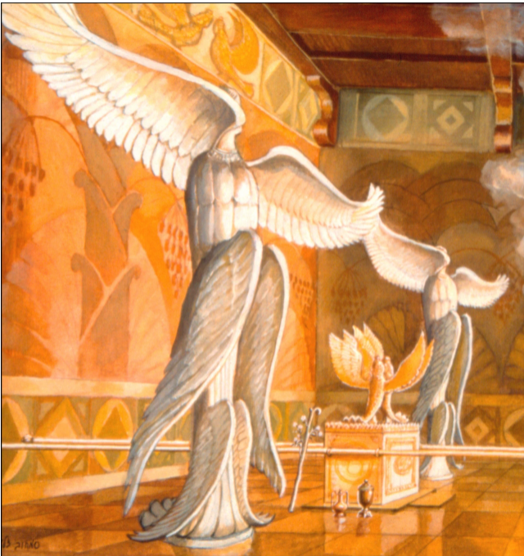

Slide 15
Can you make cherubs? (Shulchan Aruch YD:141:4)
It is forbidden to create images of the dwelling place of the Divine Presence, such as the four faces, similarly the images of Seraphim, Ophanim, and other angels. Similar the images of man alone. All of these are forbidden to make and if a non-Jew made them you cannot keep them.
Rama – but if you find them you are permitted to keep them except for the sun, moon, stars that idolaters worship, or if there is proof they were worshipped, then all sculptures are forbidden.
What is forbidden? When it juts out (sculpture) but sunken in, such as when weaving a garment, or drawing on a wall is permitted. You can never make a sun moon and stars. If it is to teach then it is permitted, even sculpture.
Rama – some permit it in public as there is no worry of idolatry worship.
אָסוּר לְצַיֵּר צוּרוֹת שֶׁבִּמְדוֹר שְׁכִינָה, כְּגוֹן ד׳ פָּנִים בַּהֲדֵי הֲדָדֵי, וְכֵן צוּרוֹת שְׂרָפִים וְאוֹפַנִּים וּמַלְאֲכֵי הַשָּׁרֵת. וְכֵן צוּרַת אָדָם לְבַדּוֹ, כָּל אֵלּוּ אָסוּר לַעֲשׂוֹת אֲפִלּוּ (הֵם) לְנוֹי [לְגוֹי]. וְאִם גּוֹי עֲשָׂאָם לוֹ, אָסוּר לְהַשְׁהוֹתָם
{הַגָּה: וּמִיהוּ, אִם מוֹצֵא אוֹתָם, מֻתָּרִים, מִלְּבַד בְּחַמָּה וּלְבָנָה שֶׁדֶּרֶךְ הָעוֹבֵד כּוֹכָבִים לְעָבְדָם, אוֹ שֶׁיֵּשׁ הוֹכָחָה שֶׁעֲשָׂאוֹ לְעָבְדָם, שֶׁאָז אָסוּר כְּכָל הַצְּלָמִים, כְּמוֹ שֶׁנִּתְבָּאֵר בְּרֵישׁ הַסִּימָן (טוּר).}
בַּמֶּה דְּבָרִים אֲמוּרִים, בְּבוֹלֶטֶת. אֲבָל בְּשׁוֹקַעַת, כְּאוֹתָם שֶׁאוֹרְגִים בְּבֶגֶד, וְשֶׁמְּצַיְּרִים בְּכֹתֶל בְּסַמָּנִין, מֻתָּר לַעֲשׂוֹתָם. וְצוּרַת חַמָּה וּלְבָנָה וְכוֹכָבִים, אָסוּר בֵּין בּוֹלְטוֹת בֵּין שׁוֹקְעוֹת. וְאִם הֵם לְהִתְלַמֵּד, לְהָבִין וּלְהוֹרוֹת, כֻּלָּן מֻתָּרוֹת אֲפִלּוּ בּוֹלְטוֹת.
{וְיֵשׁ מַתִּירִין בְּשֶׁל רַבִּים, דְּלֵיכָּא חֲשָׁדָא (טוּר בְּשֵׁם הָרא״ש).}

Slide 16
Guide for the Perplexed 3, 45 Friedlander translation
From the preceding remarks it is clear that the belief in the existence of angels is connected with the belief in the Existence of God; and the belief in God and angels leads to the belief in Prophecy and in the truth of the Law. In order to firmly establish this creed, God commanded [the Israelites] to make over the ark the form of two angels. The belief in the existence of angels is thus inculcated into the minds of the people, and this belief is in importance next to the belief in God's Existence; it leads us to believe in Prophecy and in the Law, and opposes idolatry. If there had only been one figure of a cherub, the people would have been misled and would have mistaken it for God's image which was to be worshipped, in the fashion of the heathen; or they might have assumed that the angel [represented by the figure] was also a deity, and would thus have adopted a Dualism. By making two cherubim and distinctly declaring "the Lord is our God, the Lord is One," Moses clearly proclaimed the theory of the existence of a number of angels; he left no room for the error of considering those figures as deities, since [he declared that) God is one, and that He is the Creator of the angels, who are more than one.

Slide 17
Alternative Etymology for Cherub
Friedrich Delitzsch- Assyrian "kirubu" = "shedu" (the name of the winged bull).
Delitzsch connected it with the Assyrian "karubu" (great, mighty); See also Haupt, in Paterson, "Numbers" ("S. B. O. T."), p. 46: "The stem of is the Assyrian 'karâbu' (= be propitious, bless), which is nothing but a transposition of the Hebrew ."
Dillmann, Duff, and others still favor the connection with γρύψ ("gryphus" = the Hindu "Garuda.")
Jewish Encyclopedia 1906

Slide 18
Forbidden Figure
On the other hand, the example you sent me of a lion with wings, that I absolutely prohibit, because it is taken from figurines of ancient civilizations and the source is a mythological deity. Blesse is He Who uprooted idolatry from these lands, and G-d forbid, shouldn’t memorialize them in our houses of prayer, nor should they be mentioned. If you want to make a lion to represent bravery like a lion to serve our Father above, please do it like the image I presented, meaning only make one side of the body, not the full form and without wings.
Responsa Heichal Yitzchak OC 11
Rabbi Yitzchak haLevi Herzog (1888-1959) second Ashkenazi Chief Rabbi of Israel
שו"ת היכל יצחק אורח חיים סימן יא
(ג) אולם, הדוגמא ששלחתם אלי צורת אריה עם כנפיים, אותה אני אוסר בהחלט, היא לקוחה מצורות ששרדו מעמי הקדם והיא ממקור אלילי מיתולוגי. ברוך שעקר ע"ז מהארצות האלה, ואנחנו ח"ו ניתן להם זכרון בבית תפלתינו הס מלהזכיר. אם תעשו צורת אריה לסמל גבור כארי לעשות רצון אביך שבשמים, עכ"פ תעשו כדוגמא שלפני, שיהא רק צד אחד של הגוף, לא צורה מלאה, ולגמרי בלי כנפים, (יעויין ברדב"ז חלק א', סימן ק"ו).

Slide 19
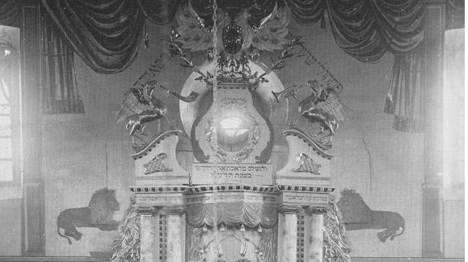
The Carved Wooden Torah Arks of Eastern Europe, Bracha Yaniv, Littman Library of Jewish Civilization in association with Liverpool University Press

Slide 20
What is a Griffin/Gryphon?
a legendary creature with the body, tail, and back legs of a lion; the head and wings of an eagle; and sometimes an eagle's talons as its front feet. Wikipedia

Slide 21
Midrashim on King Solomon, Throne and Hippodrome of King Solomon (published 1872)
Domesticated and wild animals and birds were held in the throne, Impure opposite pure; a lion opposite an ox ... a deer on the right, and an elephant on the left, a re'em (aurochs or oryx) on the right and a graffis on left and a man standing at the end of all of them ... Rabbi Yochanan said: How did Solomon arise and sit on his throne? The ox would take him with its horns and pass him to the \ion .. . and the elephant to the re'ern, and the re'em to the graffis, and the graffis to the man, and they would say in a loud voice, "We have delivered you completely,
Rabbi Yochanan said: They would all raise their voices, and the entire earth would tremble. The ox would \ow, the lion would roar ... the graffis would shout, the man would sing ...
Rabbi Elazar said: How did Solomon sit on his throne? He would take a Torah and look at it… the re’em would recite “And these are the laws…” the graffis would recite, “and you shall judge between man and his friend…” (Translation Rabbi Natan Slifkin Sacred Monsters p249-250)
אמר ר׳ יוחנן, העמידם המלך שלמה לכסא, אחד מימין ואחד משמאל, כבש מימין וזאב משמאל, צבי מימין ודוב משמאל, יחמור מימין ופיל משמאל, ראם מימין וגרפית משמאל, ובסוף כולם העמיד בן אדם ונגדו שד והעמיד למעלה זיז ונגדו נשר, ושם יונה ונגדה התקין נץ, ובתוכה לוח חקוק נחש בו על נס. ואמר ר׳ יוחנן, היאך היה דרך שלמה לעלות ולישב בכסא? נוטלו שור בקרניו והיה נותנו לאריה והיה מזהירו ואומר לו הזהר במלך שלמה שלא ירע בו דבר, ואריה נותנו לאיל, ואיל נותנו לנמר, ונמר לכבש, וכבש לזאב, וזאב לצבי, וצבי לדוב, ודוב ליחמור, ויחמור לפיל, ופיל לראם, וראם לגרפית, וגרפית לאדם, והיו אומרים לו בקול גדול: הרי שלחנו לך המלך שלם
גרפית היה אומר - ושפטתם בין איש ובין רעהו, ואתה המלך שפוט בין איש ובין רעהו,

Slide 22
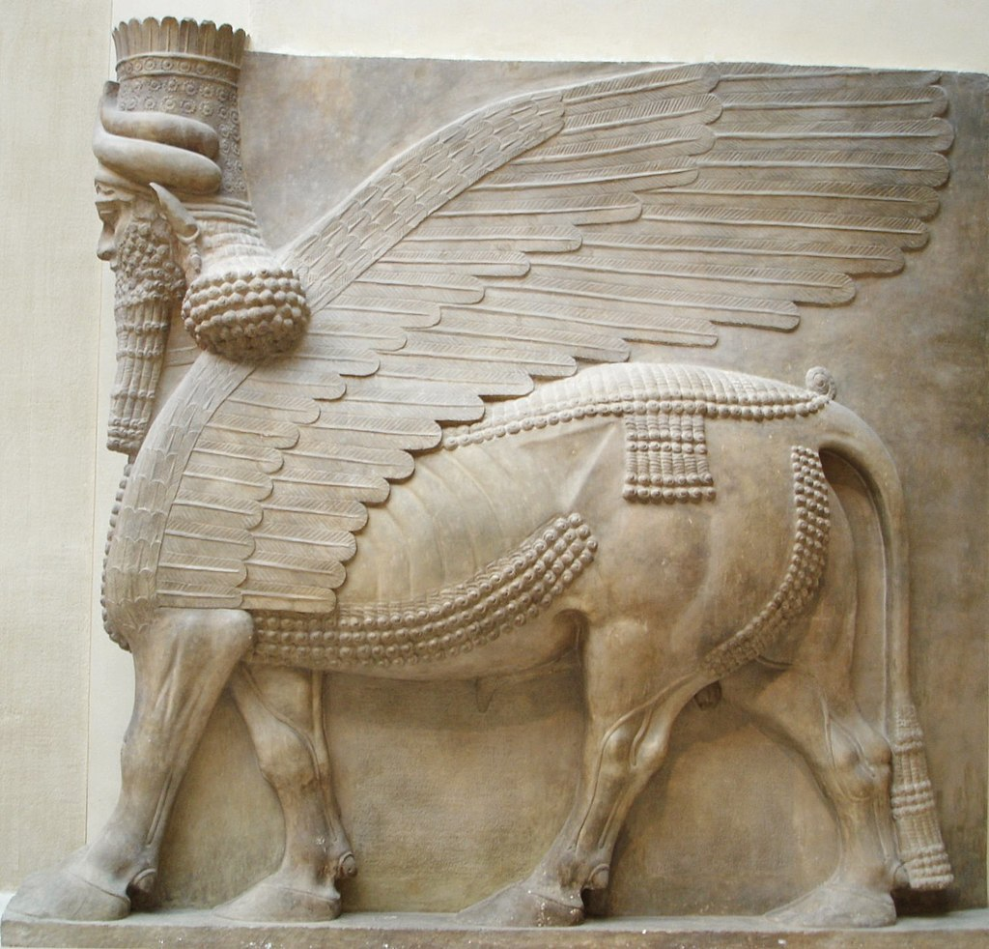
Assyrian Lammassu

Slide 23
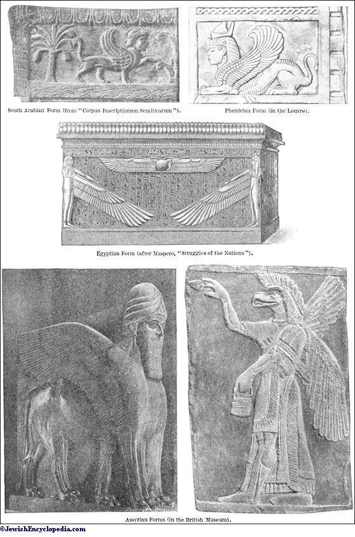

Slide 25
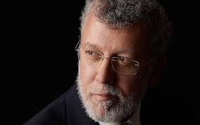
Rabbi Professor Joshua Berman
Was There an Exodus
Ani Maamin

Slide 26
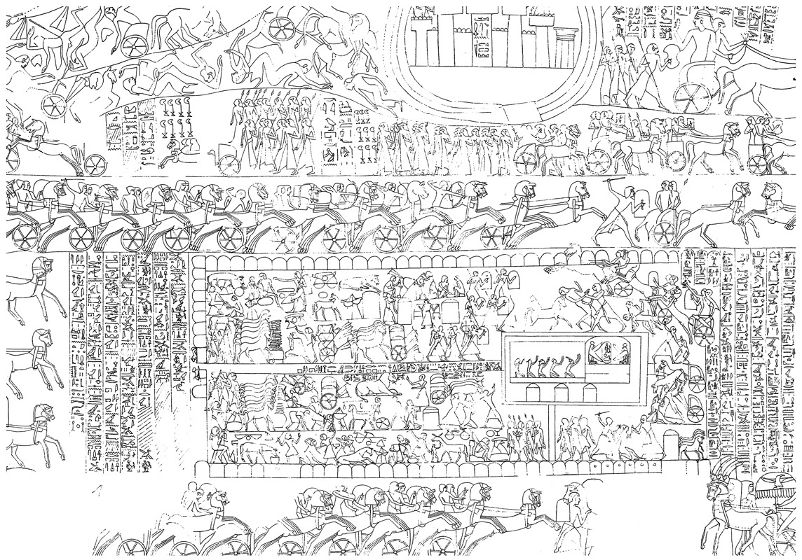
The Throne Tent Of Ramesses II With Winged Falcons Flanking His Cartouche At Abu Simbel. W. Wreszinski, Atlas Zur Altägyptischen Kulturgeschichte Vol. Ii (1935), Pl. 169.

Slide 27
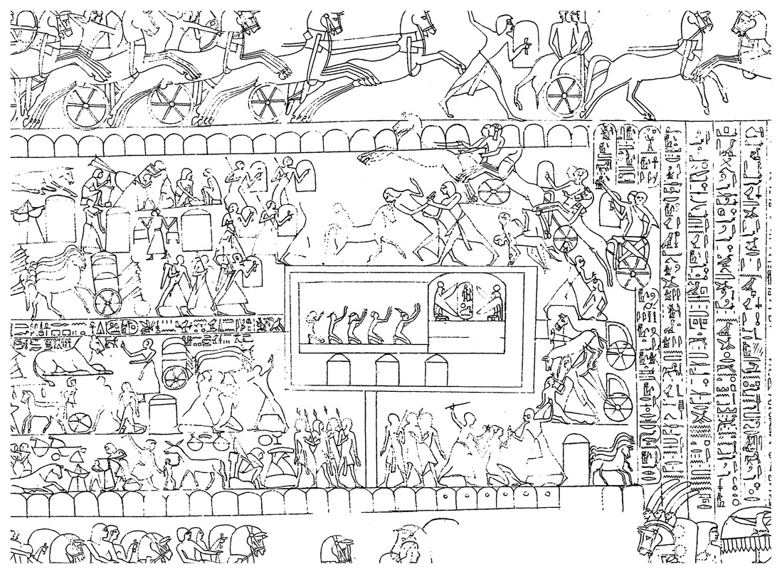

Slide 28
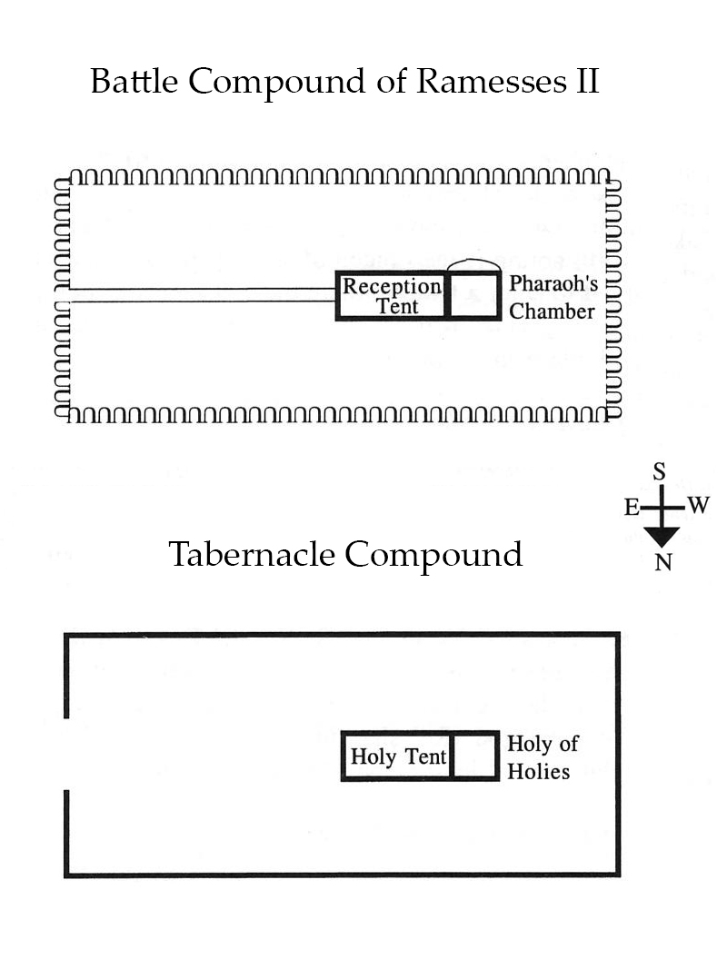

Slide 29
Griffon in Daniel? (Daniel 7:4)
The first was like a lion but had eagles’ wings. As I looked on, its wings were plucked off, and it was lifted off the ground and set on its feet like a man and given the mind of a man.
Rashi on Daniel 7:4:1 The first one was like a lion, and it had the wings of an eagle It was like a lion, and it had the wings of an eagle; that is the kingdom of Babylon, which was ruling at that time, and so did Jeremiah see it (4:7): “A lion has come up from its thicket,” and he says also (48:40): “like an eagle he shall soar.” (Sefaria)
קַדְמָיְתָ֣א כְאַרְיֵ֔ה וְגַפִּ֥ין דִּֽי־נְשַׁ֖ר לַ֑הּ חָזֵ֣ה הֲוֵ֡ית עַד֩ דִּי־מְּרִ֨יטוּ גַפַּ֜יהּ וּנְטִ֣ילַת מִן־אַרְעָ֗א וְעַל־רַגְלַ֙יִן֙ כֶּאֱנָ֣שׁ הֳקִימַ֔ת וּלְבַ֥ב אֱנָ֖שׁ יְהִ֥יב לַֽהּ׃
קדמיתא כאריה וגפין די נשר לה. היא כאריה ולה כנפי נשר זו היא מלכות בבל שהיתה מושלת באותה שעה וכך ראה אותה ירמיה שנאמר עלה אריה מסבכו (ירמיהו ה׳:ו׳) ואומר הנה כאשר ידאה וגו' (שם מח):

Slide 30
Summary
Cherubs
From Tanakh
Wings
Multiple Faces (Yechezkel)
Angels
Heavenly Chariot
Gemara
Faces of children
Griffins
Perhaps Mythological in origin
We were given Korbanot because that is what we were used to (Rambam)
Was always intended but corrupted by idolaters (Ramban)
Professor Berman - Doesn’t matter because G-d is rebranding it

Slide 31
