Slide 1
Jewish Art: Birds
Rabbi Chaim Metzger
cmetzger@torontotorah.com

Slide 2
Types of birds in Jewish literature
Natural
Kosher ( Vayikra 11, Devarim 14)
Not Kosher
Dove, raven, Nesher, Kenaf Renanim
Supernatural
Phoenix, griffon, dragon, Roc, Ziz, Bar Yochni

Slide 3
Birds-head Haggadah

Slide 4
Dove vs Raven
5. The waters went on diminishing until the tenth month; in the tenth month, on the first of the month, the tops of the mountains became visible. 6 At the end of forty days, Noah opened the window of the ark that he had made 7 and sent out the raven; it went to and fro until the waters had dried up from the earth. 8. Then he sent out the dove to see whether the waters had decreased from the surface of the ground. 9 But the dove could not find a resting place for its foot, and returned to him to the ark, for there was water over all the earth. So putting out his hand, he took it into the ark with him. 10 He waited another seven days, and again sent out the dove from the ark. 11 The dove came back to him toward evening, and there in its bill was a plucked-off olive leaf! Then Noah knew that the waters had decreased on the earth. 12 He waited still another seven days and sent the dove forth; and it did not return to him any more. (Breishit 8:5-12) JPS 1985
בראשית פרשת נח פרק ח פסוק ה - יב, ה-יב
(ה) וְהַמַּ֗יִם הָיוּ֙ הָל֣וֹךְ וְחָס֔וֹר עַ֖ד הַחֹ֣דֶשׁ הָֽעֲשִׂירִ֑י בָּֽעֲשִׂירִי֙ בְּאֶחָ֣ד לַחֹ֔דֶשׁ נִרְא֖וּ רָאשֵׁ֥י הֶֽהָרִֽים: (ו) וַֽיְהִ֕י מִקֵּ֖ץ אַרְבָּעִ֣ים י֑וֹם וַיִּפְתַּ֣ח נֹ֔חַ אֶת־חַלּ֥וֹן הַתֵּבָ֖ה אֲשֶׁ֥ר עָשָֽׂה: (ז) וַיְשַׁלַּ֖ח אֶת־הָֽעֹרֵ֑ב וַיֵּצֵ֤א יָצוֹא֙ וָשׁ֔וֹב עַד־יְבֹ֥שֶׁת הַמַּ֖יִם מֵעַ֥ל הָאָֽרֶץ: (ח) וַיְשַׁלַּ֥ח אֶת־הַיּוֹנָ֖ה מֵאִתּ֑וֹ לִרְאוֹת֙ הֲקַ֣לּוּ הַמַּ֔יִם מֵעַ֖ל פְּנֵ֥י הָֽאֲדָמָֽה: (ט) וְלֹֽא־מָצְאָה֩ הַיּוֹנָ֨ה מָנ֜וֹחַ לְכַף־רַגְלָ֗הּ וַתָּ֤שָׁב אֵלָיו֙ אֶל־הַתֵּבָ֔ה כִּי־מַ֖יִם עַל־פְּנֵ֣י כָל־הָאָ֑רֶץ וַיִּשְׁלַ֤ח יָדוֹ֙ וַיִּקָּחֶ֔הָ וַיָּבֵ֥א אֹתָ֛הּ אֵלָ֖יו אֶל־הַתֵּבָֽה: (י) וַיָּ֣חֶל ע֔וֹד שִׁבְעַ֥ת יָמִ֖ים אֲחֵרִ֑ים וַיֹּ֛סֶף שַׁלַּ֥ח אֶת־הַיּוֹנָ֖ה מִן־הַתֵּבָֽה: (יא) וַתָּבֹ֨א אֵלָ֤יו הַיּוֹנָה֙ לְעֵ֣ת עֶ֔רֶב וְהִנֵּ֥ה עֲלֵה־זַ֖יִת טָרָ֣ף בְּפִ֑יהָ וַיֵּ֣דַע נֹ֔חַ כִּי־קַ֥לּוּ הַמַּ֖יִם מֵעַ֥ל הָאָֽרֶץ: (יב) וַיִּיָּ֣חֶל ע֔וֹד שִׁבְעַ֥ת יָמִ֖ים אֲחֵרִ֑ים וַיְשַׁלַּח֙ אֶת־הַיּוֹנָ֔ה וְלֹֽא יָסְפָ֥ה שׁוּב־ אֵלָ֖יו עֽוֹד:

Slide 5
Mishlei 30: 17
The eye that mocks a father And disdains the homage due a mother— The ravens of the brook will gouge it out, Young Nesher will devour it.
עַ֤יִן ׀ תִּ֥לְעַ֣ג לְאָב֮ וְתָבֻ֢ז לִֽיקְּהַ֫ת־אֵ֥ם יִקְּר֥וּהָ עֹֽרְבֵי־נַ֑חַל וְֽיֹאכְל֥וּהָ בְנֵי־נָֽשֶׁר׃ {פ}

Slide 6
Eliyahu’s Ravens
1) Elijah the Tishbite, an inhabitant of Gilead, said to Ahab, “As the LORD lives, the God of Israel whom I serve, there will be no dew or rain except at my bidding.” 2) The word of the LORD came to him: 3)“Leave this place; turn eastward and go into hiding by the Wadi Cherith, which is east of the Jordan. 4) You will drink from the wadi, and I have commanded the ravens to feed you there.” 5) He proceeded to do as the LORD had bidden: he went, and he stayed by the Wadi Cherith, which is east of the Jordan. 6) The ravens brought him bread and meat every morning and every evening, and he drank from the wadi.
מלכים א פרק יז פסוק א - ו, א-ו
(א) וַיֹּאמֶר֩ אֵלִיָּ֨הוּ הַתִּשְׁבִּ֜י מִתֹּשָׁבֵ֣י גִלְעָד֘ אֶל־אַחְאָב֒ חַי־יְקֹוָ֞ק אֱלֹהֵ֤י יִשְׂרָאֵל֙ אֲשֶׁ֣ר עָמַ֣דְתִּי לְפָנָ֔יו אִם־יִהְיֶ֛ה הַשָּׁנִ֥ים הָאֵ֖לֶּה טַ֣ל וּמָטָ֑ר כִּ֖י אִם־ לְפִ֥י דְבָרִֽי: ס (ב) וַיְהִ֥י דְבַר־יְקֹוָ֖ק אֵלָ֥יו לֵאמֹֽר: (ג) לֵ֣ךְ מִזֶּ֔ה וּפָנִ֥יתָ לְּךָ֖ קֵ֑דְמָה וְנִסְתַּרְתָּ֙ בְּנַ֣חַל כְּרִ֔ית אֲשֶׁ֖ר עַל־פְּנֵ֥י הַיַּרְדֵּֽן: (ד) וְהָיָ֖ה מֵהַנַּ֣חַל תִּשְׁתֶּ֑ה וְאֶת־הָעֹרְבִ֣ים צִוִּ֔יתִי לְכַלְכֶּלְךָ֖ שָֽׁם: (ה) וַיֵּ֥לֶךְ וַיַּ֖עַשׂ כִּדְבַ֣ר יְקֹוָ֑ק וַיֵּ֗לֶךְ וַיֵּ֙שֶׁב֙ בְּנַ֣חַל כְּרִ֔ית אֲשֶׁ֖ר עַל־פְּנֵ֥י הַיַּרְדֵּֽן: (ו) וְהָעֹרְבִ֗ים מְבִיאִ֨ים ל֜וֹ לֶ֤חֶם וּבָשָׂר֙ בַּבֹּ֔קֶר וְלֶ֥חֶם וּבָשָׂ֖ר בָּעָ֑רֶב וּמִן־ הַנַּ֖חַל יִשְׁתֶּֽה:

Slide 7
Metzudat David on I Kings 17:4
Why ravens? To arose the spirit of Eliyahu so he will not be cruel to Israel, as he sees the cruel ravens being compassionate and sustaining him, how could he not have compassion on Israel?
ואת העורבים וכו׳. בכדי להעיר רוחו לבל יתאכזר על ישראל, בראותו כי העורבים האכזרים יחמלו עליו לכלכלו, ואיך לא יחמול הוא על ישראל:

Slide 8
Never abandoned
Who provides food for the raven When his young cry out to God And wander about without food? (Iyov 38:41)
Malbim - Providence also extends to the raven, traditionally regarded as one of the meanest of beasts: 'He gives cattle their food; to the raven's offspring too when they cry out' (Psalms 147:9). The Talmudic Sages asserted that 'when the raven has offspring the male tells the female that another bird impregnated her and so they despise and abandon them. What does the Holy One Blessed be He do? He ordains midges [or flies] for them [the offspring] that come out of their excrement and they eat them' (Tanchuma Deuteronomy: Ekev). (Translation from Sefaria)
מִ֤י יָכִ֥ין לָעֹרֵ֗ב צֵ֫יד֥וֹ כִּֽי־יְ֭לָדָו אֶל־אֵ֣ל יְשַׁוֵּ֑עוּ יִ֝תְע֗וּ לִבְלִי־אֹֽכֶל׃
מי, והשפל שבכולם הם בני עורב, וה' יכין לעורב צידו, הגם שילדיו יתעו לבלי אוכל שהם עזובים מאמם, ובכ"ז אל אל ישועו והוא יכין להם את צידם ע"י יתושים כמ"ש חז"ל:

Slide 9
What is a Nesher?
You have seen what I did to the Egyptians, how I bore you on Neshers’ wings and brought you to Me. (Shemot 19:4)
אַתֶּ֣ם רְאִיתֶ֔ם אֲשֶׁ֥ר עָשִׂ֖יתִי לְמִצְרָ֑יִם וָאֶשָּׂ֤א אֶתְכֶם֙ עַל־כַּנְפֵ֣י נְשָׁרִ֔ים וָאָבִ֥א אֶתְכֶ֖ם אֵלָֽי׃

Slide 10
Devarim 32: 12
Like an eagle who rouses his nestlings, Gliding down to his young, So did He spread His wings and take him, Bear him along on His pinions;
Rashi - SPREADETH ABROAD ITS WINGS, TAKETH IT — When it comes to remove them (the young) from one place to another, it does not take them with its claws, as other birds do: because other birds are afraid of the eagle that soars so high and flies above them, therefore they carry them (the young) by their (the mother’s) claws for fear of the nesher. But the nesher is afraid only of an arrow, therefore it carries them (the young) on its wings, saying, “It is better that the arrow pierce me than that it should pierce my young”. So, too, the Holy One, blessed be He, says, (Exodus 19:4) “I bare you as on Nesher’s wings” (Mekhilta d'Rabbi Yishmael 19:4:3): when the Egyptians marched after them and overtook them at the Red Sea, they threw arrows and stone missiles at them, whereupon at once “The angel of God moved … and came between the camp of Egypt [and the camp of Israel]” that it might receive the arrows etc. (Exodus 14:19—20 And Rashi thereon).
כְּנֶ֙שֶׁר֙ יָעִ֣יר קִנּ֔וֹ עַל־גּוֹזָלָ֖יו יְרַחֵ֑ף {ס} יִפְרֹ֤שׂ כְּנָפָיו֙ יִקָּחֵ֔הוּ יִשָּׂאֵ֖הוּ עַל־אֶבְרָתֽוֹ׃
רש"י - יפרש כנפיו יקחהו. כְּשֶׁבָּא לִטְּלָם מִמָּקוֹם לְמָקוֹם אֵינוֹ נוֹטְלָן בְּרַגְלָיו כִּשְׁאָר עוֹפוֹת, לְפִי שֶׁשְּׁאָר עוֹפוֹת יְרֵאִים מִן הַנֶּשֶׁר שֶׁהוּא מַגְבִּיהַּ לָעוּף וּפוֹרֵחַ עֲלֵיהֶם, לְפִיכָךְ נוֹשְׂאָן בְּרַגְלָיו, מִפְּנֵי הַנֶּשֶׁר, אֲבָל הַנֶּשֶׁר אֵינוֹ יָרֵא אֶלָּא מִן הַחֵץ, לְפִיכָךְ נוֹשְׂאָן עַל כְּנָפָיו, אוֹמֵר מוּטָב שֶׁיִּכָּנֵס הַחֵץ בִּי וְלֹא יִכָּנֵס בְּבָנַי, אַף הַקָּבָּ"ה (שמות י"ט) "וָאֶשָּׂא אֶתְכֶם עַל כַּנְפֵי נְשָׁרִים" — כְּשֶׁנָּסְעוּ מִצְרַיִם אַחֲרֵיהֶם וְהִשִּׂיגוּם עַל הַיָּם הָיוּ זוֹרְקִים בָּהֶם חִצִּים וְאַבְנֵי בָּלִיסְטְרָאוֹת, מִיָּד "וַיִּסַּע מַלְאַךְ הָאֱלֹהִים וְגוֹ' וַיָּבֹא בֵּין מַחֲנֵה מִצְרַיִם וְגוֹ'" (שמות י"ד): יפרש כנפיו יקחהו

Slide 11
Connotations of Nesher
Kings of the Birds
Nobility
Protective
Majestic

Slide 12
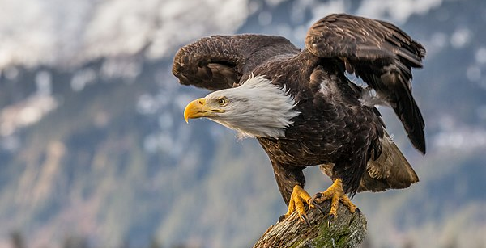
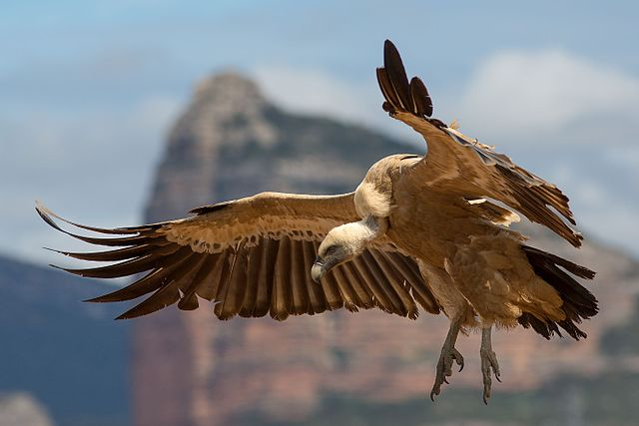
Nesher
Eagle (Sefer Ha-Itur, Chizkuni and Yalkut Me'am Loez)
Griffon Vulture – Rabbi Saadia Gaon, Rabbi Avraham Ibn Ezra
For full explanation see the “The Identity of the Nesher” by Rabbi Natan Slifkin

Slide 13
Carrion - Supports for Griffon Vulture
Does the nesher rise up at your command, and make its nest on high? It dwells and abides on the rock, upon the crag of the rock, and the strong place. From there it seeks the prey, and its eyes behold from far away. Its young ones gulp blood; and where there are carcasses, there it is. (Job 39:27-30)
The eye that mocks at his father, and scorns to obey his mother, will be picked out by the ravens of the valley, and the young nesher shall eat it. (Proverbs 30:17)
איוב פרק לט פסוק כז - ל
כז) אִם־עַל־פִּ֭יךָ יַגְבִּ֣יהַּ נָ֑שֶׁר וְ֝כִ֗י יָרִ֥ים קִנּֽוֹ: (כח) סֶ֣לַע יִ֭שְׁכֹּן וְיִתְלֹנָ֑ן עַֽל־שֶׁן־סֶ֝֗לַע וּמְצוּדָֽה: (כט) מִשָּׁ֥ם חָֽפַר־אֹ֑כֶל לְ֝מֵרָח֗וֹק עֵינָ֥יו יַבִּֽיטוּ: (ל) ואפרחו וְאֶפְרֹחָ֥יו יְעַלְעוּ־דָ֑ם וּבַאֲשֶׁ֥ר חֲ֝לָלִ֗ים שָׁ֣ם הֽוּא:
משלי פרק ל פסוק יז
עַ֤יִן׀ תִּֽלְעַ֣ג לְאָב֘ וְתָב֪וּז לִֽיקֲּהַ֫ת־אֵ֥ם יִקְּר֥וּהָ עֹרְבֵי־נַ֑חַל וְֽיֹאכְל֥וּהָ בְנֵי־נָֽשֶׁר:

Slide 14
Bald
Shear off your hair and make yourself bald For the children you once delighted in; Make yourself as bald as a Nesher, For they have been banished from you. (Michah 1:16)
מיכה פרק א פסוק טז
קָרְחִ֣י וָגֹ֔זִּי עַל־בְּנֵ֖י תַּעֲנוּגָ֑יִךְ הַרְחִ֤בִי קָרְחָתֵךְ֙ כַּנֶּ֔שֶׁר כִּ֥י גָל֖וּ מִמֵּֽךְ:

Slide 15
Height
The vision of Obadiah. Thus says the Lord God concerning Edom; We have heard tidings from the Lord, and an ambassador has been sent among the nations, Arise! Let us rise up against her in battle! Behold, I will make you small among the nations; you shall be greatly despised. The pride of your heart has deceived you, you who dwell in the clefts of the rock, whose habitation is high; who said in his heart, Who shall bring me down to the ground? Though you soar aloft like the nesher, and though you set your nest among the stars, from there will I bring you down, says the Lord. (Obadiah 1:1-4) (translated by R’ Slifkin)
עובדיה פרק א פסוק א - ד, א-ד
(א) חֲז֖וֹן עֹֽבַדְיָ֑ה כֹּֽה־אָמַר֩ אֲדֹנָ֨י יְקֹוִ֜ק לֶאֱד֗וֹם שְׁמוּעָ֨ה שָׁמַ֜עְנוּ מֵאֵ֤ת יְקֹוָק֙ וְצִיר֙ בַּגּוֹיִ֣ם שֻׁלָּ֔ח ק֛וּמוּ וְנָק֥וּמָה עָלֶ֖יהָ לַמִּלְחָמָֽה: (ב) הִנֵּ֥ה קָטֹ֛ן נְתַתִּ֖יךָ בַּגּוֹיִ֑ם בָּז֥וּי אַתָּ֖ה מְאֹֽד: (ג) זְד֤וֹן לִבְּךָ֙ הִשִּׁיאֶ֔ךָ שֹׁכְנִ֥י בְחַגְוֵי־סֶ֖לַע מְר֣וֹם שִׁבְתּ֑וֹ אֹמֵ֣ר בְּלִבּ֔וֹ מִ֥י יוֹרִדֵ֖נִי אָֽרֶץ: (ד) אִם־תַּגְבִּ֣יהַּ כַּנֶּ֔שֶׁר וְאִם־בֵּ֥ין כּֽוֹכָבִ֖ים שִׂ֣ים קִנֶּ֑ךָ מִשָּׁ֥ם אוֹרִֽידְךָ֖ נְאֻם־יְקֹוָֽק:

Slide 16
So what is an eagle? – עיט, נץ
Birds of prey came down upon the carcasses, and Abram drove them away. (Breishit 15:11)
No bird of prey knows the path to it; The falcon’s eye has not gazed upon it. (Iyov 28:7) JPS 1985
My own people acts toward Me Like a bird of prey [or] a hyena; Let the birds of prey surround her! Go, gather all the wild beasts, Bring them to devour! (Yirmiyahu 12:9)
וַיֵּ֥רֶד הָעַ֖יִט עַל־הַפְּגָרִ֑ים וַיַּשֵּׁ֥ב אֹתָ֖ם אַבְרָֽם׃
נָ֭תִיב לֹֽא־יְדָ֣עוֹ עָ֑יִט וְלֹ֥א שְׁ֝זָפַ֗תּוּ עֵ֣ין אַיָּֽה׃
הַעַ֨יִט צָב֤וּעַ נַחֲלָתִי֙ לִ֔י הַעַ֖יִט סָבִ֣יב עָלֶ֑יהָ לְכ֗וּ אִסְפ֛וּ כָּל־חַיַּ֥ת הַשָּׂדֶ֖ה הֵתָ֥יוּ לְאָכְלָֽה׃

Slide 17
What is Kenaf-renanim?
13) The Kenah Renanim beats joyously; Are her pinions and plumage like the stork’s? 14) She leaves her eggs on the ground, Letting them warm in the dirt, 15) Forgetting they may be crushed underfoot, Or trampled by a wild beast. 16) Her young are cruelly abandoned as if they were not hers; Her labor is in vain for lack of concern. 17) For God deprived her of wisdom, Gave her no share of understanding, 18) Else she would soar on high, Scoffing at the horse and its rider.
איוב פרק לט פסוק יג - יח, יג-יח
(יג) כְּנַף־רְנָנִ֥ים נֶעֱלָ֑סָה אִם־אֶ֝בְרָ֗ה חֲסִידָ֥ה וְנֹצָֽה: (יד) כִּֽי־תַעֲזֹ֣ב לָאָ֣רֶץ בֵּצֶ֑יהָ וְֽעַל־עָפָ֥ר תְּחַמֵּֽם: (טו) וַ֭תִּשְׁכַּח כִּי־רֶ֣גֶל תְּזוּרֶ֑הָ וְחַיַּ֖ת הַשָּׂדֶ֣ה תְּדוּשֶֽׁהָ: (טז) הִקְשִׁ֣יחַ בָּנֶ֣יהָ לְּלֹא־לָ֑הּ לְרִ֖יק יְגִיעָ֣הּ בְּלִי־פָֽחַד: (יז) כִּֽי־הִשָּׁ֣הּ אֱל֣וֹהַּ חָכְמָ֑ה וְלֹא־חָ֥לַק לָ֝֗הּ בַּבִּינָֽה: (יח) כָּ֭עֵת בַּמָּר֣וֹם תַּמְרִ֑יא תִּֽשְׂחַ֥ק לַ֝סּ֗וּס וּלְרֹֽכְבֽוֹ:

Slide 18
Bekhorot 57a
Rabbi Yishmael ben Satriel also testified before Rabbi Yehuda HaNasi: Once an egg of the bird called bar yokhani fell, and the contents of the egg drowned sixty cities and broke three hundred cedar trees. The Gemara asks: And does the bar yokhani bird throw its eggs to the ground? But isn’t it written: “The kenaf renanim bird rejoices, but are her wings and feathers those of the stork? For she leaves her eggs on the earth, and warms them in dust” (Job 39:13–14)? The Sages understood that kenaf renanim is another name for the bar yokhani bird. If so, how could its egg fall if it lays its eggs on the ground? Rav Ashi said in explanation: That egg was unfertilized, and since it would never hatch the bird threw it to the ground.
פעם אחת נפלה ביצת בר יוכני וטבעה ששים כרכים ושברה שלש מאות ארזים ומי שדיא ליה והא כתיב (איוב לט, יג) כנף רננים נעלסה אמר רב אשי ההוא מוזרתא הואי:

Slide 19
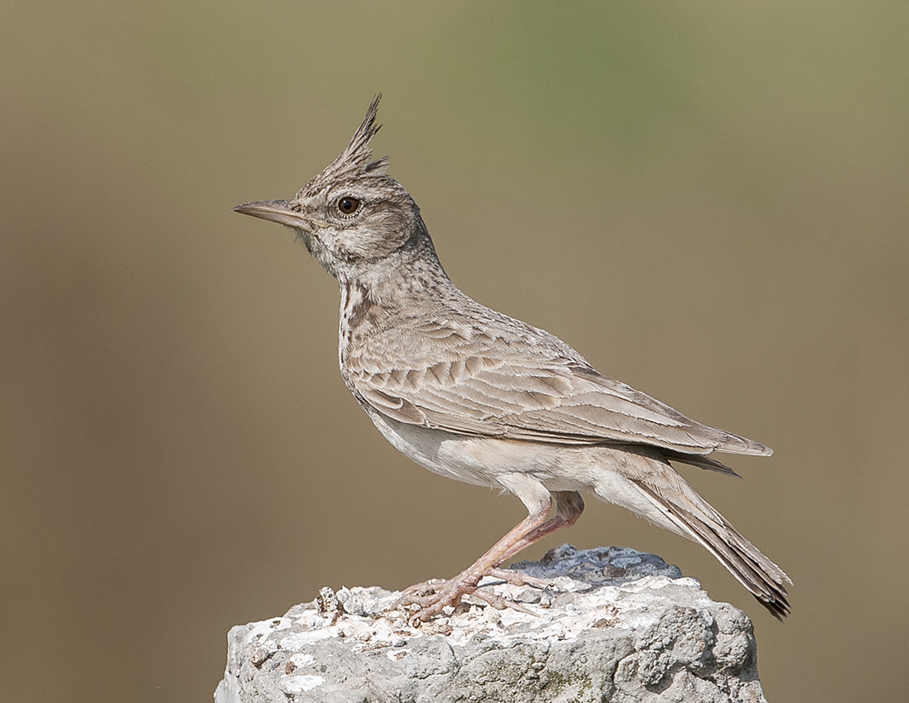
Menachem Dor - Crested Lark
Leaves its egg on the ground despite being able to fly,
It’s a songbird

Slide 20
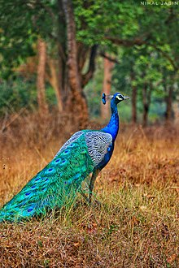
Metsudat David, - Peacock
It’s a type of bird called peacock and is called renanim because it is happy and joyful because of its beautiful plumage and this joyous bird is happy at all time. Or it is a type of stork
מצודת דוד איוב פרק לט
כנף רננים - הוא שם עוף ובדרז"ל נקרא טווס ונקרא רננים ע"ש שתשמח ותרנן ביופי כנפיה ואמר הנה העוף רננים השמחה בכל עת או מין בעל כנף חסידה או מן נוצה הידעת מנהגם:

Slide 21
Chaim Moyel - Eurasian stone-curlew, Eurasian thick-knee –
The description flies through the air while provoking the hunters, referring to the diversionary representations that the mother makes when the nest is threatened

Slide 22
Ostrich ( Malbim, Professor Yehuda Felix, and more)
Malbim - According to the commentators on the ostrich that she can not fly to the heights like the stork, and For, and there the Lord in nature ostrich that she lays her eggs in the sand and in the depths of the earth, became from the stork whose places her nest in cypresses and will lay her eggs in a safe place, and the ostrich daughter laid her eggs in the desert dirt:
כנף רננים, פי' המפרשים על בת היענה שהיא אינה יכולה לעוף למרום כמו החסידה, וז"ש וכי כנף רננים נעלסה שתעלה עם הכנף לגבהי מרום, וכי תדמה כנף רננים אל אברה חסידה ואל נוצה שתעוף ביעף:
כי, ושם ה' בטבע היענה שהיא מניחה את ביציה בחול ובעומק האדמה, הפך מן החסידה אשר ברושים ביתה ותניח את ביציה במרום במקום משומר, ובת היענה ביציה בעפר המדבר:

Slide 23
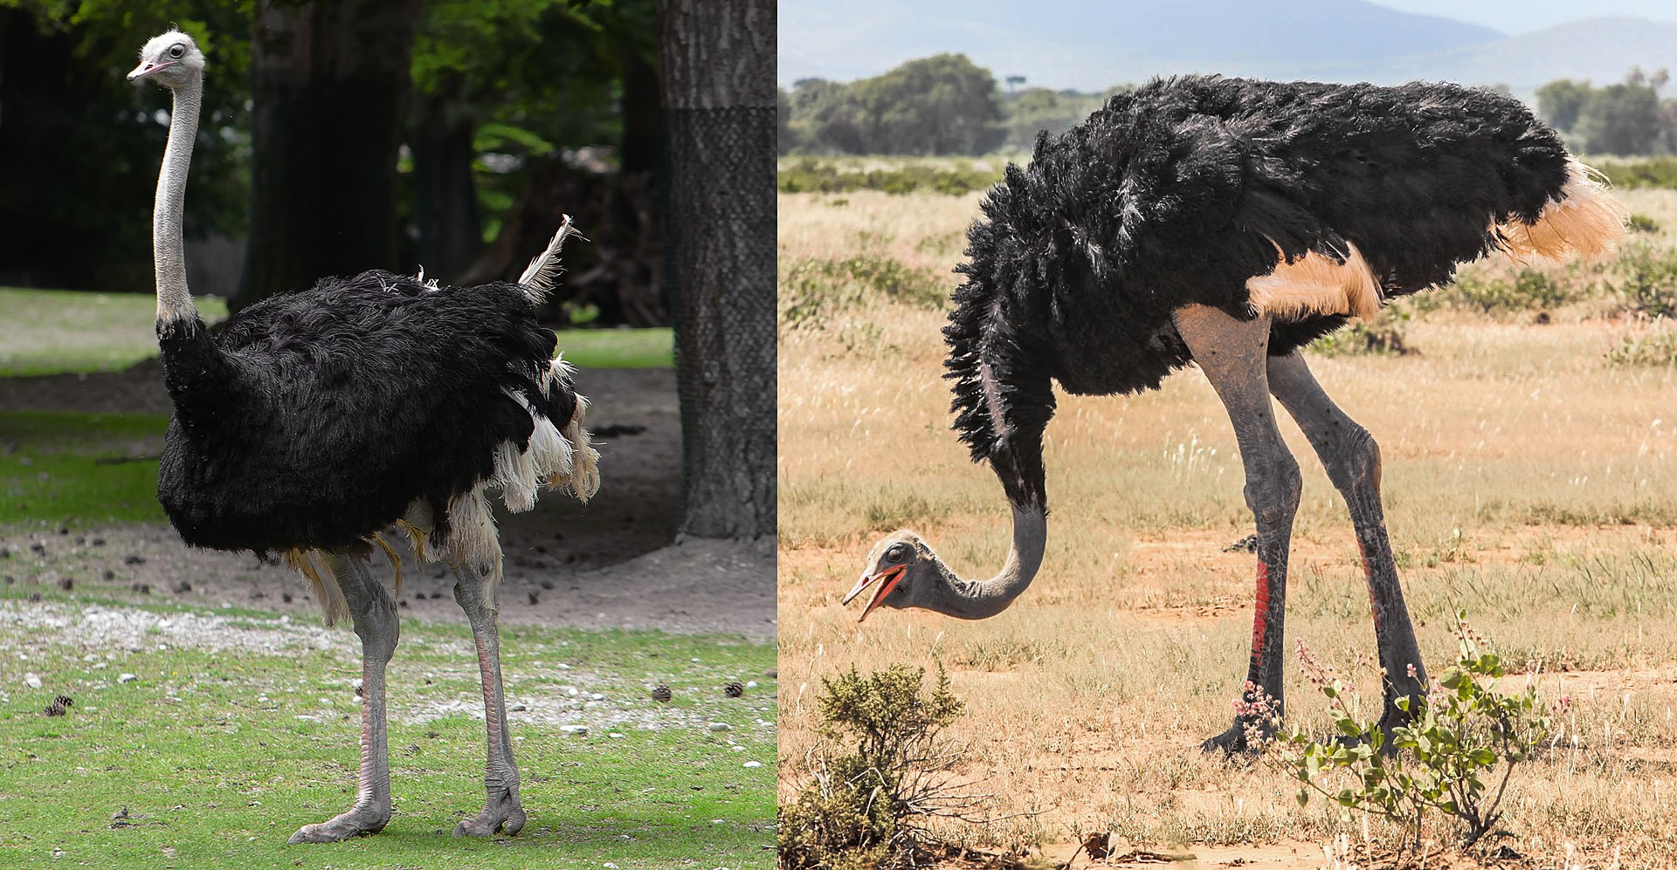

Slide 24
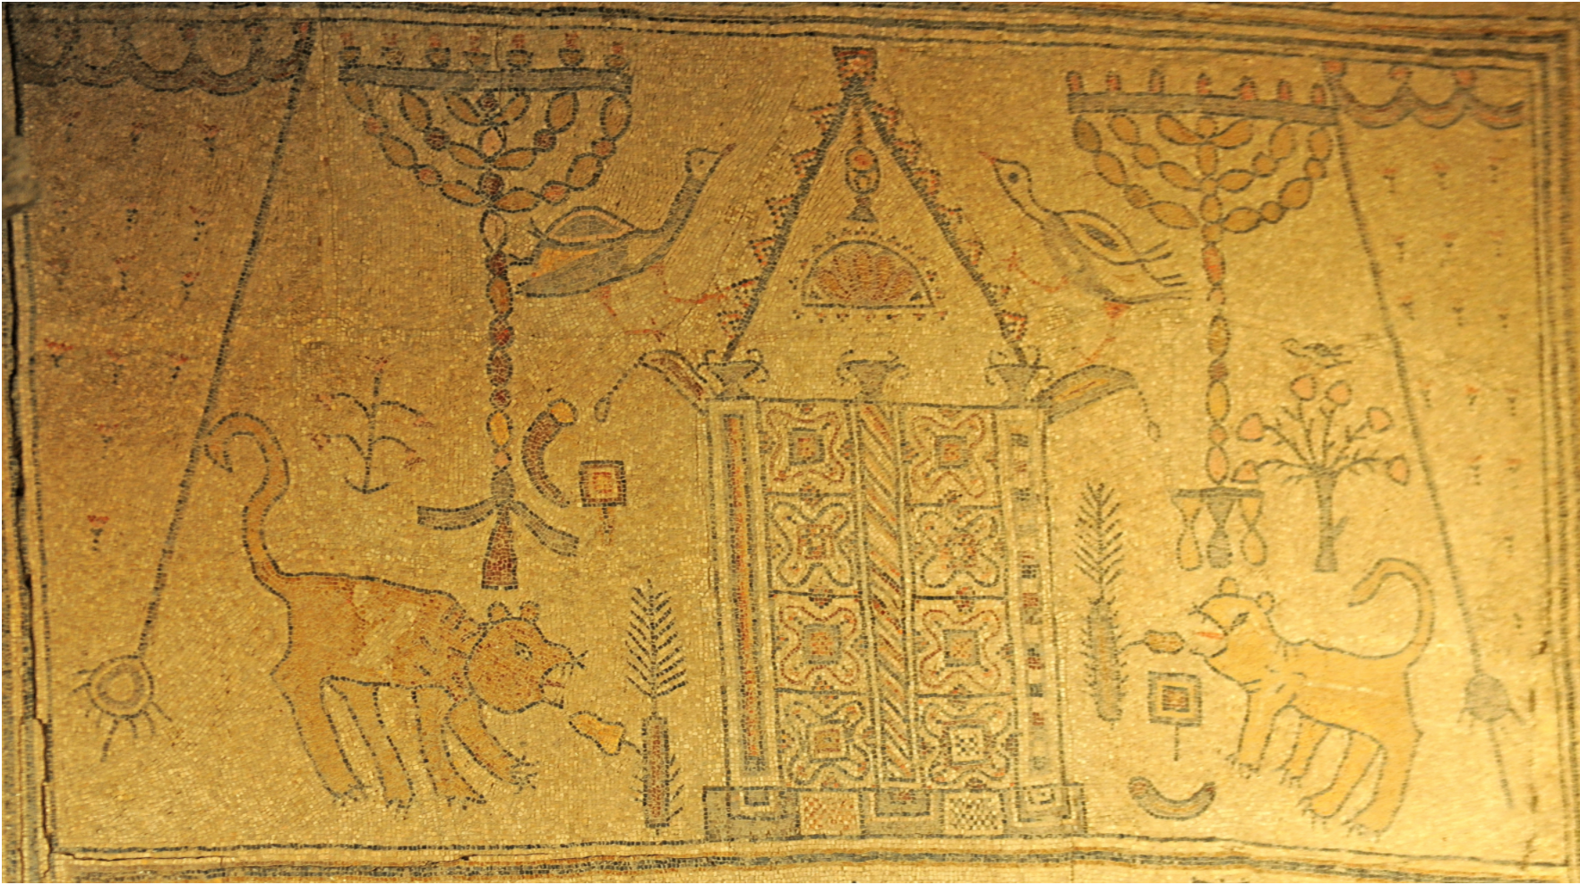

Slide 25
Eliezer Sukenik – ostrich
Professor Hachlili - peacock

Slide 26
Summary
Dove
kind, generous, peace loving, bearers of good news
Ravens
Selfish, cruel
Nesher
Majestic, regal, protective
Could be an eagle but more likely griffon vulture
Eagle associated with Ayit
Kenaf Renanim
Mythical Bar Yokhani
Crested Lark
Eurasian stone-curlew
Peacock
Ostrich

