Slide 1
Symbolism in Jewish Art Sun, Moon, & Stars
Rabbi Chaim Metzger
cmetzger@torontotorah.com

Slide 2
Ordering the Cosmos
Why would it be prohibited?
What is included in the prohibition?
What art can be made using the sun moon and stars? Are there any ways around it?

Slide 3
Second Commandment
Shemot 20:2-5
I the LORD am your God who brought you out of the land of Egypt, the house of bondage: You shall have no other gods besides Me. You shall not make for yourself a sculptured image, or any likeness of what is in the heavens above, or on the earth below, or in the waters under the earth. You shall not bow down to them or serve them. For I the LORD your God am an impassioned God, visiting the guilt of the parents upon the children, upon the third and upon the fourth generations of those who reject Me,
שמות פרשת יתרו פרק כ פסוק ב - ה
(ב - ג) אָֽנֹכִ֖י֙ יְקֹוָ֣ק אֱלֹהֶ֑֔יךָ אֲשֶׁ֧ר הוֹצֵאתִ֛יךָ מֵאֶ֥רֶץ מִצְרַ֖יִם מִבֵּ֣֥ית עֲבָדִֽ֑ים לֹֽ֣א יִהְיֶֽ֥ה־לְךָ֛֩ אֱלֹהִ֥֨ים אֲחֵרִ֖֜ים עַל־פָּנָֽ֗י:
(ד) לֹֽ֣א תַֽעֲשֶׂ֨ה־לְךָ֣֥ פֶ֣֨סֶל֙׀ וְכָל־תְּמוּנָ֡֔ה אֲשֶׁ֣֤ר בַּשָּׁמַ֣֨יִם֙׀ מִמַּ֡֔עַל וַֽאֲשֶׁ֥ר֩ בָּאָ֖֨רֶץ מִתָּ֑֜חַת וַאֲשֶׁ֣֥ר בַּמַּ֣֖יִם׀ מִתַּ֣֥חַת לָאָֽ֗רֶץ:
(ה) לֹֽא־תִשְׁתַּחֲוֶ֣֥ה לָהֶ֖ם֘ וְלֹ֣א תָעָבְדֵ֑ם֒ כִּ֣י אָֽנֹכִ֞י יְקֹוָ֤ק אֱלֹהֶ֙יךָ֙ אֵ֣ל קַנָּ֔א פֹּ֠קֵד עֲוֹ֨ן אָבֹ֧ת עַל־ בָּנִ֛ים עַל־שִׁלֵּשִׁ֥ים וְעַל־רִבֵּעִ֖ים לְשֹׂנְאָֽ֑י:

Slide 4
Shemot 20:19-20
The LORD said to Moses: Thus shall you say to the Israelites: You yourselves saw that I spoke to you from the very heavens: With Me, therefore, you shall not make any gods of silver, nor shall you make for yourselves any gods of gold.
וַיֹּ֤אמֶר יְקוָק֙ אֶל־מֹשֶׁ֔ה כֹּ֥ה תֹאמַ֖ר אֶל־בְּנֵ֣י יִשְׂרָאֵ֑ל אַתֶּ֣ם רְאִיתֶ֔ם כִּ֚י מִן־הַשָּׁמַ֔יִם דִּבַּ֖רְתִּי עִמָּכֶֽם׃ לֹ֥א תַעֲשׂ֖וּן אִתִּ֑י אֱלֹ֤הֵי כֶ֙סֶף֙ וֵאלֹהֵ֣י זָהָ֔ב לֹ֥א תַעֲשׂ֖וּ לָכֶֽם׃
שמות כ:יט-כ

Slide 5
Rabban Gamliel’s moons (Rosh HaShanah 24a-b)
MISHNA: Rabban Gamliel had a diagram of the different forms of the moon drawn on a tablet that hung on the wall of his attic, which he would show to the laymen who came to testify about the new moon but were unable to describe adequately what they had seen. And he would say to them: Did you see a form like this or like this?
GEMARA: The Gemara asks: And is it permitted to create these types of forms? Isn’t it written: “You shall not make with Me gods of silver, or gods of gold” (Exodus 20:19), which is interpreted as teaching: You shall not make images of My attendants, i.e., those celestial bodies that were created to serve God, including the sun and the moon?
מַתְנִי׳ דְּמוּת צוּרוֹת לְבָנָה הָיוּ לוֹ לְרַבָּן גַּמְלִיאֵל בְּטַבְלָא וּבְכוֹתֶל בַּעֲלִיָּיתוֹ שֶׁבָּהֶן מַרְאֶה אֶת הַהֶדְיוֹטוֹת וְאוֹמֵר הֲכָזֶה רָאִיתָ אוֹ כָּזֶה:
גְּמָ׳ וּמִי שְׁרֵי וְהָכְתִיב לֹא תַעֲשׂוּן אִתִּי לֹא תַּעֲשׂוּן כִּדְמוּת שַׁמָּשַׁיי

Slide 6
It’s a fake!
Abaye said: The Torah prohibited only the images of those attendants with regard to which it is possible to reproduce an item in their likeness. Since it is impossible for anyone to reproduce the sun and the moon, the prohibition does not apply to these objects. As it is taught in a baraita: A person may not construct a house in the exact form of the Sanctuary, nor a portico in the exact form of the Entrance Hall of the Sanctuary, nor a courtyard corresponding to the Temple courtyard, nor a table corresponding to the table in the Temple, nor a candelabrum corresponding to the candelabrum in the Temple. However, one may fashion a candelabrum of five or of six or of eight lamps. But one may not fashion a candelabrum with seven lamps even if he constructs it from other kinds of metal rather than gold, as in exigent circumstances the candelabrum in the Temple may be fashioned from other metals.
Rabbi Yosei bar Yehuda says: Also, one may not fashion a candelabrum of wood, in the manner that the kings of the Hasmonean monarchy fashioned it. When they first purified the Temple they had to prepare the candelabrum out of wood, as no other material was available. Since this candelabrum is fit for the Temple, it is prohibited to fashion one of this kind for oneself.
אָמַר אַבָּיֵי לָא אָסְרָה תּוֹרָה אֶלָּא שַׁמָּשִׁין שֶׁאֶפְשָׁר לַעֲשׂוֹת כְּמוֹתָן כִּדְתַנְיָא לֹא יַעֲשֶׂה אָדָם בַּיִת תַּבְנִית הֵיכָל אַכְסַדְרָה תַּבְנִית אוּלָם חָצֵר כְּנֶגֶד עֲזָרָה שֻׁלְחָן כְּנֶגֶד שֻׁלְחָן מְנוֹרָה כְּנֶגֶד מְנוֹרָה אֲבָל עוֹשֶׂה שֶׁל חֲמִשָּׁה וְשֶׁל שִׁשָּׁה וְשֶׁל שְׁמוֹנָה וְשֶׁל שִׁבְעָה לֹא יַעֲשֶׂה אֲפִילּוּ שֶׁל שְׁאָר מִינֵי מַתָּכוֹת רַבִּי יוֹסֵי בַּר יְהוּדָה אוֹמֵר אַף שֶׁל עֵץ לֹא יַעֲשֶׂה כְּדֶרֶךְ שֶׁעָשׂוּ מַלְכֵי בֵּית חַשְׁמוֹנַאי

Slide 7
The other Sages said to Rabbi Yosei bar Yehuda: From there you seek to bring a proof?
There the branches of the candelabrum were comprised of spits [shippudin] of iron and they covered them with tin. Later, when they grew richer and could afford a candelabrum of higher-quality material, they fashioned them from silver. When they grew even richer, they fashioned them from gold. Still, Abaye proves from this baraita that the prohibition against forming an image applies only to items that can be reconstructed in an accurate manner. Since this is not possible in the case of the moon, Rabban Gamliel’s forms were permitted.
אָמְרוּ לוֹ מִשָּׁם רְאָיָיה שַׁפּוּדִין שֶׁל בַּרְזֶל הָיוּ וְחִיפּוּם בְּבַעַץ הֶעֱשִׁירוּ עֲשָׂאוּם שֶׁל כֶּסֶף חָזְרוּ הֶעֱשִׁירוּ עֲשָׂאוּם שֶׁל זָהָב

Slide 8
Only all four faces of angels
The Gemara asks: And is it really permitted to form images of those attendants concerning which it is impossible to reproduce their likeness? Isn’t it taught in a baraita that the verse: “You shall not make with Me gods of silver” (Exodus 20:19), comes to teach: You shall not make images of My attendants that serve before Me on high. Apparently, this includes the sun and the moon.
Abaye said: This does not include the sun and the moon, as the Torah prohibited only the fashioning of an image of all four faces of the creatures of the Heavenly Chariot together (see Ezekiel, chapter 1). However, all other images, which are not the likeness of the ministering angels, are permitted.
וְשַׁמָּשִׁין שֶׁאִי אֶפְשָׁר לַעֲשׂוֹת כְּמוֹתָן מִי שְׁרֵי וְהָתַנְיָא לֹא תַעֲשׂוּן אִתִּי לֹא תַּעֲשׂוּן כִּדְמוּת שַׁמָּשַׁיי הַמְשַׁמְּשִׁין לְפָנַי בַּמָּרוֹם אָמַר אַבָּיֵי לֹא אָסְרָה תּוֹרָה אֶלָּא דְּמוּת אַרְבָּעָה פָּנִים בַּהֲדֵי הֲדָדֵי

Slide 9
Don’t make a man
The Gemara raises a difficulty: However, if that is so, let the fashioning of an image of a human face [partzuf ] alone be permitted. Why, then, is it taught in a baraita: All faces are permitted for ornamental purposes, except for the face of a person?
Rav Huna, son of Rav Idi, said: From a lecture of Abaye I heard that there is a different reason why one may not form an image of a human face, as the verse states: “You shall not make with Me [iti]” (Exodus 20:19). This can be read as: You shall not make Me [oti]. Since man is created in the image of God, it is prohibited to form an image of a human being.
אֶלָּא מֵעַתָּה פַּרְצוּף אָדָם לְחוֹדֵיהּ תִּשְׁתְּרֵי אַלְּמָה תַּנְיָא כׇּל הַפַּרְצוּפוֹת מוּתָּרִין חוּץ מִפַּרְצוּף אָדָם אָמַר רַב הוּנָא בְּרֵיהּ דְּרַב אִידִי מִפִּרְקֵיהּ דְּאַבָּיֵי שְׁמִיעָא לִי לֹא תַעֲשׂוּן אִתִּי לֹא תַּעֲשׂוּן אוֹתִי

Slide 10
No Angels
The Gemara asks: And is it permitted to form images of other attendants?
Isn’t it taught in another baraita that the verse: “You shall not make with Me gods of silver” (Exodus 20:19), teaches that you shall not make images of My attendants that serve before Me on high, for example, ofanim and seraphim and the sacred ḥayyot and the ministering angels.
Abaye said: The Torah prohibited only those attendants that are found in the upper Heaven, i.e., the supreme angels in the highest firmament, but not the celestial bodies, e.g., the sun and the moon, despite the fact that they too are located in heaven.
וּשְׁאָר שַׁמָּשִׁין מִי שְׁרֵי וְהָא תַּנְיָא לֹא תַעֲשׂוּן אִתִּי לֹא תַּעֲשׂוּן כִּדְמוּת שַׁמָּשַׁיי הַמְּשַׁמְּשִׁין לְפָנַי בַּמָּרוֹם כְּגוֹן אוֹפַנִּים וּשְׂרָפִים וְחַיּוֹת הַקּוֹדֶשׁ וּמַלְאֲכֵי הַשָּׁרֵת אָמַר אַבָּיֵי לֹא אָסְרָה תּוֹרָה אֶלָּא שַׁמָּשִׁין שֶׁבַּמָּדוֹר הָעֶלְיוֹן

Slide 11
Only an issue to worship angel, not make them
The Gemara raises another difficulty: And is it permitted to form images of those bodies found in the lower heaven?
Isn’t it taught in a baraita: “You shall not make for yourself any graven image, nor any manner of likeness, of anything that is in heaven above, or that is in the earth beneath, or that is in the water under the earth” (Exodus 20:3). The phrase “that is in heaven” comes to include the sun, the moon, the stars, and the constellations. The term “above” serves to include the ministering angels. Apparently, it is prohibited to form an image even of the celestial bodies found in the lower Heaven.
The Gemara answers: When that baraita is taught, it is in reference to the prohibition against worshipping them. However, there is no prohibition against forming an image in their likeness.
וְשֶׁבַּמָּדוֹר הַתַּחְתּוֹן מִי שְׁרֵי וְהָתַנְיָא אֲשֶׁר בַּשָּׁמַיִם לְרַבּוֹת חַמָּה וּלְבָנָה כּוֹכָבִים וּמַזָּלוֹת מִמַּעַל לְרַבּוֹת מַלְאֲכֵי הַשָּׁרֵת כִּי תַּנְיָא הָהִיא לְעׇבְדָם

Slide 12
Idol worship
The Gemara asks: If that baraita is referring to the prohibition against worshipping them, then even a tiny worm should also be prohibited.
The Gemara answers: Yes, it is indeed so, as it is taught in the same baraita with regard to the continuation of the verse, “in the earth” comes to include mountains and hills, seas and rivers, streams and valleys; “beneath” comes to include a tiny worm. If so, it is indeed possible to explain that the entire baraita is referring to the prohibition against idol worship.
אִי לְעׇבְדָם אֲפִילּוּ שִׁלְשׁוּל קָטָן נָמֵי אִין הָכִי נָמֵי דְּתַנְיָא אֲשֶׁר בָּאָרֶץ לְרַבּוֹת הָרִים וּגְבָעוֹת יַמִּים וּנְהָרוֹת אֲפִיקִים וְגֵאָיוֹת מִתַּחַת לְרַבּוֹת שִׁלְשׁוּל קָטָן

Slide 13
Abaye is out
The Gemara raises yet another objection: And is the mere fashioning of images of the celestial bodies permitted?
Isn’t it taught in another baraita: “You shall not make with Me gods of silver” (Exodus 20:19). This verse teaches that you shall not make images of My attendants that serve before Me, for example the sun, the moon, the stars and the constellations. This is explicit proof that it is prohibited to form images of the sun and the moon; consequently, the solution proposed by Abaye is rejected, leaving the difficulty with Rabban Gamliel’s diagram unresolved.
וַעֲשִׂיָּיה גְּרֵידְתָּא מִי שְׁרֵי וְהָתַנְיָא לֹא תַעֲשׂוּן אִתִּי לֹא תַּעֲשׂוּן כִּדְמוּת שַׁמָּשַׁיי הַמְשַׁמְּשִׁין לְפָנַי כְּגוֹן חַמָּה וּלְבָנָה כּוֹכָבִים וּמַזָּלוֹת

Slide 14
Gentiles did it
The Gemara proposes an alternative resolution: The case of Rabban Gamliel is different, as others, i.e., gentiles, fashioned those images for him, and it is prohibited only for a Jew to fashion such images; there is no prohibition against having them in one’s possession. The Gemara raises a difficulty: But there is the case of Rav Yehuda, as others fashioned for him a seal in the form of a human being, and Shmuel said to Rav Yehuda, who was his student: Sharp-witted one, blind this one’s eyes, i.e., disfigure the image, as it is prohibited even to have the image of a human being in one’s possession.
שָׁאנֵי רַבָּן גַּמְלִיאֵל דַּאֲחֵרִים עָשׂוּ לוֹ וְהָא רַב יְהוּדָה דַּאֲחֵרִים עָשׂוּ לוֹ וַאֲמַר לֵיהּ שְׁמוּאֵל לְרַב יְהוּדָה שִׁינָּנָא סַמִּי עֵינֵיהּ דְּדֵין

Slide 15
Protruding Problem
The Gemara answers: There, in the case of Rav Yehuda, his was a protruding seal, i.e., the image projected from the ring, and Shmuel prohibited it due to the potential suspicion that he had an object of idol worship in his hand. As it is taught in a baraita: With regard to a ring, if its seal protrudes it is prohibited to place it on one’s finger, due to the suspicion of idol worship, but it is permitted to seal objects with it. In this case, the act of sealing creates an image that is sunken below the surface, which is not prohibited. However, if its seal is sunken, it is permitted to place it on one’s finger, but it is prohibited to seal objects with it, as that creates a protruding image.
הָתָם חוֹתָמוֹ בּוֹלֵט הֲוָה וּמִשּׁוּם חֲשָׁדָא כִּדְתַנְיָא טַבַּעַת חוֹתָמוֹ בּוֹלֵט אָסוּר לְהַנִּיחָהּ וּמוּתָּר לַחְתּוֹם בָּהּ חוֹתָמוֹ שׁוֹקֵעַ מוּתָּר לְהַנִּיחָהּ וְאָסוּר לַחְתּוֹם בָּהּ

Slide 16
Suspicions vs Large Crowds
The Gemara asks: And are we concerned about arousing suspicion in a case of this kind?
But what about that certain synagogue that had been destroyed in Eretz Yisrael and its stones were relocated and it was rebuilt so that it sat in Neharde’a, and there was a statue [andarta] of the king in it. And nevertheless Rav and Shmuel and Shmuel’s father and Levi would all enter and pray there and they were not concerned about arousing suspicion.
The Gemara answers: When many Jews are present it is different, as a large group is not suspected of having idolatrous intentions. Rather, it is assumed that the statue is there exclusively for purposes of ornamentation.
וּמִי חָיְישִׁינַן לַחֲשָׁדָא וְהָא הָהִיא בֵּי כְנִישְׁתָּא דְּשַׁף וִיתֵיב בִּנְהַרְדְּעָא דַּהֲוָה בֵּיהּ אִנְדְּרָטָא וַהֲווֹ עָיְילִי רַב וּשְׁמוּאֵל וַאֲבוּהּ דִּשְׁמוּאֵל וְלֵוִי וּמְצַלּוּ הָתָם וְלָא חָיְישִׁי לַחֲשָׁדָא רַבִּים שָׁאנֵי

Slide 17
Incomplete Image
The Gemara asks: But isn’t Rabban Gamliel an individual? According to this reasoning, his images of the moon should have been prohibited, as they would have aroused suspicion. The Gemara answers: Since he is the Nasi, the head of the Great Sanhedrin, many people were always found with him, and therefore there was no room for suspicion. The Gemara suggests an alternative answer: If you wish, say that these images were not whole; rather, they were formed from pieces of images that had to be put together. Only complete images are prohibited.
וְהָא רַבָּן גַּמְלִיאֵל יָחִיד הוּא כֵּיוָן דְּנָשִׂיא הוּא שְׁכִיחִי רַבִּים גַּבֵּיהּ אִיבָּעֵית אֵימָא דִּפְרָקִים הֲוָה

Slide 18
Educational Purposes
The Gemara suggests yet another answer: If you wish, say: Rabban Gamliel did this to teach himself, which is not prohibited, as it is written: “You shall not learn to do after the abominations of those nations” (Deuteronomy 18:9), which indicates: However, you may learn to understand and to teach. In other words, it is permitted to do certain things for the sake of Torah study which would otherwise be prohibited.
וְאִיבָּעֵית אֵימָא לְהִתְלַמֵּד עֲבַד וּכְתִיב לֹא תִּלְמַד לַעֲשׂוֹת אֲבָל אַתָּה לָמֵד לְהָבִין וּלְהוֹרוֹת

Slide 19
Summary of Solutions for Rabban Gamliel
Abaye – forbidden only if accurate reproduction is possible, depends which celestial bodies
But rejected
Non-Jew Made it
Protruding is a problem
Large public place with people mitigate idolatry suspicions
Incomplete image
Instructional purposes

Slide 20
How about 2-dimensional?
It is likewise forbidden to sketch the image of the sun, of the moon, of the stars, of the planets, and of angels; for, it is said: "Ye shall not make with me", that is to say: ye shall not make images like unto My ministers, who minister before Me Above, not even upon a tablet.
Rambam, Mishneh Torah, Foreign Worship and Customs of the Nations, 3:11 Trans. Simon Glazer
וְכֵן אָסוּר לָצוּר דְּמוּת חַמָּה וּלְבָנָה כּוֹכָבִים מַזָּלוֹת וּמַלְאָכִים שֶׁנֶּאֱמַר (שמות כ כ) "לֹא תַעֲשׂוּן אִתִּי" (גמרא ראש השנה כד ב) "לֹא תַעֲשׂוּן כִּדְמוּת שְׁמָשַׁי הַמְשַׁמְּשִׁין לְפָנַי בַּמָּרוֹם" וַאֲפִלּוּ עַל הַלּוּחַ.

Slide 21
Why are they different?
Tosafot Avodah Zarah 43b
Why is what Rabban Gamliel made prohibited if it wasn’t protruding?
R’ Yitzchak, Rabbeinu Tam, Riv”a (R’ Yitzchak ben Asher) explain that for the sun, moon, and stars there is no difference in the sunken way we perceive them in the heavens versus on cloth, unlike other faces and the like.
תוספות מסכת עבודה זרה דף מג:
והא ר"ג יחיד הוה - וא"ת אמאי לא משני דצורת לבנה לא היתה בולטת ולכך עשאה ר"ג? ואור"י ור"ת וריב"א כי בחמה ולבנה ומזלות אין חילוק בין בולטין לשוקעין וכן ברקיע שוקעין הם ולא מפליג בהכי אלא גבי פרצופין וכיוצא בהן.

Slide 22
Partial Images
Rabbeinu Asher – Rosh Hashana 3:5
bePrakim – it was a partial image and only a complete image is a problem.
Rav Eliezer Waldenburg (20th century)
Just a circle won’t violate the prohibition, rather you need sparks or rays coming out of it in a way that everyone who sees it know it is the sun
רא"ש - אִיבָּעֵית אֵימָא דִּפְרָקִים הֲוָה – ואין איסור אלא דמות שלם
שו"ת ציץ אליעזר חלק ט סימן מד
דאין ספק אצלו דבעיגול וזולת זה אין לו שום תמונת חמה לא מבפנים ולא מן העיגול ולחוץ, דזה לא מקרי צורת או דמות החמה, אלא צריך או מבפנים או מבחוץ שיהיה ניכר לכל למראה חמה, דהיינו שיהיו ניצוצות בולטים סביבות העיגול כניצוץ חמה בזריחתה דצריך שיהא ניכר לכל למראה חמה,

Slide 23
Can Kids draw sun moon and stars?
R’ Moshe Feinstein Igrot Moshe 5: 9
Regarding children doing art with ink and colors if they can make a sun or moon. If it really looks like the moon or sun, that adults recognize it as such, it is prohibited when they reach “Gil Chinuch,” age when you educate them (8 or 9), … and even if it is only prohibited when it truly looks a sun. but for this very reason it isn’t a good idea to teach children to draw the sun and moon, as they want to make them as good as possible, which is prohibited. Why teach them when once they can draw well it will be prohibited.
שו"ת אגרות משה אורח חיים חלק ה סימן ט
בדבר התינוקות שמציירין בדיו ובצבע צורת לבנה וחמה. אם יש ממש דמיון להלבנה ולחמה, שאנשים גדולים יאמרו שהוא צורת חמה ולבנה, יש לאוסרם לאלו שבאו לחינוך. ... והוא כמו שהביא כתר"ה מספר יד הקטנה, דרק אם בעיני הבריות דומה לחמה אסור. אבל בשביל זה לא טוב ללמד לתינוקות לעשות ציורי חמה ולבנה, דרוצים שילמדו ברוב זמן לעשות ציורים הדומות ממש, שזה הא הוא דבר אסור. ולמה לנו ללמדם, כיוון שכשיוכלו לצייר היטב נאסור להם.

Slide 24
Educationally what should you do?
Rav Shemuel HaLevi Vosner (1914-2015)
Can you draw a sun, moon, stars by Parshat Breishit to teach the creation of the world? Is this considered in order teach teach as explained in the Shulchan Aruch, and permitted? Or is it not? What about drawing Yosef’s dream in Parshat Vayeshev? Is that part of teaching?
Answer: the Shach (Siftei Cohen) permits even drawing the 12 Mazalot (Constellations) in order to understand and teach, even more so to teach in our case.
שו"ת שבט הלוי חלק ז סימן קלד
שאלה: ח. האם מותר לצייר שמש וירח וכוכבים בפרשת בראשית כשלומדים עניני בריאת העולם האם זה נחשב להתלמד שמבואר בשו"ע (שם) שמותר או לא, וכן מציירין חלום יוסף בפרשת וישב, האם זהו בכלל להתלמד.
תשובה: הרי הש"ך בנקודת הכסף התיר אפילו ציורים של י"ב מזלות מטעם להבין ולהורות ומכ"ש להתלמד כענינינו.

Slide 25
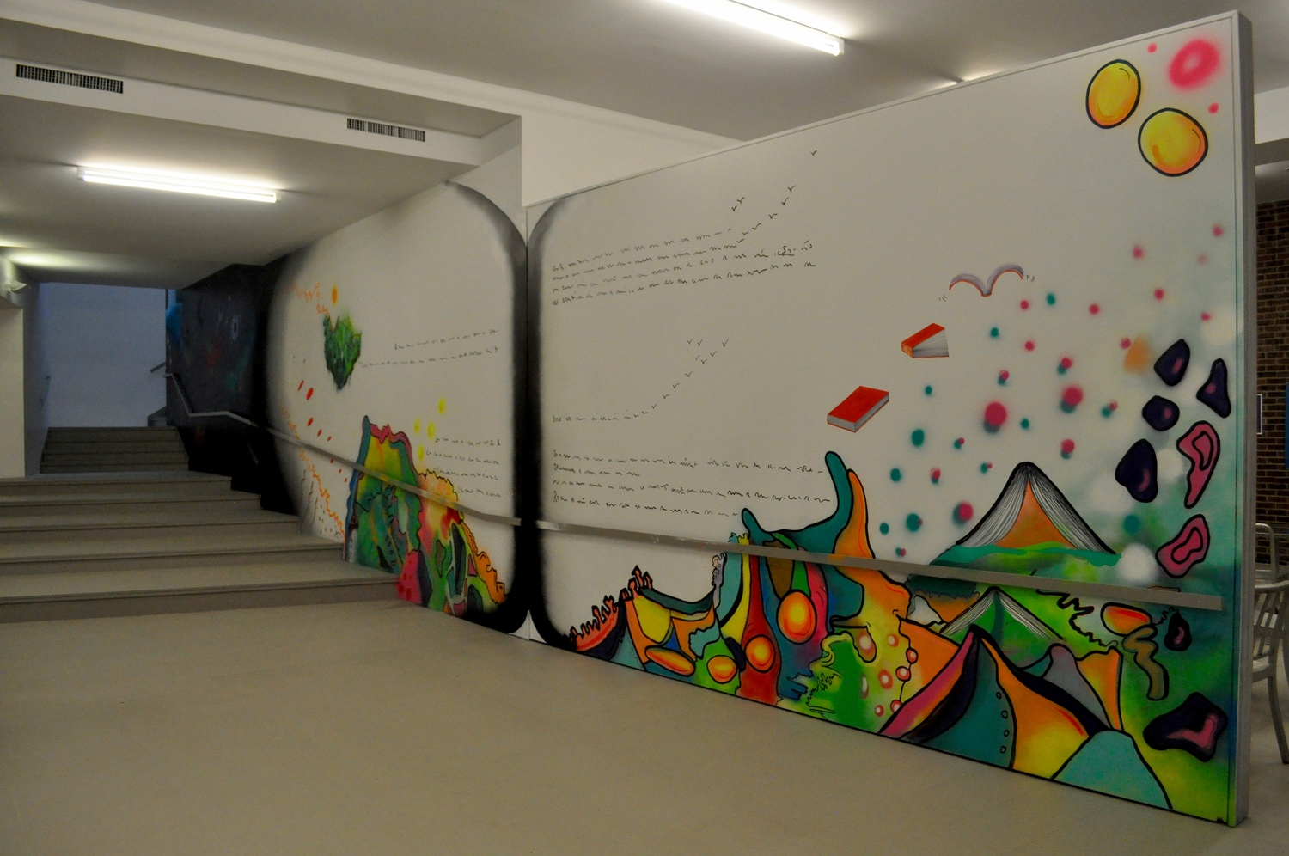

Slide 26
YU Library Mural
Mural For Yeshiva University Library, NYC
Upper West Side, Manhattan, 2016. A swing wall that opens like a book. An abstract surreal landscape with imagined words and books that turn into birds. A floating land above the bright landscape. A parallel universe that stretches up and around the stairs.
Connie Rose

Slide 27
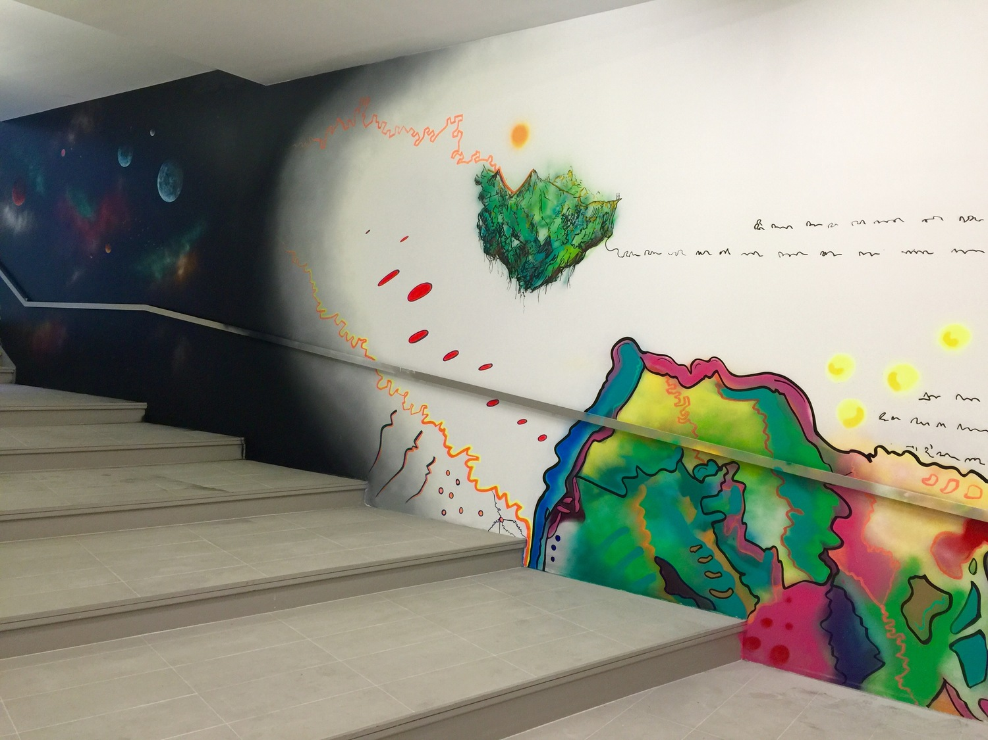

Slide 28
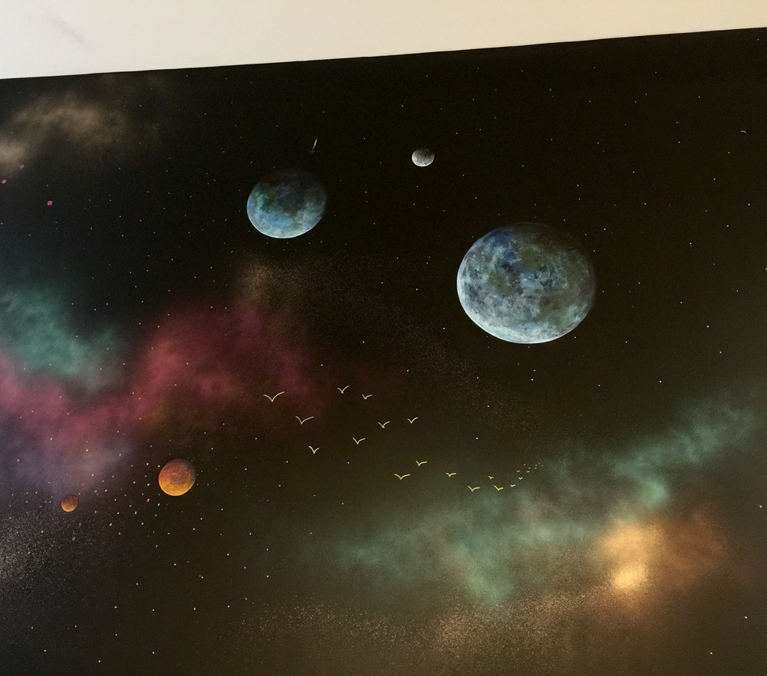

Slide 30
Summary
There is a biblical prohibition to make images of sun moon and stars
Rabban Gamliel had moon diagrams
Non-Jew Made it
Protruding is a problem
Large public place with people mitigate idolatry suspicions
Incomplete image
Instructional purposes
Practically what should you do?
Don’t make 3-d sculptures
Partial or bad drawing may be ok
Can draw for educational purposes, but problematic to be used in for art displays

