Slide 1
Ebola Ethics: A Jew at the WHO Barry Pakes MD MPH FRCPC CCFP DTMH PhD

Slide 3
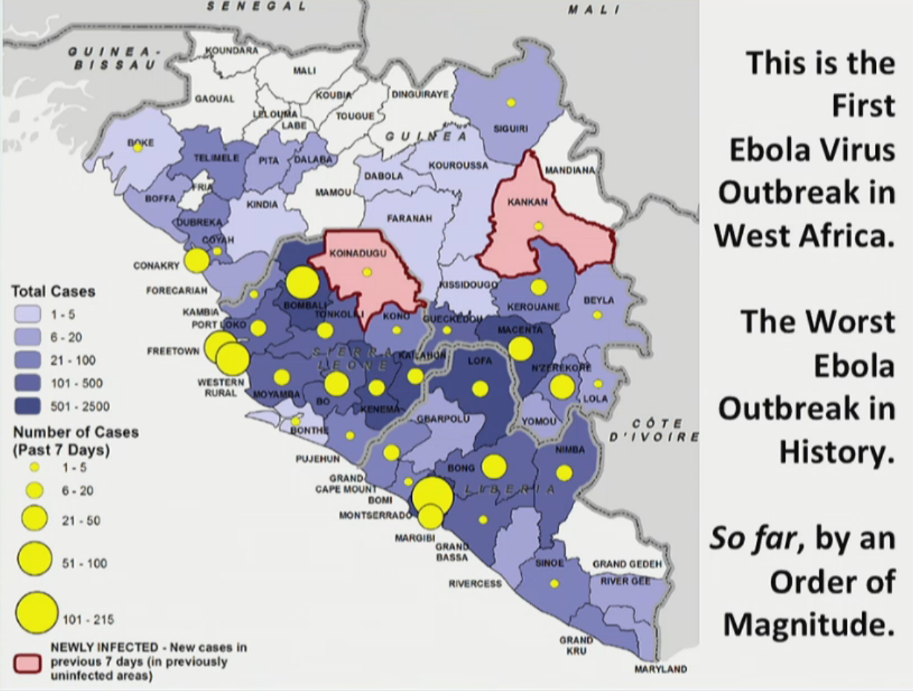

Slide 4
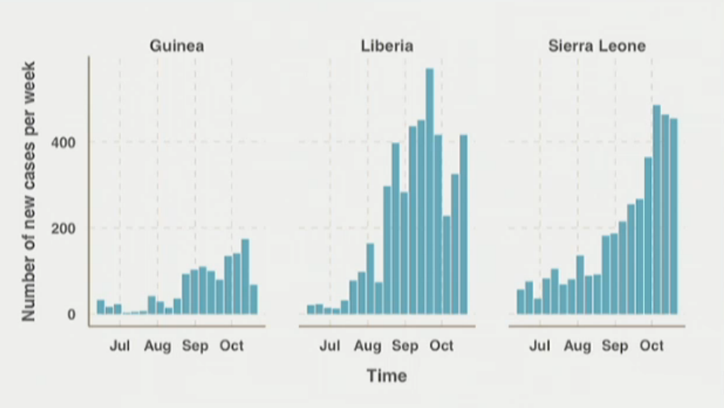
400 dead health care workers
Many were leading physician experts and international scholars
~2/3 of Liberia’s country doctors have died.
Untreated Mortality 70-90%

Slide 5
Notes:
Ebola unit – family member goes in, no contact whatsoever with anyone…comes out 1 week later in opaque body bag – that’s ideal.

Slide 6
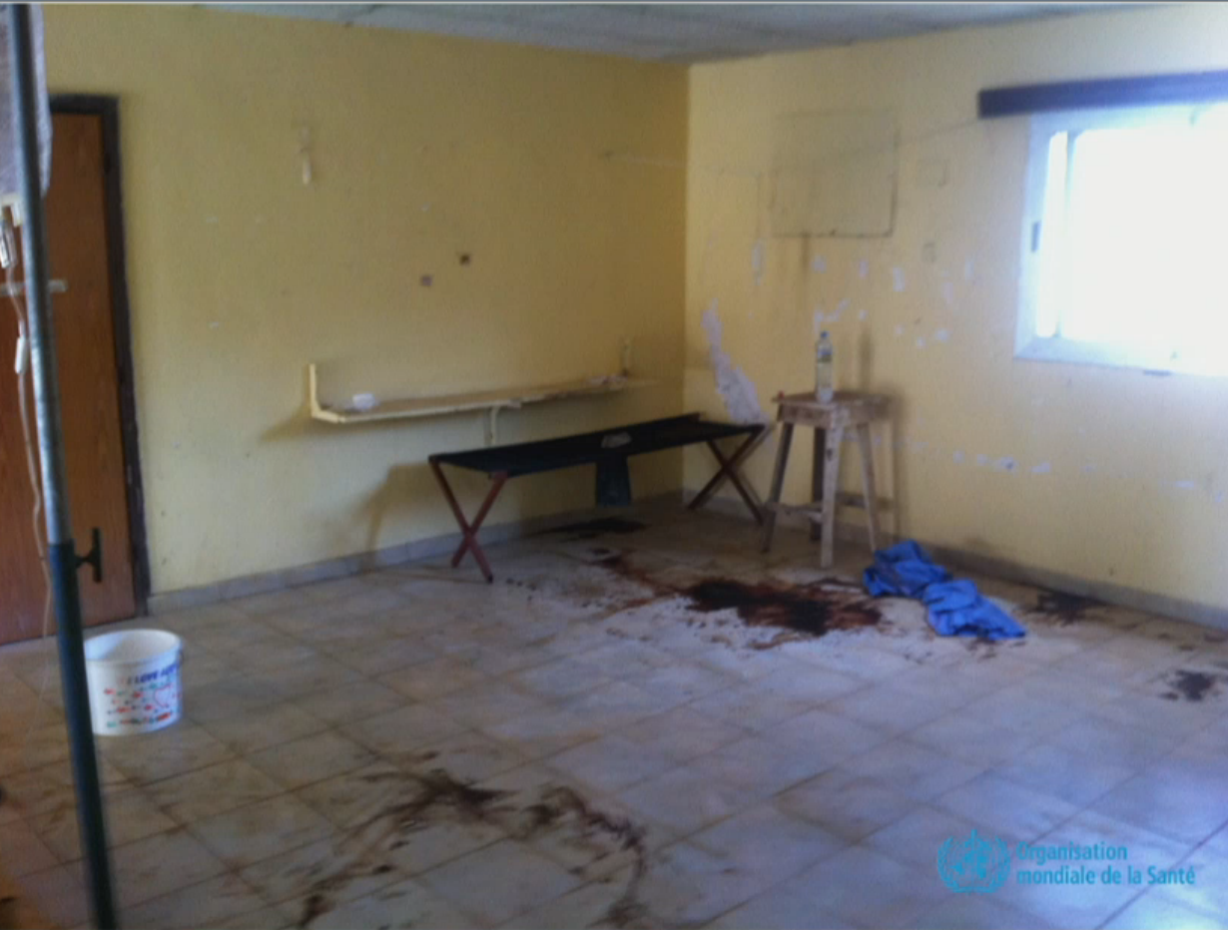

Slide 7
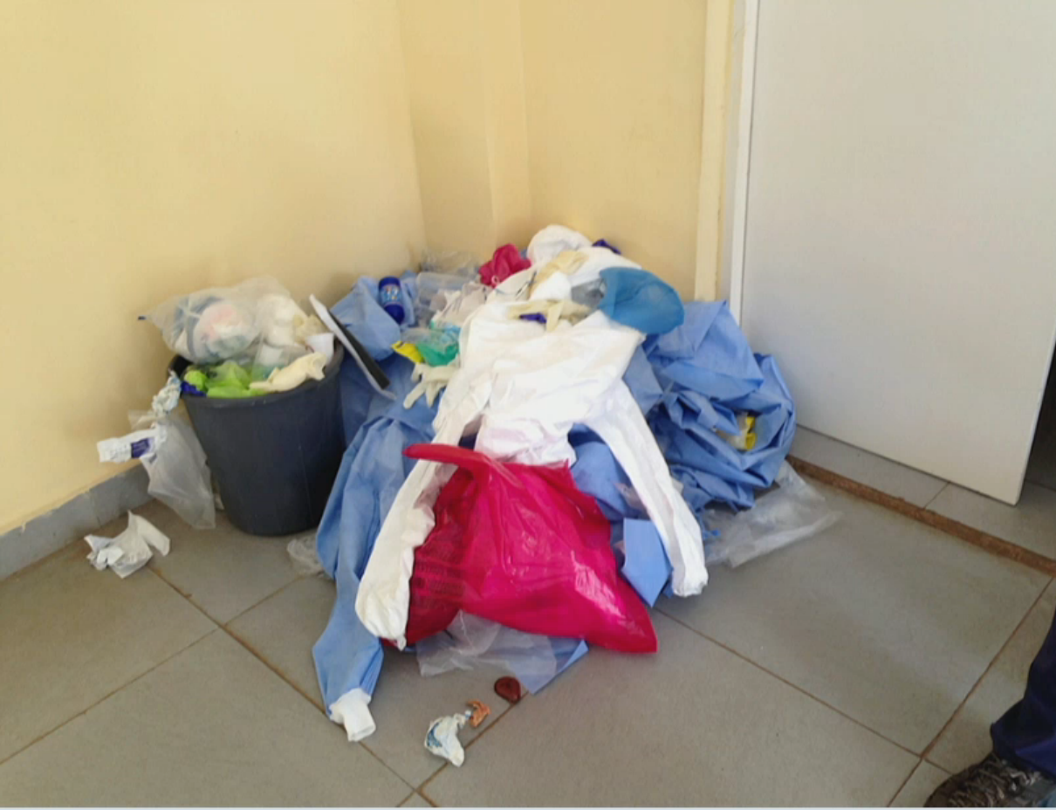

Slide 8
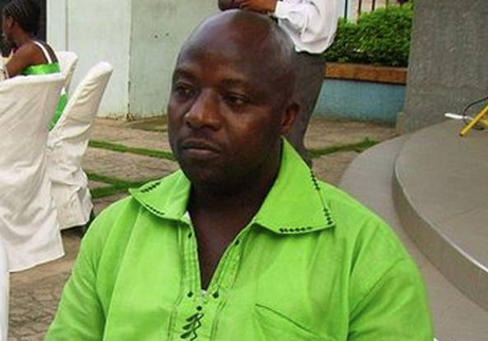
Ebola thrives only in dysfunctional or non-existent health systems.
Ebola has killed 1 of 9 infected in the US.
Thomas Eric Duncan
Notes:
Black man without insurance, presented…d/c with tylenol Abx as is done with black men without insurance.

Slide 9
Why care?
On its way here?
Based on infection rates and travel volume, we estimate that an Ebola virus–infected international traveler would depart from Guinea every 2.7 months, from Liberia every 0.2 months, and from Sierra Leone every 0.6 months.
Our Ethical problem!
Consumption of bushmeat caused by…
Massive PPE purchases in North America/Europe are making it impossible for West Africa to get supplies.
“In Public Health, if you’re not saving more lives in a week than a clinical physician saves in a lifetime, you’re not doing your job.”
- D. Sawyer
How to respond?

Slide 10
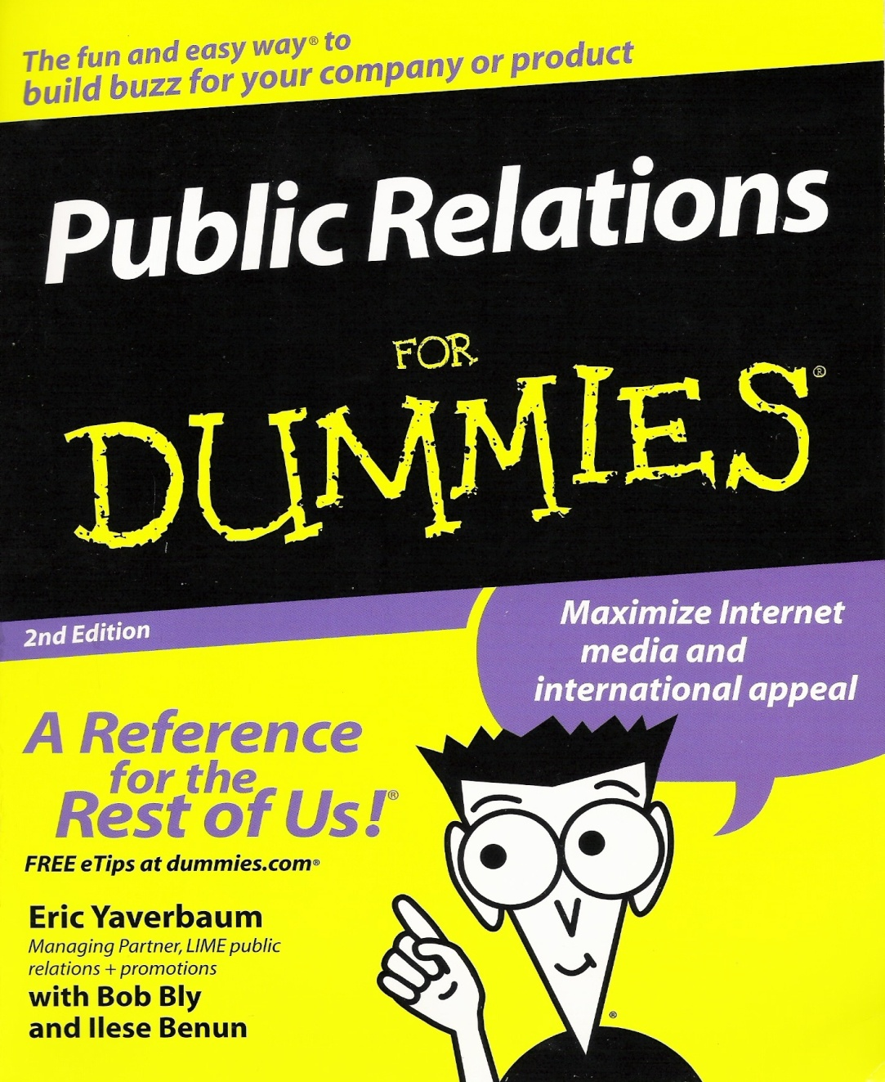
Essential knowledge for any
global citizen
Global Health
Ethics
Impress your friends
by solving the Ebola crisis in West Africa
A Reference
for all
Global Health Practitioners!
Barry Pakes
MD MPH FRCPC PhD
World Renowned Public Health Expert

Slide 11
Notes:
Why does it scare us – simpler than history, collective memory, media scares…you can not eat certain things and protect from foodborne, you can protect from mosquitos, eat right, not have unprotected sex..but everyone breathes and now they breath fear.
During the 2008 annual General Session of the Office International des Epizooties (OIE) in Paris, 25-30 May 2008, the head of the Organisation's Animal Health Information Department, Dr Karim Ben Jebara, presented the traditional annual report addressing the evolution of the most prominent transboundary animal diseases since the beginning of the previous year.
This epizootic of HPAI subtype H5N1 is unprecedented since there are no records of an epizootic having lasted so long a time and having covered such a wide geographical area in such a short period of time.
Between 2003 and early 2008, a total of 61 countries/territories reported
the occurrence of highly pathogenic avian influenza (HPAI) virus subtype H5N1.
Some historical background information on this disease: in late 2003 and in
2004 the disease was restricted to South East Asia and in 2005 spread to
Central Asia, Russia, and Eastern Europe. In 2006, it reached the African
continent and the Middle East for the first time and spread to Western
Europe, where mainly wild birds were infected. In 2006, a total of 47
countries/territories notified the OIE of the presence of the disease.
In 2008 (up to the end of May), 12 countries/territories had notified the
reoccurrence of HPAI H5N1 following its previous eradication, thus
indicating that the virus is continuing to circulate.

Slide 12
Pandemic Ethics @WHO:
1 - Prioritization of vaccines, anti-virals and medical care.
2 - Legitimate use of public health measures.
3 - Role and obligations of health care workers.
4 - Research, licensing, use and ownership of biologicals, novel therapeutic and prophylactic measures.
5 -Transnational issues…
Notes:
Should treatments be used if they have not undergone safety testing?
* How should treatment recipients be prioritized?
Dr. Pakes speaks to these two issues; Rabbi Torczyner responds from a Jewish perspective.
2. Rabbi Cheses presents two local ethical questions:
* Is a physician or nurse obligated to treat an Ebola patient?
* Should government have the right to impose mandatory quarantines?

Slide 13
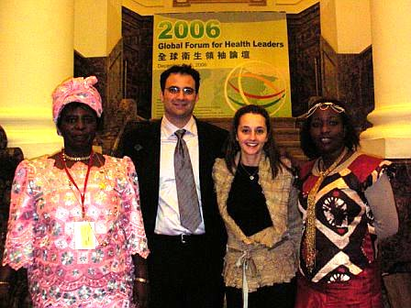
Pandemic Ethics: Fundamental Issues
How can we justify devoting scarce resources to a potential pandemic?
Notes:
Already a pandemic – several actually…malaria, HIV, tuberculosis, diarheal diseases still kill more people in Ebola areas. But CV mortality, diabetes, strokes and cancer are bigger killers now also.

Slide 14
Pandemic Ethics: Fundamental Issues
How can we justify devoting scarce resources to a potential pandemic?
What are our priorities (and how do we set them):
Decreasing morbidity and mortality.
Minimizing social disruption.
Restricting area affected.
What are justifiable rationing strategies?
Social utility, need, ability to pay, previous injustice.
Who should be making these decisions?
Politicians, scientists, the public.
Based on what values: principles, processes or outcomes?
‘All of the above’ is not an option!

Slide 15
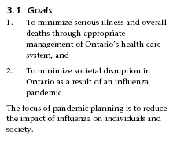

Slide 16
Decision Making in Global Health
Ethical Analysis in Global Health
KNOWLEDGE
JUDGEMENT
OUTCOME
FACT
Perception
Bias
Experience
EVIDECE
Values
Logic
Experience
Intelligence
Education
Beliefs
ETHICS
Imagination
Action
DECISIONS
Behaviour
CRITICAL THINKING
Awareness

Slide 17
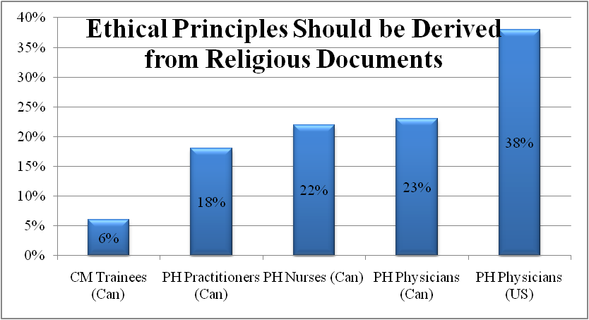
International
PERCENT who AGREE
or STRONGLY AGREE

Slide 18
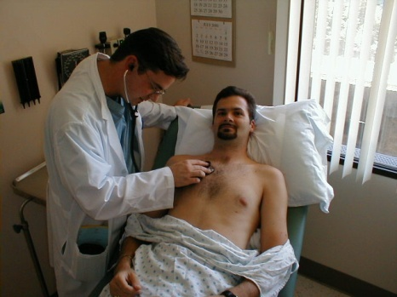
The Context of Most Issues
Global Health Ethics
Public Health Ethics
Institutional
Ethics
Clinical Ethics
?
Research Ethics

Slide 19
Public Health Analytical Reasoning Tool
An Integrated Approach for Ethics in Public Health Practice
© Barry N. Pakes MD MPH FRCP(C) PhD
PHART

Slide 20
Global Health Ethical Reflection Matrix
An Integrated Approach to Ethical Decision-Making in Public Health Practice
© Barry N. Pakes MD MPH FRCPC PhD (c)
VALUES
PROXIMITY
4
DECISION MAKER
8
PRINCIPLES
LOCAL
PROCESSES
REGIONAL
OUTCOMES
GLOBAL
TIME
FRAME
1
DUTY CONTEXT
5
7
MORAL LOCUS
IMMEDIATE
INDIVIDUALS
SHORT-TERM
INSTITUTIONS
LONG-TERM
6
POPULATIONS
STAKEHOLDERS
TARGET
FUNDER
IMPLEMENTER
EVIDENCE
CERTAINTY
CONSENSUS
CONJECTURE
AGENTS
2
3
ACTIONS
CONSEQUENCES
Innovative
Alternatives
Opportunity Costs
Undesirable Consequences
9
10
11

Slide 21
Who decides?
Medical Officer of Health?
Expert group?
Ethicists? (Rabbis/Imam/Priest)
The Mayor?
The people? (a subset of ‘the people’)
A third party?

Slide 22
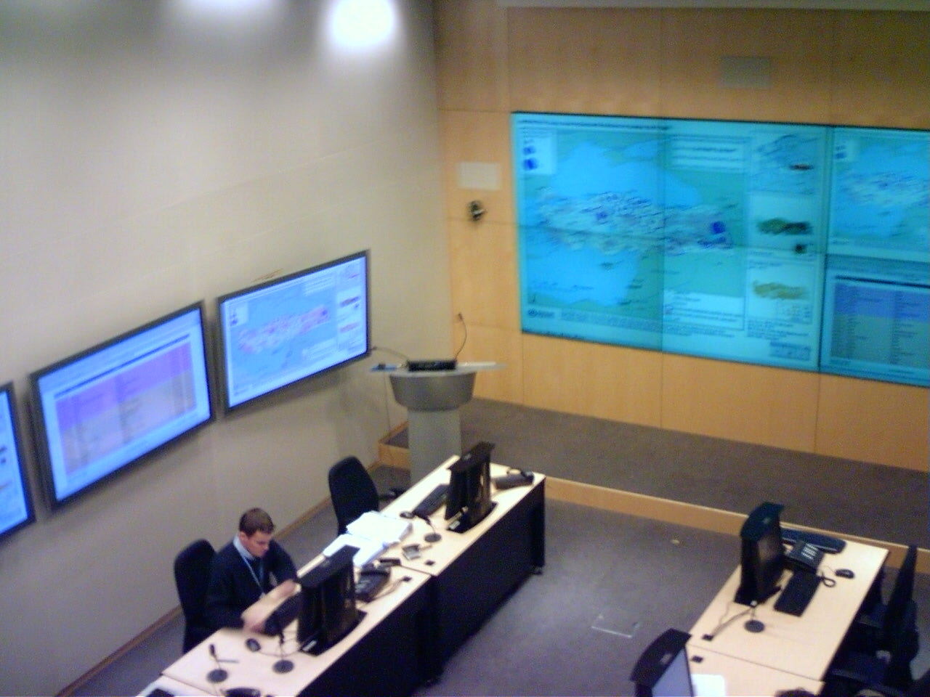
SHOC Room
WHO decides?

Slide 23
Who gets vaccine, anti-virals, PPE?
Traditional Priority Setting…
Titanic is sinking…who do you save?
In theory: Women and Children:
Kids - Maximizing PYLL
Women - Maximizing number of people on earth
Both – Fundamentally vulnerable
In practice: Priviledged
Males, rich, politically powerful

Slide 24
Panflu vaccine ranking
Answer Options | 1-2 (Highest Priority) | 3 to 5 | 6-7 (Lowest Priority)
To those who are most AT RISK OF DYING from influenza complications. (eg: pregnant, comorbidities, elderly) | 81% | 19% | 0%
To those who are most ESSENTIAL IN COMBATTING THE PANDEMIC. (eg: nurses, doctors, Public health, logistics) | 62% | 38% | 0%
To those most AT RISK OF EXPOSURE AND ILLNESS. (eg: childcare workers) | 46% | 54% | 0%
To those who are most ESSENTIAL FOR THE FUNCTIONING OF SOCIETY. (eg: police, politicians) | 12% | 76% | 12%
To those who have suffered a prior INJUSTICE. (eg: poor, refugees) | 0% | 56% | 44%
To those who can PAY for the vaccine.(eg:wealthy) | 0% | 48% | 52%
Your extended family | 0% | 9% | 91%

Slide 25
Vaccine Priority Groups
Notes:
Doesn’t make any sense b/c only 1000 doses.

Slide 26
Older/Male
Younger/Female
PH Nurses
PH Inspectors
Notes:
Legislated norms – of jurisdiction or employer
Maximize aggregate – even if certain groups are marginalized, less well served.
Prof standards – from training
Fairness/Equity – even if overall well-being deminished

Slide 27
CONSEQUENCES
PROCESSES
PRINCIPLES
Notes:
What we are really talking about what things have moral value?

Slide 29
JCB Model
Defines 10 substantive values
1. Individual Liberty
2. Protection of Public from Harm
3. Proportionality
4. Privacy
5. Duty to Provide Care
6. Reciprocity
7. Equity
8. Trust
9. Solidarity
10. Stewardship

Slide 30
JCB Model
Defines 10 substantive values
Describes 5 procedural requirements for decisions:
1. Reasonable
2. Open and Transparent
3. Inclusive
4. Responsive
5. Accountable

Slide 31
JCB Model
Defines 10 substantive values
Describes 5 procedural values
Identifies 4 key issues
1. HCW duties
2. Quarantine/Isolation
3. Priority setting/allocation of resources and drugs
4. Global governance

Slide 32
JCB Model
Defines 10 substantive values
Describes 5 procedural values
Identifies 4 key issues

Slide 34
Notes:
Very nice and good...we have some guidance, but we don’t actually know what PHP think, how they identify ethical issues or what general approach they take now.

Slide 35
Value Priority

Slide 36
Bottom Line - Prioritizing
In Theory:
Evidence - regarding overall epidemic control
Ethics – equity (marginalized and vulnerable)
In practice:
Privileged: Americans, expats, wealthy, OECD
Convenience/Random luck: FCFS, right NGO in town.

Slide 38
Issues? NOT
Can one use experimental therapies in order to potentially save lives?
Must there be adequate safeguards in place to protect individuals? (communities?)
Will there really be full voluntary informed consent?
Is there an alternative to testing these therapies in an outbreak situation?

Slide 39
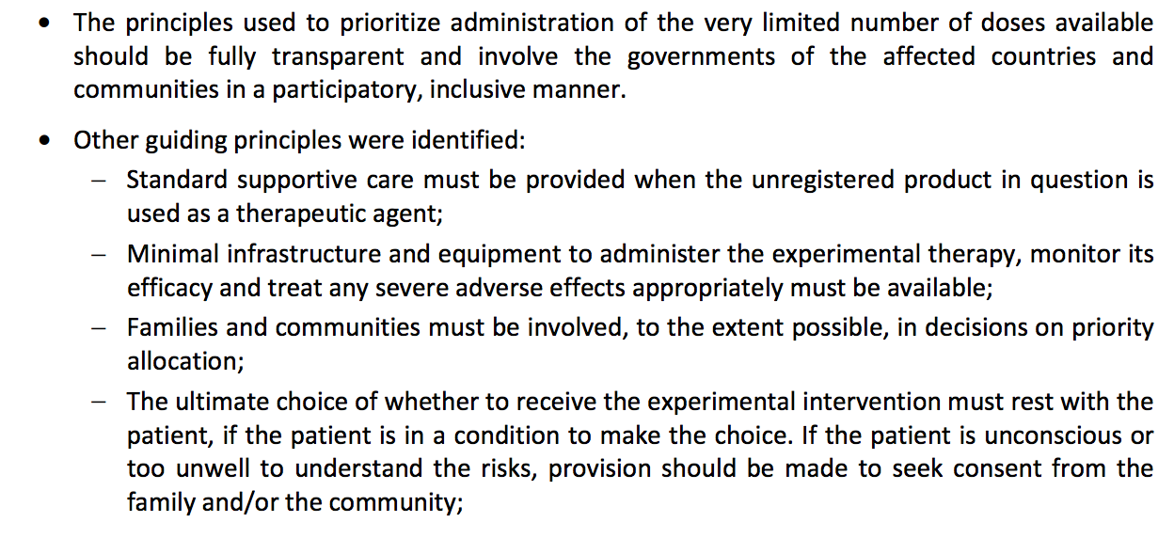

Slide 40
Real Issues? Easy…
How ethically gather evidence to establish efficacy?
Randomized placebo controlled? CDC Stepwedge
Who will own therapies?
Currently Tobacco Company ☺; USAMRIID
Devote resources to treatment or prevention or research?

Slide 41
Real Issues? Hard
Not about individuals or diseases or therapies…
Its about global systems, power, money, economies.
‘Public health-population interests’ approach to pharmaceutical and health governance.

Slide 42
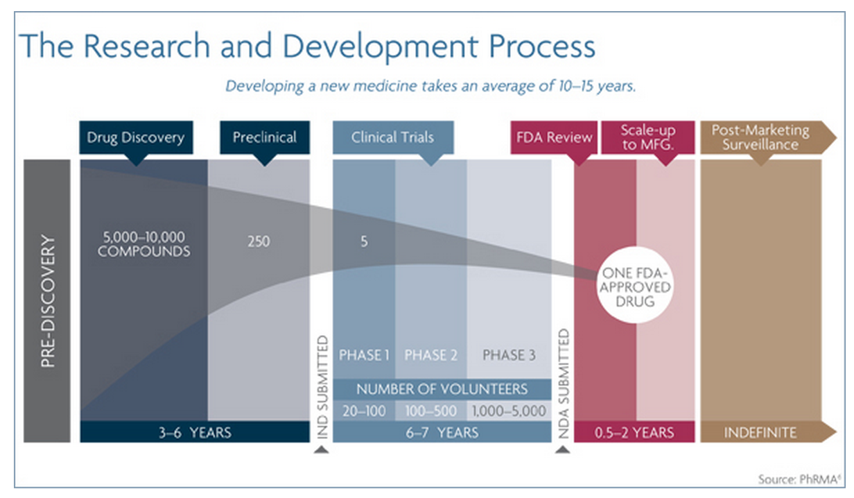
$4-12 billion over 10-15years

Slide 43
Bottom Line – Experimental Therapies
Its going to be messy, but OK…
Now….
By what criteria should protocol be abrogated?
The next epidemic, or existing ones
?HIV, Malaria, Dengue
How does this fundamentally change $1.4 T industry and relationships with NGOs…

Slide 44
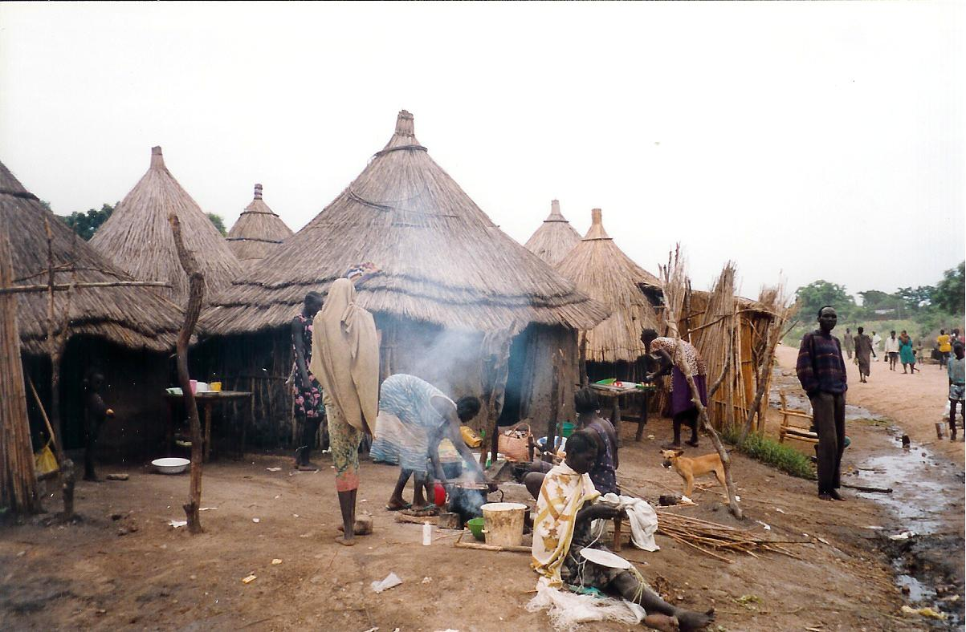
Syndemic?
A syndemic occurs when two or more afflictions, interacting synergistically, contribute to excess burden of disease in a population. (CDC)

Slide 45
Protecting the public vs the rights of individuals.
Collection and use of aggregate data and information.
Allocating scarce resources.
“You think that if you understand one, you understand two - because one and one are two. But you must also understand 'and'.”
- - Sufi saying
Conflicts of interest arising because of collaboration.
Conflicts related to political and intergovernmental relationships,
Marginalized populations vs the needs of the population
legal obligations vs ethical/professional duties
sharing of clients personal data
Notes:
It’s a mess!

Slide 46
For every complex human problem there is an answer that is clear and simple,
and wrong.
H. L. Mencken

