Slide 1
Finding Our Own Haggadah’s
From Within

Slide 2
Why Aramaic?

Slide 3
Haggadah
Spark
01
Stories
02
Dreams
03

Slide 4
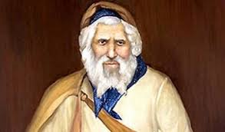
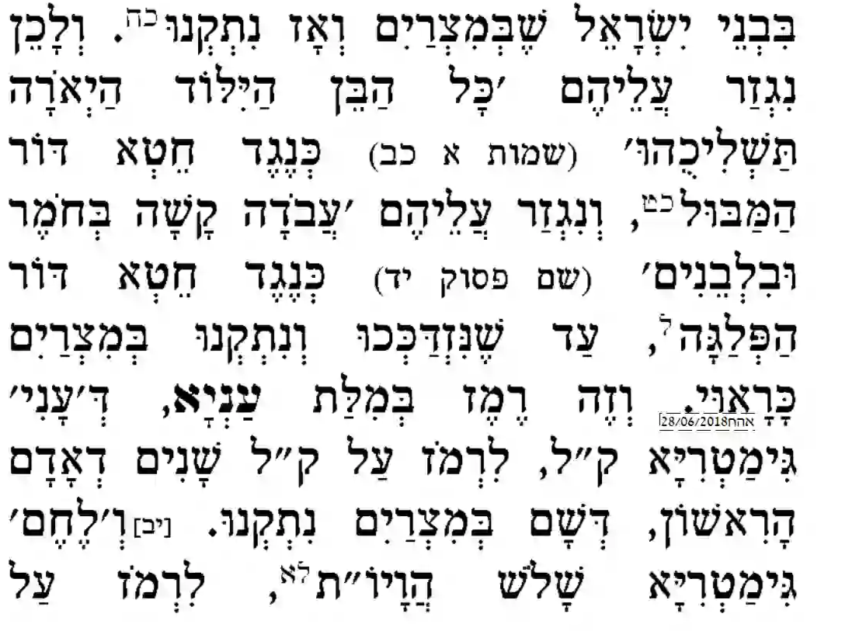
Bidgei Sarad – Abir Yakov

