Slide 1
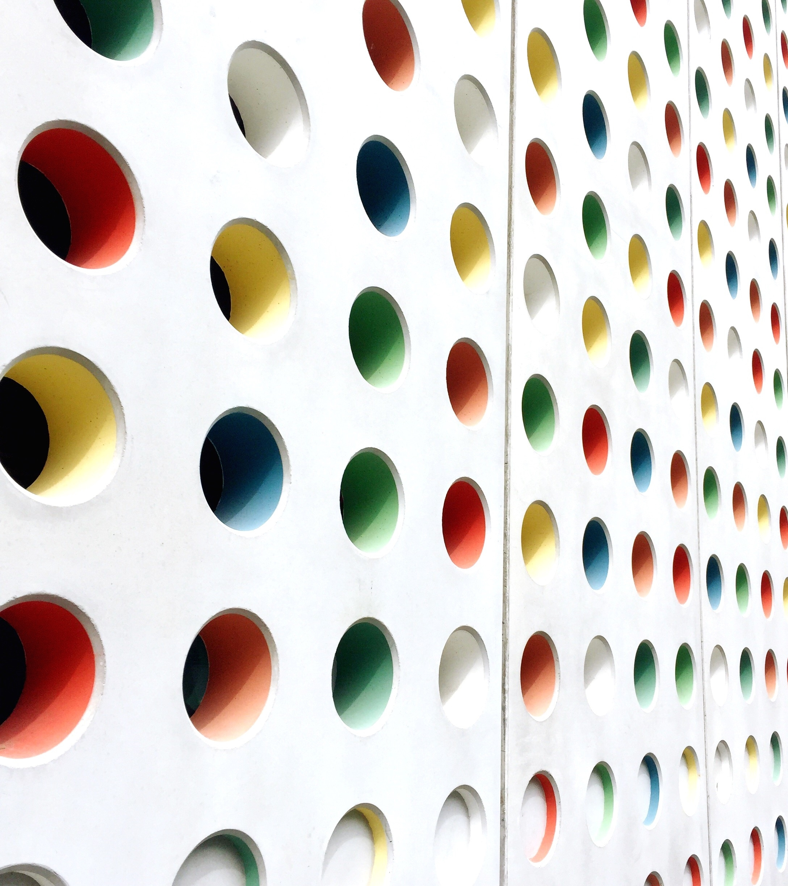
Cleaning for Pesach, Erev Pesach on Shabbat, Fast of the Firstborns, and more!
Halacha lmaaseh

Slide 2
Timeline
Thursday
Tanit Bechorot
Thursday Night
Bedika
Friday
Biur
Shabbat Goodbye Chametz
Thursday - Tanit Bechorot
Thursday Night – Bedika
Friday Morning – Burning of Chametz
Friday Night/Shabbat Morning – Chametz Meal
Shabbat Morning by 10:29am – Finish Chametz
Shabbat Afternoon – Seuda Shelishit
Motzei Shabbat - Seder

Slide 3
Bedika
Where to check
Scattering Chametz
How well do you have to check?

Slide 4
Bedika in the Dorm or Apartment
Gather all chametz onto the table or one spot
No Bracha before Thursday Night
Clean the kitchen utensils, microwave, or mini-frig
Sweep
Check briefly in each drawer, shelf, closet
Check pants pockets

Slide 5
Selling Chametz
Ask parents to live your apartment or dorm
Or do it yourself – find Rabbi Cohen, Rabbi Willig or whoever your rebbe is
Write down where the chametz is located
You can include medication and cosmetics but most aren’t chametz at all
Try to make the key to the dorm/apartment available so that it is possible to get it open
If you’re going to be in NJ/NY area you could theoretically get it to them quickly
If you’re not going to be then you should try to leave the key with someone who lives closer to where it is sold

Slide 6
Tanit Bechorot
To give a zechut to the bechorim who were saved from Macot Bechorot
We listen to a siyum today
This year when pushed off – theoretically patur but it is proper to listen to siyum
If you can’t get to a synagogue you can listen on zoom
If you have a firstborn son you should listen to a siyum for them
Sephardi women don’t have minhag to fast today

Slide 7
Erev Pesach on Shabbat
Friday Night and Shabbat Morning
Method 1 – Chametz 10:29AM
Only save chametz for Friday night and Shabbat morning
Eat up the chametz on top of tissues that you can flush down the toilet
Method 2 – Cold Turkey
Instead if you want to eat matzah Friday night – muter
Shabbat morning if you want to eat cooked or deep-fried matzah that’s fine
Seuda Shelishit
Hamotzei 5:26PM
Cooked or deep-fried matzah
Mezonot
Egg matzah
Matzah balls
Shehakol/Haetz
Meat, fish, cheese, shivat haminim
No matzah meal cakes

