Slide 1
Eating Disorders in the Jewish Community: Detection, Prevention and Treatment

Slide 2
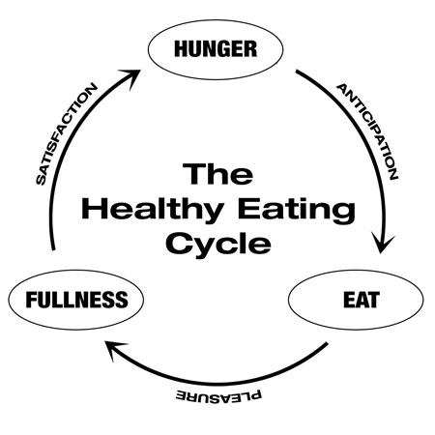
What is disordered eating?
What is NORMAL eating?
Eating satisfies a physiological need
Appetite is regulated without conscious input
Eating is controlled by hunger, appetite and satisfaction
Personal taste plays a moderate role in food selection, eating is pleasurable
Sensible choices help regulate portion control and nutritional intake
Accommodates temporary shifts in schedule, needs or environment (i.e. allows for an occasional fast or feast, with no disruption or sudden instability)

Slide 3
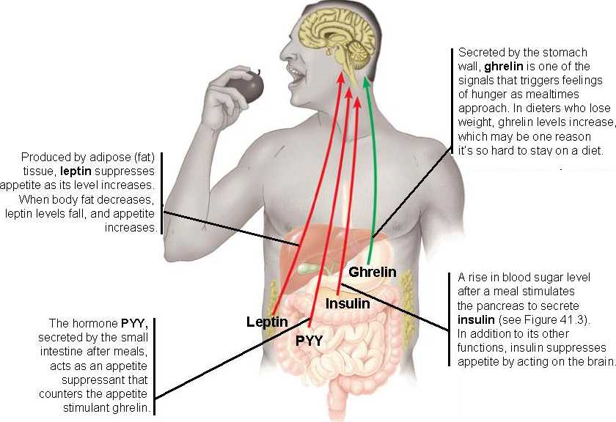

Slide 4
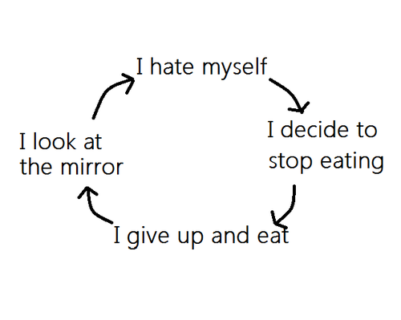
What is disordered eating?
Eating/restricting satisfies a psychological/emotional need
Appetite is regulated with conscious input
Eating is controlled by will, planned diet
Eating is not necessarily pleasurable
Portion control and nutritional intake become severely compromised

Slide 5
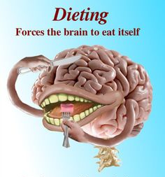
Brain turns on itself, Natural instinct for survival becomes compromised

Slide 6
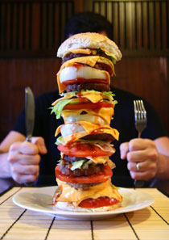
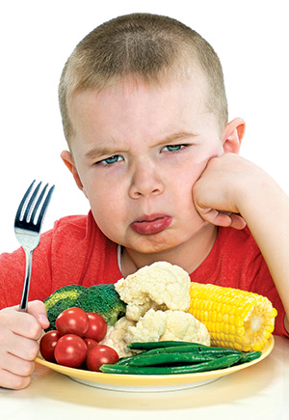
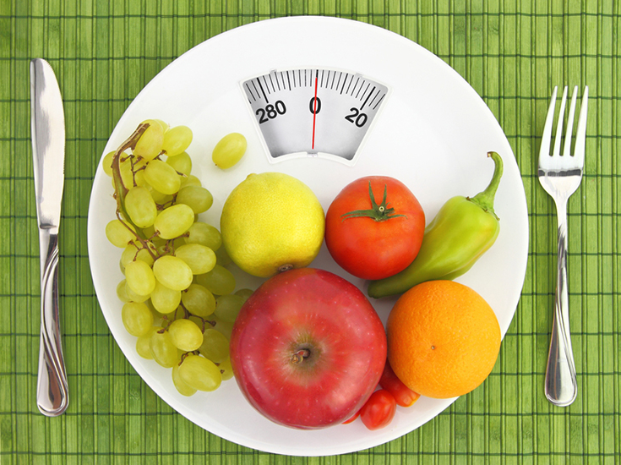
EATING DISORDERS ARE NOT TO BE CONFUSED WITH:
Picky eating
Unhealthy dieting
Overindulgence

Slide 7
EATING DISORDERS ARE SERIOUS BUSINESS
Over 11,000,000 Americans suffer from EDs, up 50% since 1960
EDs have the highest mortality rate of any mental illness
Anorexia is the 3rd most chronic illness among adolescents
95% of those who have EDs are between the ages of 12 and 25
20% of those suffering from anorexia will die prematurely from complications due to their ED
Treatment of EDs can cost between $500 and $2,000 per day
Rates of Recovery
• 1/3 recover after initial episode
• 1/3 fluctuate with recovery and relapse
• 1/3 suffer chronic deterioration

Slide 8
ANOREXIA NERVOSA
Individual has a distorted body image and an irrational fear of becoming overweight, so he/she deliberately attempts to lose weight, through restriction and other forms of calorie burning and purging.
Malnourishment can cause many other physiological complications, including:
  Slowed cognitive abilities
  Suppressed immune system
  Anemia
  Abnormal blood pressure
  Suspension of menstruation
  Stunted development
  Brittle and thin hair
  Weak muscles / bones, osteoporosis
  Kidney malfunction
  Cardiac complications

Slide 9

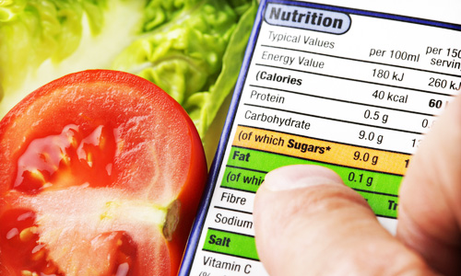



ANOREXIA NERVOSA SYMPTOMS
FOOD BEHAVIOR SIGNS AND SYMPTOMS:
Dieting despite being thin – Severely restricted diet, eats only certain low-calorie foods, banning “bad” foods
Obsession with calories, fat grams, and nutrition – Reading food labels, measuring and weighing portions, keeping a food diary, reading diet books.
Pretending to eat or lying about eating – Hiding, playing with, or throwing away food to avoid eating. Making excuses to get out of meals (“I had a huge lunch” or “My stomach isn’t feeling good.”).
Preoccupation with food – Constantly thinking about food. Cooking for others, collecting recipes, reading food magazines, or making meal plans while eating very little.
Strange or secretive food rituals – Refusing to eat around others or in public places. Eating in rigid, ritualistic ways (e.g. cutting food “just so”, chewing food and spitting it out, using a specific plate).

Slide 10
ANOREXIA NERVOSA SYMPTOMS
ANOREXIC APPEARANCE AND BODY IMAGE SIGNS AND SYMPTOMS:
Dramatic weight loss – Rapid, drastic weight loss with no medical cause.
Feeling fat, despite being underweight – feel overweight in general or just “too fat” in certain places such as the stomach, hips, or thighs.
Fixation on body image – Obsessed with weight, body shape, or clothing size. Frequent weigh-ins and concern over tiny fluctuations in weight.
Harshly critical of appearance – Spending a lot of time in front of the mirror checking for flaws. There’s always something to criticize. Never feels thin enough.
Denial of thinness – May deny that low body weight is a problem, while trying to conceal it (drinking a lot of water before being weighed, wearing baggy or oversized clothes).

Slide 11
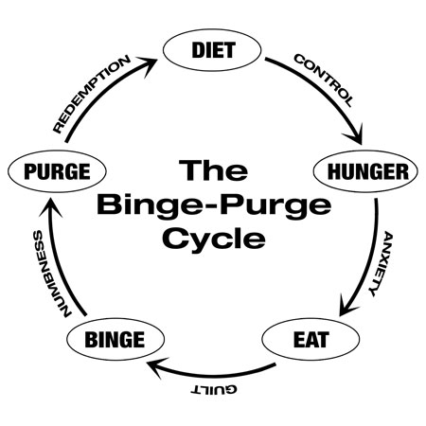
BULIMIA NERVOSA
The individual experiences regular bouts of serious overeating, which are always followed by a feeling of guilt, which can then lead to extreme reactions such as crash dieting, doing lots of exercise, and purging (deliberately vomiting).

Slide 12
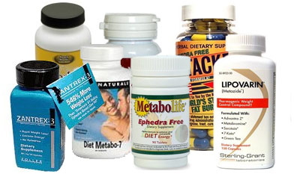
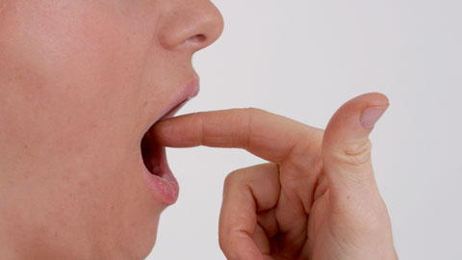
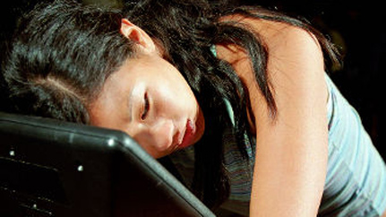
BULIMIA NERVOSA SYMPTOMS
Purging Signs And Symptoms:
Using diet pills, laxatives, or diuretics – Abusing water pills, herbal appetite suppressants, prescription stimulants, ipecac syrup, and other drugs for weight loss.
Throwing up after eating – Frequently disappearing after meals or going to the bathroom. May run the water to disguise sounds of vomiting or reappear smelling like mouthwash or mints.
Compulsive exercising – Following a punishing exercise regimen aimed at burning calories. Exercising through injuries, illness, and bad weather. Working out extra hard after bingeing or eating something “bad.”

Slide 13
BULIMIA NERVOSA
Unlike anorexia nervosa, bulimia nervosa is difficult to identify. The sufferer is not usually underweight. Because of the shame and guilt associated with the illness, patients are skilled in masking the symptoms.
puffy face
scars or red marks on the fingers or knuckles
tooth damage
redness around and in the eyes
constant sore throat and a compromised immune system
rapid weight fluctuations
short finger nails
frequent visits to the bathroom after eating
food disappearing in large quantities
look out for unexpected walks or drives at night
social withdrawal
an increase in irritability and mood swings
fatigue

Slide 14
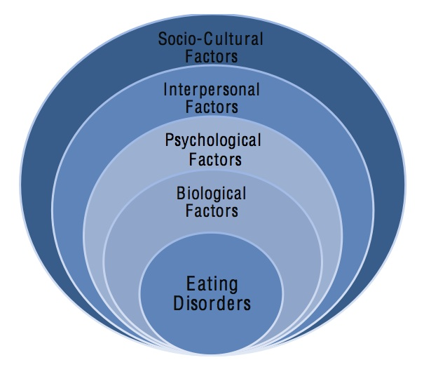
WHAT CAUSES EDs?
Eating disorders are complex conditions that arise from a combination of long-standing behavioral, biological, emotional, psychological, interpersonal, and social factors. Scientists and researchers are still learning about the underlying causes of these emotionally and physically damaging conditions. We do know, however, about some of the general issues that can contribute to the development of eating disorders.
Biological – hormonal, chemical imbalance, genetic links
Psychological - low self esteem, anxiety, difficulty coping
Interpersonal – troubled family relationships, difficulty expressing emotions, history of physical or sexual abuse
Social - Cultural values, peer pressure, focus on beauty, thinness, looks…

Slide 15

WHAT CAUSES EDs?
“LOADED GUN” THEORY
Biological – hormonal, chemical imbalance, genetic links
Psychological - low self esteem, anxiety, difficulty coping (very high rate of comorbidity)
Interpersonal – troubled family relationships, difficulty expressing emotions, history of physical or sexual abuse
Social - Cultural values, peer pressure, focus on beauty, thinness, looks…

Slide 16
WHEN IN DOUBT, REFER FOR HELP
Don’t dismiss what you see / hear – NEVER encourage someone to “fix it yourself”
Don’t be an alarmist, but know that EDs often go undetected until too late – treatment much more effective with early intervention

Slide 17

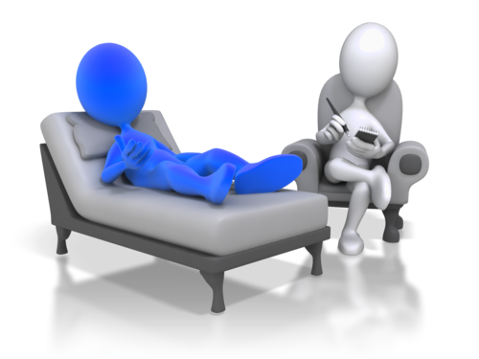

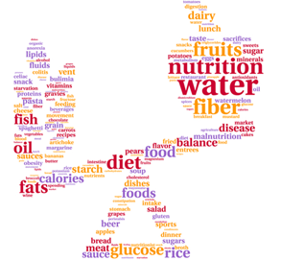
TREATMENT OF EDs
HEALTH PROFESSIONALS:
MD
Patient psychotherapist
Family therapist
Nutritionist
LEVEL OF CARE:
Outpatient
PHP
Residential
Inpatient / Acute Level Care

Slide 18
EVIDENCE-BASED EATING DISORDER TREATMENT MODALITIES
INDIVIDUAL AND GROUP THERAPIES
  Cognitive Behavior Therapy (CBT)
  Dialectical Behavior Therapy (DBT)
FAMILY THERAPY / COUPLES THERAPY
  Family-Based Therapy (FBT) / Maudsley
** Those struggling with EDs often require treatment and maintenance of comorbid psychiatric conditions/disorders **

Slide 19
New York Times, April 11, 2011 / Rabbis Sound an Alarm Over Eating Disorders
“Israeli studies consistently find high rates of disordered eating among Jewish adolescents but not Arab ones, and Israel’s rate of dieting is among the highest in the world — more than one woman in four — though obesity rates are relatively low.”
“Data about American Jews is limited, but two small studies have reported high rates of disordered eating in certain communities. One of those, a 1996 study of an Orthodox high school in Brooklyn, found 1 in 19 girls had an eating disorder — about 50 percent higher than in the general population at the time. The 1996 study was done with the agreement that it would not be published. The other study, done in 2008, looked at 868 Jewish and non-Jewish high school students in Toronto and found that 25 percent of the Jewish girls suffered from eating disorders that merited treatment, compared with 18 percent of the non-Jewish girls.”
INCONCLUSIVE

Slide 23
On the other hand…
AREAS FOR HONEST CONSIDERATION
High demands / expectations of ourselves and children, triggering to those who are vulnerable
Highly competitive community, peer-pressure
Shidduch process
Larger family sizes, less attention for each child
Centrality of food within culture and lifestyle (שבת, יו"ט)…
Overindulgence – שמחות, קידוש, cookbook craze…
Stigmatization

Slide 24
Food for Thought: Eating Disorders and the Jewish Community
By Esther Altmann PhD

Slide 25
Food for Thought: Eating Disorders and the Jewish Community
By Esther Altmann PhD

Slide 26
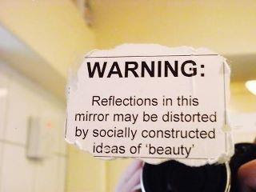

Slide 27
TORAH LIVING
FOR THE
EATING DISORDERED

Slide 28

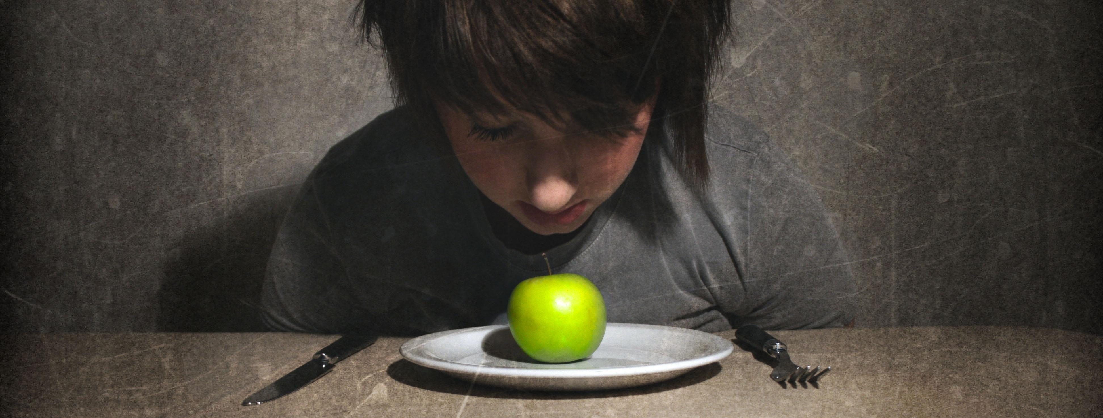
Elizabeth, 38, has struggled for many years with an eating disorder. After years of treatment, she has successfully refrained from restricted eating for close to one year. Her therapists warn that fasting, even for one day, could potentially trigger a relapse. What should she do on Yom Kippur?

Slide 29
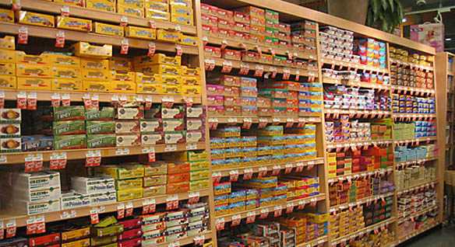

Chaim, 16, has been suffering from AN for 2 years. He was recently discharged from an inpatient facility, where he had been receiving treatment for 7 weeks. Although his weight has been completely restored, he has not tolerated any variety in his diet and receives much of his nutrition from supplement bars, which contain chametz. May he continue to eat these on Pesach? If so, should he be encouraged to eat them in a separate room? When he/his father performs a bittul chametz, are these bars to be included?

Slide 30

Esther, 15, suffers from anorexia and is currently undergoing inpatient treatment. In an effort to optimize treatment, all meals are prepared on site by the trained staff and no outside food may be brought into the facility. May Esther eat non-kosher food as part of her treatment? If she refuses to eat non-kosher food, may her family lie to her and tell her that the food is kosher? (May other members of her family eat the food?)

Slide 31


Bracha, 19, has been recovering from an ED and has thankfully made significant progress. She is still unable to eat on her own and relies on her parents to be present with her during each meal. When they can not be physically present, she has been able to complete her meals while skyping them. An opportunity has arose for her to travel to Israel for 2 weeks, which she would very much like to do, especially given that she was unable to attend seminary with her friends, as she was in treatment for her ED. Her doctors feel that this opportunity may be a very helpful step towards her recovery. May she travel to Israel, if doing so would require that she and her parents continue to skype each other during meals, even on Shabbos?

Slide 32
A SAMPLE LETTER

Slide 33
As you may know, the recovery from an eating disorder typically takes several years and occurs through stages. Thankfully, the most intensive stage of Rachel's treatment will shortly be coming to an end and she will then begin the next phase of her recovery. Given that you will possibly see Rachel in the coming days or weeks, we wanted to share with you some of the important do's / do not's when speaking to someone with an ED. Please do not misinterpret the intent of this message in any way. Needless to say, we are grateful for any positive support that you can offer Rachel. At the same time however, this entire experience has afforded us the opportunity to gain a broader perspective and a deeper understating into ED's and, as a result, we have learned many things that we did not know beforehand. We would therefore like to be proactive in reducing the amount of negative "triggers" (albeit inadvertent) that she will undoubtedly encounter.
As we have recently come to learn and understand, fundamentally, eating disorders have nothing to do with food, weight or calories. As such, we have been directed to avoid discussions that include these issues, unless the conversation is in a controlled, therapeutic setting. Please resist any temptation to mention these issues or directly respond to any questions that she may offer on these subjects. These types of comments should be avoided even if they are not directed to the person who is recovering. For example, one should not say in her presence, "I hate my body" or "I just ate so much..." or "I haven't eaten all day and I'm starving."

Slide 34
Additionally, some of the most well-intentioned comments that are directed to someone recovering from an ED, will often be misperceived or processed quite differently than they were intended. To be more specific, here are a few general examples of the types of comments that one should not say to someone who is in the process of recovering from an ED. (Please note how objection to some of these comments is remarkably counterintuitive.)
"You look great"
"You look so healthy."
"I hear / see that you are eating a lot better now."
"Don't you feel better than you used to?"
"Do you want me to get you something to eat?" / "Are you hungry?"
"I knew someone who had an eating disorder and she..."
Please do not ask her any questions about her experiences in the hospital or of her immediate / future plans, treatments or school.
Additionally, one recovering from an ED will be very conscious of who is looking at her body. It is best therefore not to gaze directly at her, other than her face, etc. In fact, it is best to avoid giving any special attention to one recovering from an ED. It is best to be as natural as possible, and avoid coming across as if you are walking on egg shells.

Slide 35
If she does open up to you regarding her illness, it is best to listen (not interrupt), validate (not argue) and admit that you can't really understand what she is experiencing. To quote something I have recently read from one with an ED: "When looking from the outside in, it is impossible understand. When looking from the inside out, it is impossible to explain."
On a more positive note, here are examples of comments that would be appropriate and could be very reassuring:
"I've missed you so much."
"Please let me know if there is anything that I could do for you."
"Let me share with you some of things that are going on in my life." (Although I can not promise that she will want to listen.)

