Slide 1
The Story of Sin: Adam, Eve, the Serpent and the Tree of Knowledge
Dedicated by Adir and Elianne Koschitzky
In memory of Cherie and Eli Kaplan z”l
And Estelle and Seymour Friend z”l

Slide 2
Structure of the Narrative
Bereishit 2:4-2:7- Vegetation Sprouts, Man is created from the ground with, and Hashem blows a soul into him
Bereishit 2:8- 2:14- Hashem plants a Garden in Eden
ח וַיִּטַּע ה’ אֱלֹקִים גַּן בְּעֵדֶן מִקֶּדֶם וַיָּשֶׂם שָׁם אֶת הָאָדָם אֲשֶׁר יָצָר. ט וַיַּצְמַח ה’ אֱלֹקִים מִן הָאֲדָמָה כָּל עֵץ נֶחְמָד לְמַרְאֶה וְטוֹב לְמַאֲכָל וְעֵץ הַחַיִּים בְּתוֹךְ הַגָּן וְעֵץ הַדַּעַת טוֹב וָרָע.
And the Lord God planted a garden eastward in ῾Eden; and there He put the man whom He had formed. And out of the ground the Lord God made to grow every tree that is pleasant to the sight, and good for food; the tree of life also in the midst of the garden, and the tree of the knowledge of good and evil

Slide 3
Structure of the Narrative: The Instructions
2:15-2:17- Adam is placed in the Garden of Eden to “work it” and to “guard it”. He is given instructions 1) You can eat from “all the trees of the garden. 2) But you must not eat from the tree of “knowledge of good and evil”.
טו וַיִּקַּח ה’ אֱלֹקִים אֶת הָאָדָם וַיַּנִּחֵהוּ בְגַן עֵדֶן לְעָבְדָהּ וּלְשָׁמְרָהּ. טז וַיְצַו ה’ אֱלֹקִים עַל הָאָדָם לֵאמֹר מִכֹּל עֵץ הַגָּן אָכֹל תֹּאכֵל. יז וּמֵעֵץ הַדַּעַת טוֹב וָרָע לֹא תֹאכַל מִמֶּנּוּ כִּי בְּיוֹם אֲכָלְךָ מִמֶּנּוּ מוֹת תָּמוּת.
And the Lord God took the man, and put him into the garden of ῾Eden to till it and to keep it.
And the Lord God commanded the man, saying, Of every tree of the garden thou mayst freely eat:
but of the tree of the knowledge of good and evil, thou shalt not eat of it: for on the day that thou eatest of it thou shalt surely die.

Slide 4
Structure of the Narrative: Adam needs a “helper”.
2:18- 2:25- A Wife is created for Adam
כג וַיֹּאמֶר הָאָדָם זֹאת הַפַּעַם עֶצֶם מֵעֲצָמַי וּבָשָׂר מִבְּשָׂרִי לְזֹאת יִקָּרֵא אִשָּׁה כִּי מֵאִישׁ לֻקֳחָה זֹּאת. כד עַל כֵּן יַעֲזָב אִישׁ אֶת אָבִיו וְאֶת אִמּוֹ וְדָבַק בְּאִשְׁתּוֹ וְהָיוּ לְבָשָׂר אֶחָד. כה וַיִּהְיוּ שְׁנֵיהֶם עֲרוּמִּים הָאָדָם וְאִשְׁתּוֹ וְלֹא יִתְבֹּשָׁשׁוּ.
. And the man said, This is now bone of my bones, and flesh of my flesh: she shall be called Woman, because she was taken out of Man. That is why a man leaves his father and his mother, and cleaves to his wife: and they become one flesh. And they were both naked, the man and his wife, and they felt no shame.
Hashem creates a wife for Adam, after Adam names all of the other animals and notices he lacks a “helper”
The man and the women are naked but not embarrased

Slide 5
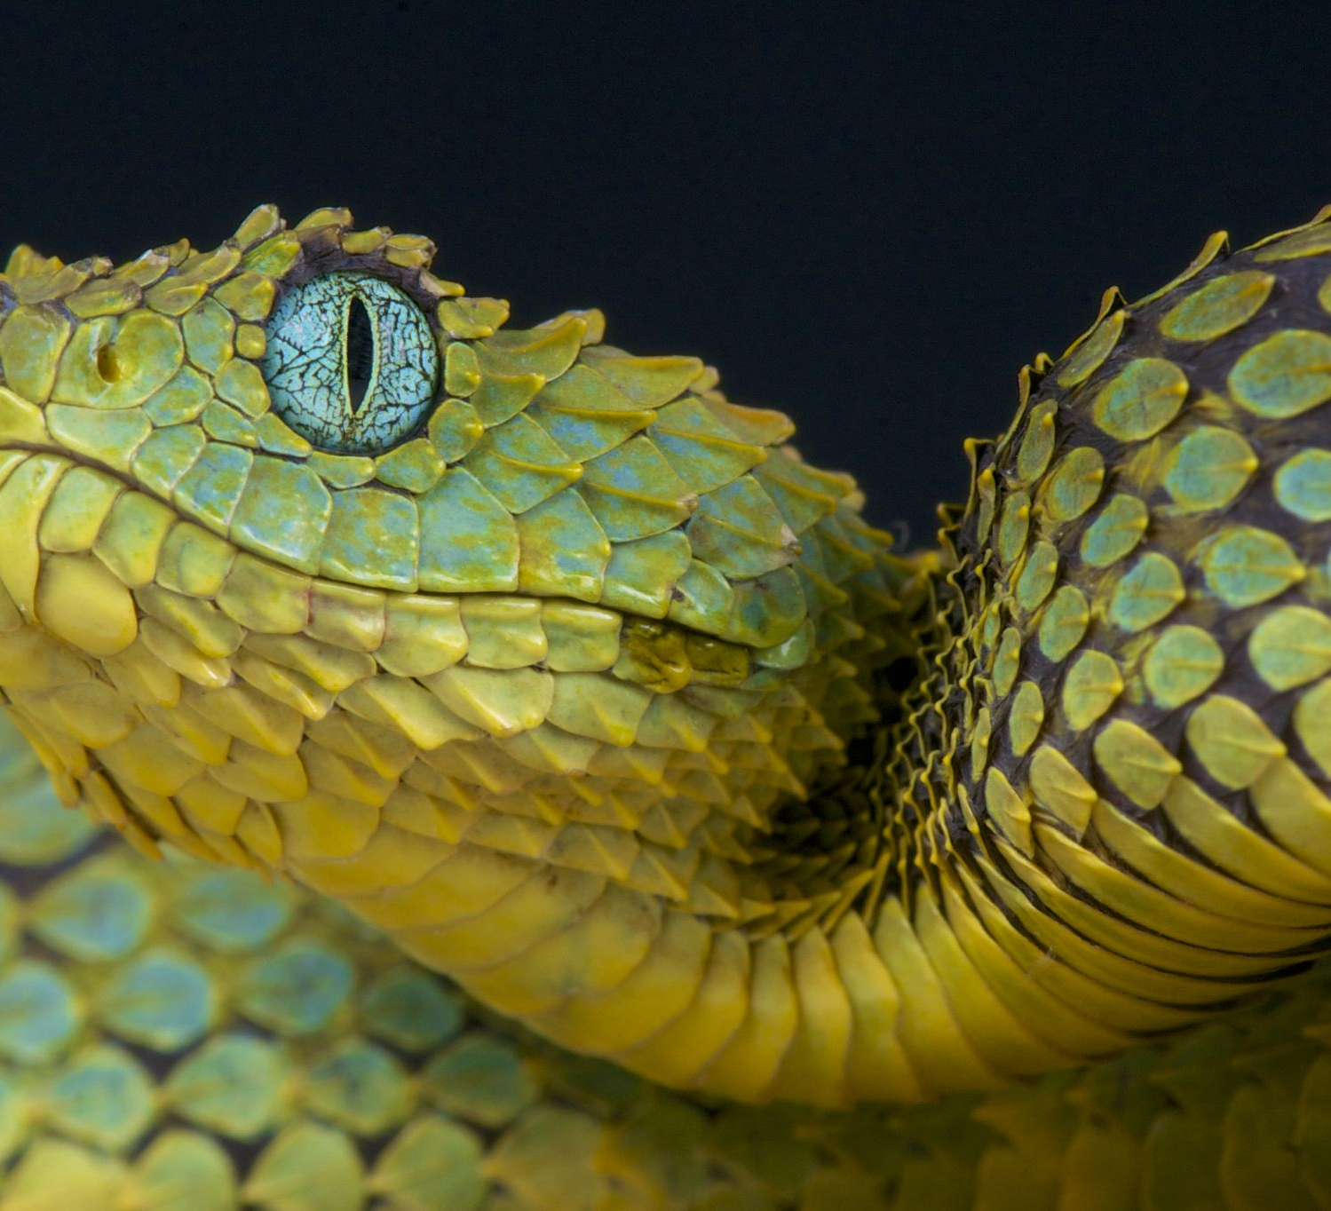
Searching for the Evil Serpent

Slide 6
Eve and The Serpent
Bereishit 3:1-6 (Koren Translation)
א וְהַנָּחָשׁ הָיָה עָרוּם מִכֹּל חַיַּת הַשָּׂדֶה אֲשֶׁר עָשָׂה ה’ אֱלֹקִים וַיֹּאמֶר אֶל הָאִשָּׁה אַף כִּי אָמַר אֱלֹקִים לֹא תֹאכְלוּ מִכֹּל עֵץ הַגָּן. ב וַתֹּאמֶר הָאִשָּׁה אֶל הַנָּחָשׁ מִפְּרִי עֵץ הַגָּן נֹאכֵל. ג וּמִפְּרִי הָעֵץ אֲשֶׁר בְּתוֹךְ הַגָּן אָמַר אֱלֹקִים לֹא תֹאכְלוּ מִמֶּנּוּ וְלֹא תִגְּעוּ בּוֹ פֶּן תְּמֻתוּן. ד וַיֹּאמֶר הַנָּחָשׁ אֶל הָאִשָּׁה לֹא מוֹת תְּמֻתוּן. ה כִּי יֹדֵעַ אֱלֹקִים כִּי בְּיוֹם אֲכָלְכֶם מִמֶּנּוּ וְנִפְקְחוּ עֵינֵיכֶם וִהְיִיתֶם כֵּאלֹהִים יֹדְעֵי טוֹב וָרָע. ו וַתֵּרֶא הָאִשָּׁה כִּי טוֹב הָעֵץ לְמַאֲכָל וְכִי תַאֲוָה הוּא לָעֵינַיִם וְנֶחְמָד הָעֵץ לְהַשְׂכִּיל וַתִּקַּח מִפִּרְיוֹ וַתֹּאכַל וַתִּתֵּן גַּם לְאִישָׁהּ עִמָּהּ וַיֹּאכַל.
Now the serpent was craftier than all the beasts of the field which the Lord God had made. And he said to the woman, Has God said, You shall not eat of any tree of the garden? And the woman said to the serpent, We may eat of the fruit of the trees of the garden: but of the fruit of the tree which is in the midst of the garden, God has said, You shall not eat of it, neither shall you touch it, lest you die. And the serpent said to the woman, You shall not surely die: for God knows that on the day you eat of it, then your eyes shall be opened, and you shall be as gods, knowing good and evil. And when the woman saw that the tree was good for food, and that it was a delight to the eyes, and a tree to be desired to make one wise, she took of its fruit, and did eat, and gave also to her husband with her; and he did eat. And the eyes of them both were opened, and they knew that they were naked; and they sewed fig leaves together, and made themselves loincloths.

Slide 7
Questions: Searching For the Serpent
Who was the Serpent?
The Serpent is “cunning”, talks, and seems to have an agenda.
On the other hand it’s described as of the “beasts of the field”.
It’s punishment for seducing Adam and Eve to sin is: You shall crawl on your belly and eat dust…
אף כי אמר אלוקים לא תאכלו מכל עץ הגן- Even though G-d said not to eat from all of the trees of the garden….
What’s the conclusion of the statement?
G-d didn’t say don’t eat from all the trees of the garden!
Eve’s Response 1) We can eat from the fruit of the trees of the garden 2) But we can’t eat from the fruit of the tree in “the midst of the garden” or touch it lest we die.
Why does she call it “העץ אשר בתוך הגן“
Why did she add that she couldn’t touch it?

Slide 8
Questions: Searching For the Serpent
"לא מות תמותון כי יודע אלוקים כי ביום אכלכם ממנו...- Wasn’t the Serpent right?
You won’t die- Adam and Even didn’t die!
You’re eyes will be opened- There eyes were opened! See 3:7
They did become like G-d, knowing Good and Evil! See 3:22
ז וַתִּפָּקַחְנָה עֵינֵי שְׁנֵיהֶם וַיֵּדְעוּ כִּי עֵירֻמִּם הֵם
They eyes were opened and they knew they were naked
כב וַיֹּאמֶר ה’ אֱלֹקִים הֵן הָאָדָם הָיָה כְּאַחַד מִמֶּנּוּ לָדַעַת טוֹב וָרָע וְעַתָּה פֶּן יִשְׁלַח יָדוֹ וְלָקַח גַּם מֵעֵץ הַחַיִּים וְאָכַל וָחַי לְעֹלָם.
Hashem, the Lord said, the Man has become like one of us, to know good and evil…
If he was right, why is the Serpent Punished?

Slide 9
Eve falters…and brings Adam along with her
ו וַתֵּרֶא הָאִשָּׁה כִּי טוֹב הָעֵץ לְמַאֲכָל וְכִי תַאֲוָה הוּא לָעֵינַיִם וְנֶחְמָד הָעֵץ לְהַשְׂכִּיל וַתִּקַּח מִפִּרְיוֹ וַתֹּאכַל וַתִּתֵּן גַּם לְאִישָׁהּ עִמָּהּ וַיֹּאכַל.
She sees the tree is 1) good to eat 2) a temptation for the eyes 3) desirable to become enlightened-
What is the significance of these three descriptions?
She gives it to Adam- what is his role in this sin?

Slide 10
Who is the Serpent?
There are Three Approaches expressed in the Commentators regarding the identity of the נחש:
The נחש is the יצר הרע- the “evil” drive inside of us.
The נחש was a snake with miraculous powers.
The נחש was a normal snake.

Slide 11
The Serpent as the Internal Evil Force
Zohar on Bereishit 1:35
כְּתִיב וְהַנָּחָשׁ הָיָה עָרוּם דָּא יֵצֶר הָרָע דָּא מַלְאַךְ הַמָּוֶת. וּבְגִין דְּנָחָשׁ אִיהוּ מַלְאַךְ הַמָּוֶת גְּרַם מוֹתָא לְכָל עָלְמָא.
And the Serpent was cunning: This is the Evil Inclination, this is the Angel of Death. Since the serpent was the angel of death, it caused death for the whole world.
Seforno on Bereshit 3:1
והנחש. "הוא שטן הוא יצר הרע", רב ההזק עם מעוט היותו נראה… ועל זה הדרך קרא בזה המקום את היצר הרע המחטיא "נחש", בהיותו דומה לנחש, אשר תועלתו במציאות מועט מאד, ונזקו רב עם מעוט הראותו.
The Serpent: “He is Satan, He is the Evil Inclination”, Much Damage but barely visible…in this way Hashem called the evil inclination that causes sin “the serpent”, in that it is similar to a serpent, in that it’s productivity toward the world is very limited, but it causes a lot of damage with a small appearance.

Slide 12
The Serpent as the Internal Evil Force
Seforno Cont’d
וכבר אמרו זכרונם לברכה שהיה סמאל רוכב עליו, והוא שהכח המתאוה המחטיא יעשה זה באמצעות הכח המדמה המוביל אליו דמיוני התענוגים החומריים, המטים מדרך השלמות המכוון מאת הקל יתברך. כי אמנם הכח המתאוה עם דמיוני התענוגים המובילים אליו הם מצוים לכחות הגשמיות הפועלות, ומחטיאים כונת ורצון האל יתברך, כשלא יתקומם עליהם הכח השכלי וימחה בהם…
They have already stated z”l, that “Samael” rode on it, this means that the forces of temptation which cause sin do so with the help of the imagination which brings with it fantasies of physical pleasure, which veer from the path of perfection intended by G-d. For the imaginative faculty, with the fantasies of pleasures it brings are common to the active physical forces and they deter G-d’s will and intern, when the power of the intellect doesn’t stand up to them and object to them.

Slide 13
אף כי אמר אלקים...
The Goal of the יצר הרע is to portray G-d as the enemy
Rabbi Yaakov Mecklenburg- (Ktav V’Hakabbalah ibid.) translates אף as “Anger”
פירוש כעס וחמה יעורר אשר אמר אלקים לא תאכלו כי על ידי המניעה מאכילת פרי הגן תרגיש הנפש צער ודאגה כי מוכרחים אנחנו לעמוד תמיד על משמרת נפש המתאוה לאכול פרי יפה עיני׳ וטוב רואי כאלה
G-d has causes greater anger by saying you shouldn’t eat. For by withholding you from eating from the fruit of the forest, the soul will feel pain, and anguish. For we have constantly stand on guard from eating beautiful, and good looking fruit such as these…
Rabbi Yitzchak Arama (15th century Spain), Sefer HaIkkarim 4:28
כלומר כעס גדול יש לי על מה שאמר לכם השם יתברך שלא תאכלו מכל עץ הגן אלא מעצים ידועים, שלא צוה אתכם זו לתועלתכם שההפך מועיל לכם יותר
I am very angry that Hashem told you not to eat from all of the trees, but only from specific trees, because it would be better for you otherwise

Slide 14
Tricks of the יצר הרע
The Cunning of the “serpent” is evident in his words:
You can’t eat from any of the trees- Rabbi Chaim Ibn Attar- Even though he withheld only one from you….it’s the best one! He might as well have withheld everything from you!
The Goal isn’t just to convince to enjoy the forbidden, but to not enjoy what is permissible to us…
Use of the imagination- The יצר הרע doesn’t complete the sentence…it’s up to our imagination to finish…Even though Hashem said we can’t..
It’s worth it
It won’t be bad anyway
Just this once….

Slide 15
Tricks of the יצר הרע
How do we relate to Hashem?
Throughout the story of Adam and Eve, the term used to refer to G-d is that of "יקוק אלוקים" as opposed to in the 1st פרק, where name used is just "אלוקים".
Rashi- quotes חז"ל who explain as follows
יקוק- refers to מדת הרחמים- Divine Attribute of Mercy
Rabbi Soloveichik- Personal, Imminent G-d
אלוקים- refers to מדת הדין- Attribute of Judgement
Rabbi Soloveichik- Global, Distant G-d
We always have to balance both conceptions…
Isn’t it interesting that the נחש only uses אלוקים….

Slide 16
The Man-Like Snake
Rabbi Avraham Ibn Ezra on Bereishit 3:1
והישר בעיני שהם הדברים כמשמעם. והנחש היה מדבר, והיה הולך בקומה זקופה, והשם דעת באדם שם בו. והנה הפסוק העיד כי היה ערום מכל חית השדה, רק לא כאדם.
I believe that the words are as they sound. The serpent spoke, walked upright, and Hashem who imparted man with knowledge, placed it [in the snake]. The verse says more cunning than the beasts of the field, but not like man.
Rabbi Yitzchak Aramah (Akeidat Yitzchak Gate 9)
הכתוב העיד כי זה הבעל חי היה בטבעו ערום מכל שאר הבעלי חיים וכאלו הוא אמצעי ביניהם ובין המין האנושי בענין הידיעה
The verse testifies this animal by nature was more cunning than the other animals, as if it was a mediator between them and the human race in terms of knowledge
So then what separates between the Snake and the Animal

Slide 17
Rabbi Hirsch z”l- Animal Wisdom
The opposition to the animal life is the probing stone and the cliff on which human morality is tried or failed. It was animal wisdom that drew the first man from his duty; it is still the same animal wisdom today that serves as a midwife to every sin. The story of the first misstep is the story of all aberrations. The animal is really כאלוקים יודעי טוב ורע-The instinct resides in it, and this instinct is the voice of God, the will of God for it. What it does according to this divine providence prevailing in it - and it does not do anything else, it cannot do anything else - is good, and everything from which this instinct holds it back is evil. The animal does not go wrong, it only has one nature that it can follow, should follow.

Slide 18
Rabbi Hirsch z”l- Animal Wisdom
Not so the Human. He should choose what is good out of free choice and a sense of duty and avoid evil; He should also do justice to his sensual nature, not out of sensory stimulus, but out of a sense of duty. Even its most sensual enjoyment should be free moral deed, it should never and nowhere and in no way be an animal. That is why he has the sensual and the divine in him; it must often resist the good of its sensuality, the evil that often appears charming to him, so that for the sake of his high divine calling, with the free energy of his divine nature, despite his sensuality and never out of sensuality, he may practice the good and avoid the evil.

Slide 19
Rabbi Hirsch z”l- Animal Wisdom
That is why the voice of God does not speak in him, but to him, what is good and bad, and this voice of God speaking to him finds contradiction in the sensuality that becomes loud in him, as soon as this sensuality expresses itself independently, unaffected and unguided by his divine nature. The divine voice breathed into man, the conscience, as its messenger we recognized shame - only admonishes man in general to be good and to avoid evil; but what is good and what is bad for man can only be heard from God's mouth.

Slide 20
Rabbi Hirsch z”l- Animal Wisdom
It is incomprehensible to the animal, even to the cleverest, how a person insensitively bypasses the most beautiful, charming, best enjoyment. - אף כי אמר אלקים, "and even if God said so" this beginning of the speech already shows us humans in conversation with animals. Man had already emphasized the prohibition of God as a reason for non-enjoyment. "And what if God said it now ?! Do you therefore have to follow? Isn't the instinct in you God's voice? If the enjoyment is bad for you, why did he give the enjoyment the stimulus and you the drive, so he does not have you clearly said yourself that this pleasure and you are there for each other? Isn't this voice his earlier, clearer voice? First God creates the pleasures and you with the desire for them, and then - should he forbid you everything?

Slide 21
What makes us Human?
According to Rabbi Hirsch, the temptation of the Snake is the temptation to listen to the inner drives.
This story flows from our discussion of צלם אלוקים, our G-dliness demands that we acknowledge complexity. That there is more to what G-d wants from us than simply the desires inside of us….

