Slide 1
Shechem: Shouldering the Fate of a Nation
Rabbi Chaim Metzger ~ cmetzger@torontotorah.com
The program is sponsored by Sarena and David Koschitzky, in memory of Riva Koschitzky z”l.
Dedicated by Dalia and Farokh Hakimi in memory of Farokh’s parents Yitzhak Shafizadeh Hakimi z”l and Rivka Shafizadeh Hakimi z”l
Dedicated by Earle Glicksman in memory of his parents Moshe ben Sol Leibich z”l and Rochel bat Aidle z”l

Slide 2
Where is Shechem?

Slide 4
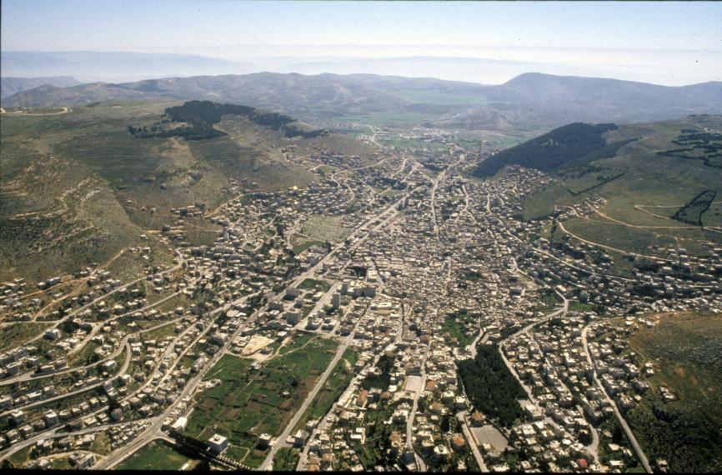
Notes:
Aerial photograph from the west of Mount Gerizim (right), Mount Ebal (left) and the valley in which the covenant was forged. (Z. Radovan) Professor Yoel Elizur

Slide 5
What happened in Shechem?
Avraham’s first stop in Israel (Breishit 12: 6-7)
Yaakov purchases land near city of Shechem. Shechem rapes Dina, Shimon and Levi slaughter city, reprimanded by Yaakov, burying of idols Alon Bachut (Breishit 33-34)
Yosef’s brothers shepherding in Shechem, Yosef visits them, Yosef ultimately sold on Dotan (Breishit 37)
Yosef gets extra portion – (Breishit 48: 22)
border between Efraim and Menashe Yehoshua 17:7
Ir Miklat (City of Refuge) in Shechem (Yehoshua 20:7)
In Ephraim, belongs to Leviim (Yehoshua 21: 21)
Yosef buried in Shechem (Yehoshua 24:32)
Avimelech ben Gideon’s “Kingdom” (Shoftim 9)
Rechavam coronated in Shechem (Melachim I 12:1)
Yeravam briefly builds up Shechem before moving on to else (Melachim I 12 25)
People of Shechem slaughtered by Yishmael ben Netanya (Yirmiyahu 41: 4-7)

Slide 6
Rise of Avimelech
Gideon (Yerubaal) – amazing Shofet (Judge) who led the people (Shoftim Chapter 6-8)
Gideon turns down being king (Shoftim 8:22-23)
Gideon has 70 sons, and a child from a concubine Avimelech before he passes away (8:29-32)
Israel sins, follow Baal-Berith and forgets G-d. And doesn’t reciprocate Gideon’s kindness to his descendants (8:33-35)
Avimelech goes to his maternal uncles in Shechem asks them to make him king, convince the rest of Shechem. Would they prefer to be rules by him their brother or 70 people? (9:1-3)
People of Shechem are convinced, give Avimelech from the treasury of Baal-Berith. He hires thugs and murders his siblings except his brother Yotam who hid. (9:4-5)
Shechem and Beit Milo appoint him as king in Elon Mutzav (9:6)

Slide 7
What’s in a name?
Avimelech אבימלך literally means my father was king
He wasn’t named language of verse of 8:31, uses his name was placed instead of called
Title used by Philistine Kings – Avimelech of Gerar
Baalei Shechem – בעלי שכם people of Shechem
Baal is the name of an idolatry
Only other people called Baalei-X is Yericho
According to Professor Yehudah Elizur Daat Mikra this means very likely Canaanite
Or at least extremely idolatrous as they have a temple to Baal-Berith in their city

Slide 8
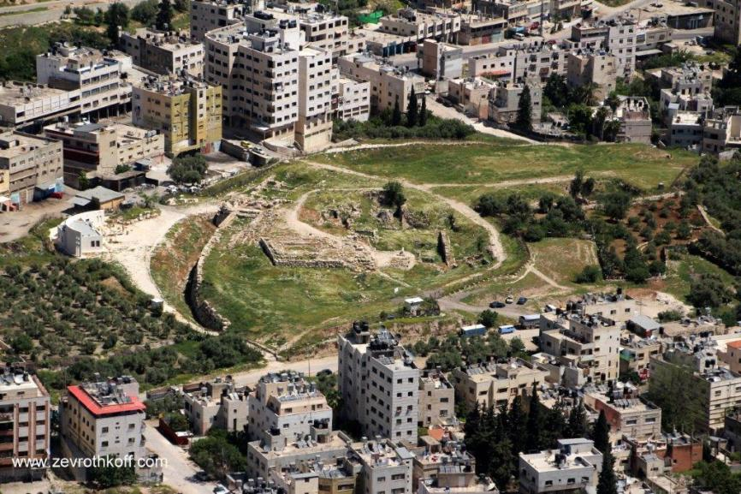
Parable of Yotam משל יותם(9:7-21)
(7) When Jotham was informed, he went and stood on top of Mount Gerizim
and called out to them in a loud voice. “Citizens of Shechem!” he cried, “Listen to me, that God may listen to you.

Slide 9
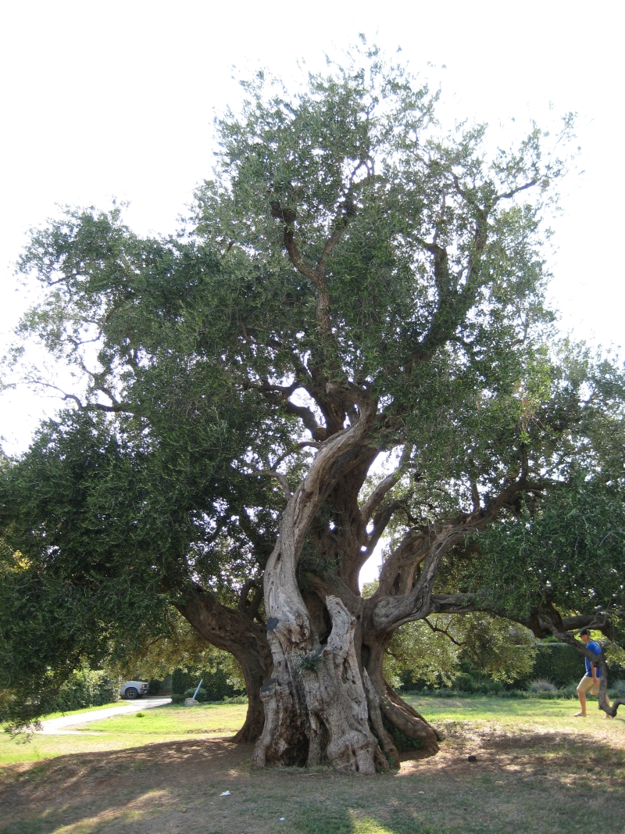
The Olive King?
(8) “Once the trees went to anoint a king over themselves. They said to the olive tree, ‘Reign over us.’ (9) But the olive tree replied, ‘Have I, through whom God and men are honored, stopped yielding my rich oil, that I should go and wave above the trees?’

Slide 10
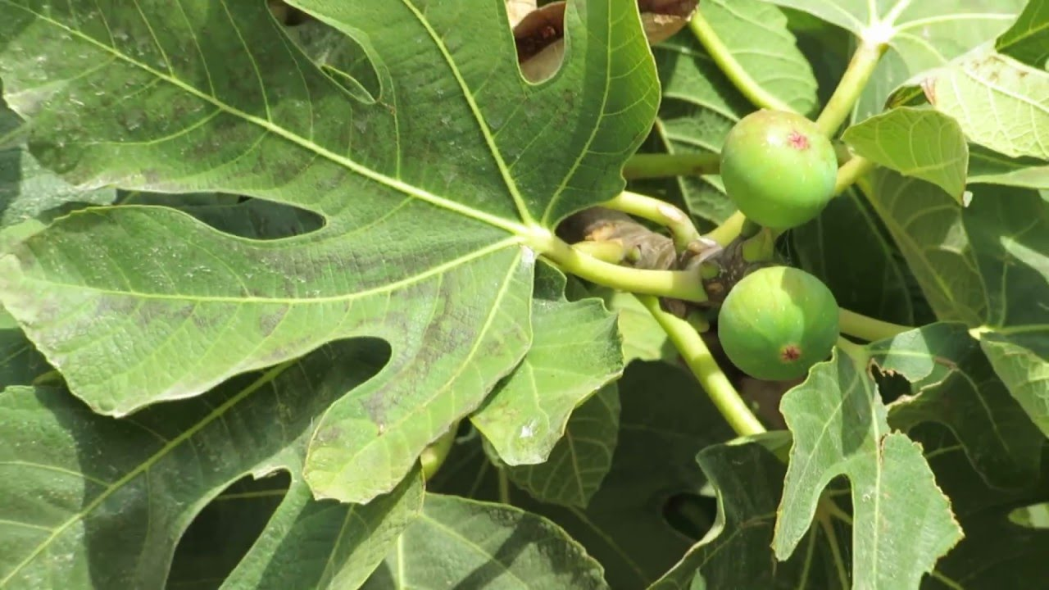
Fig Rulin’?
(10) So the trees said to the fig tree, ‘You come and reign over us.’ (11) But the fig tree replied, ‘Have I stopped yielding my sweetness, my delicious fruit, that I should go and wave above the trees?’

Slide 11
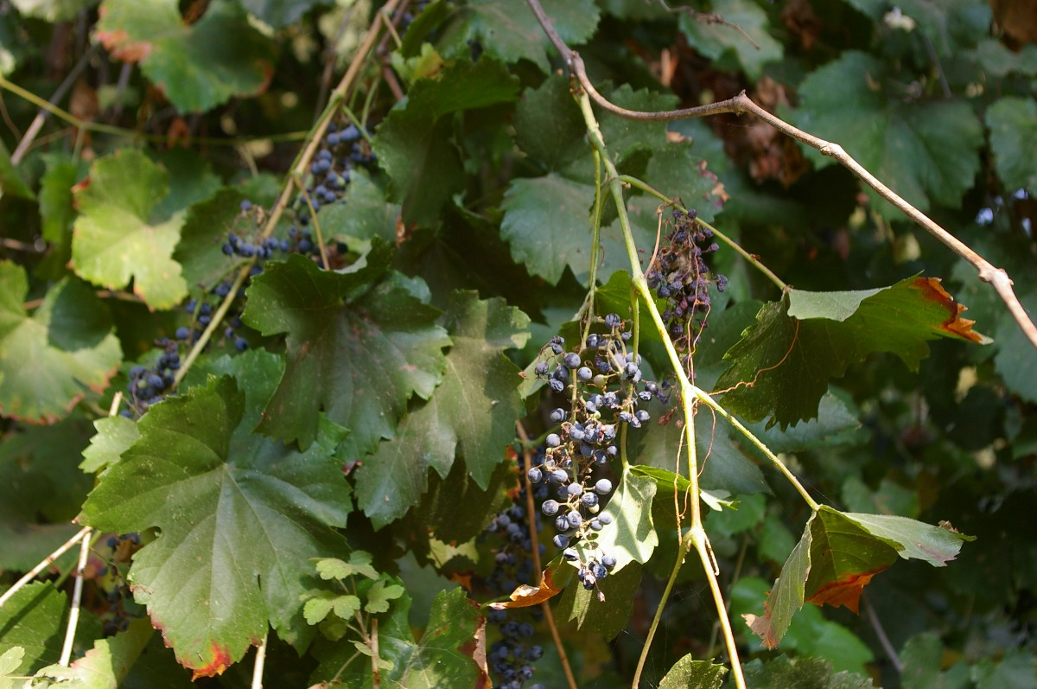
Grape the Great Vine?
(12) So the trees said to the vine, ‘You come and reign over us.’ (13) But the vine replied, ‘Have I stopped yielding my new wine, which gladdens God and men, that I should go and wave above the trees?’

Slide 12
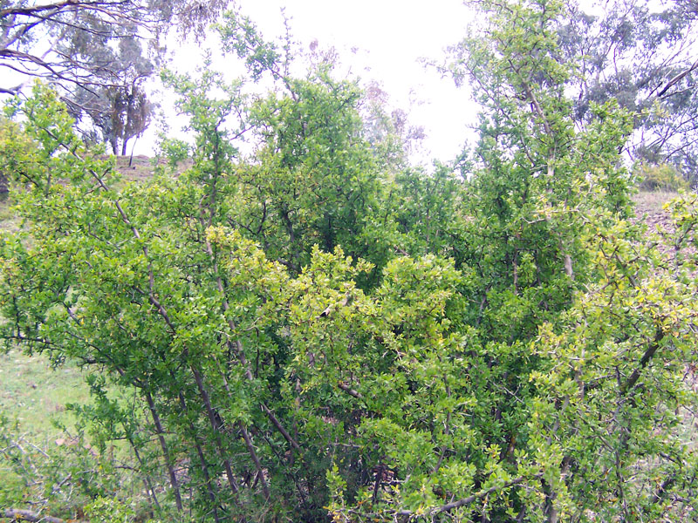
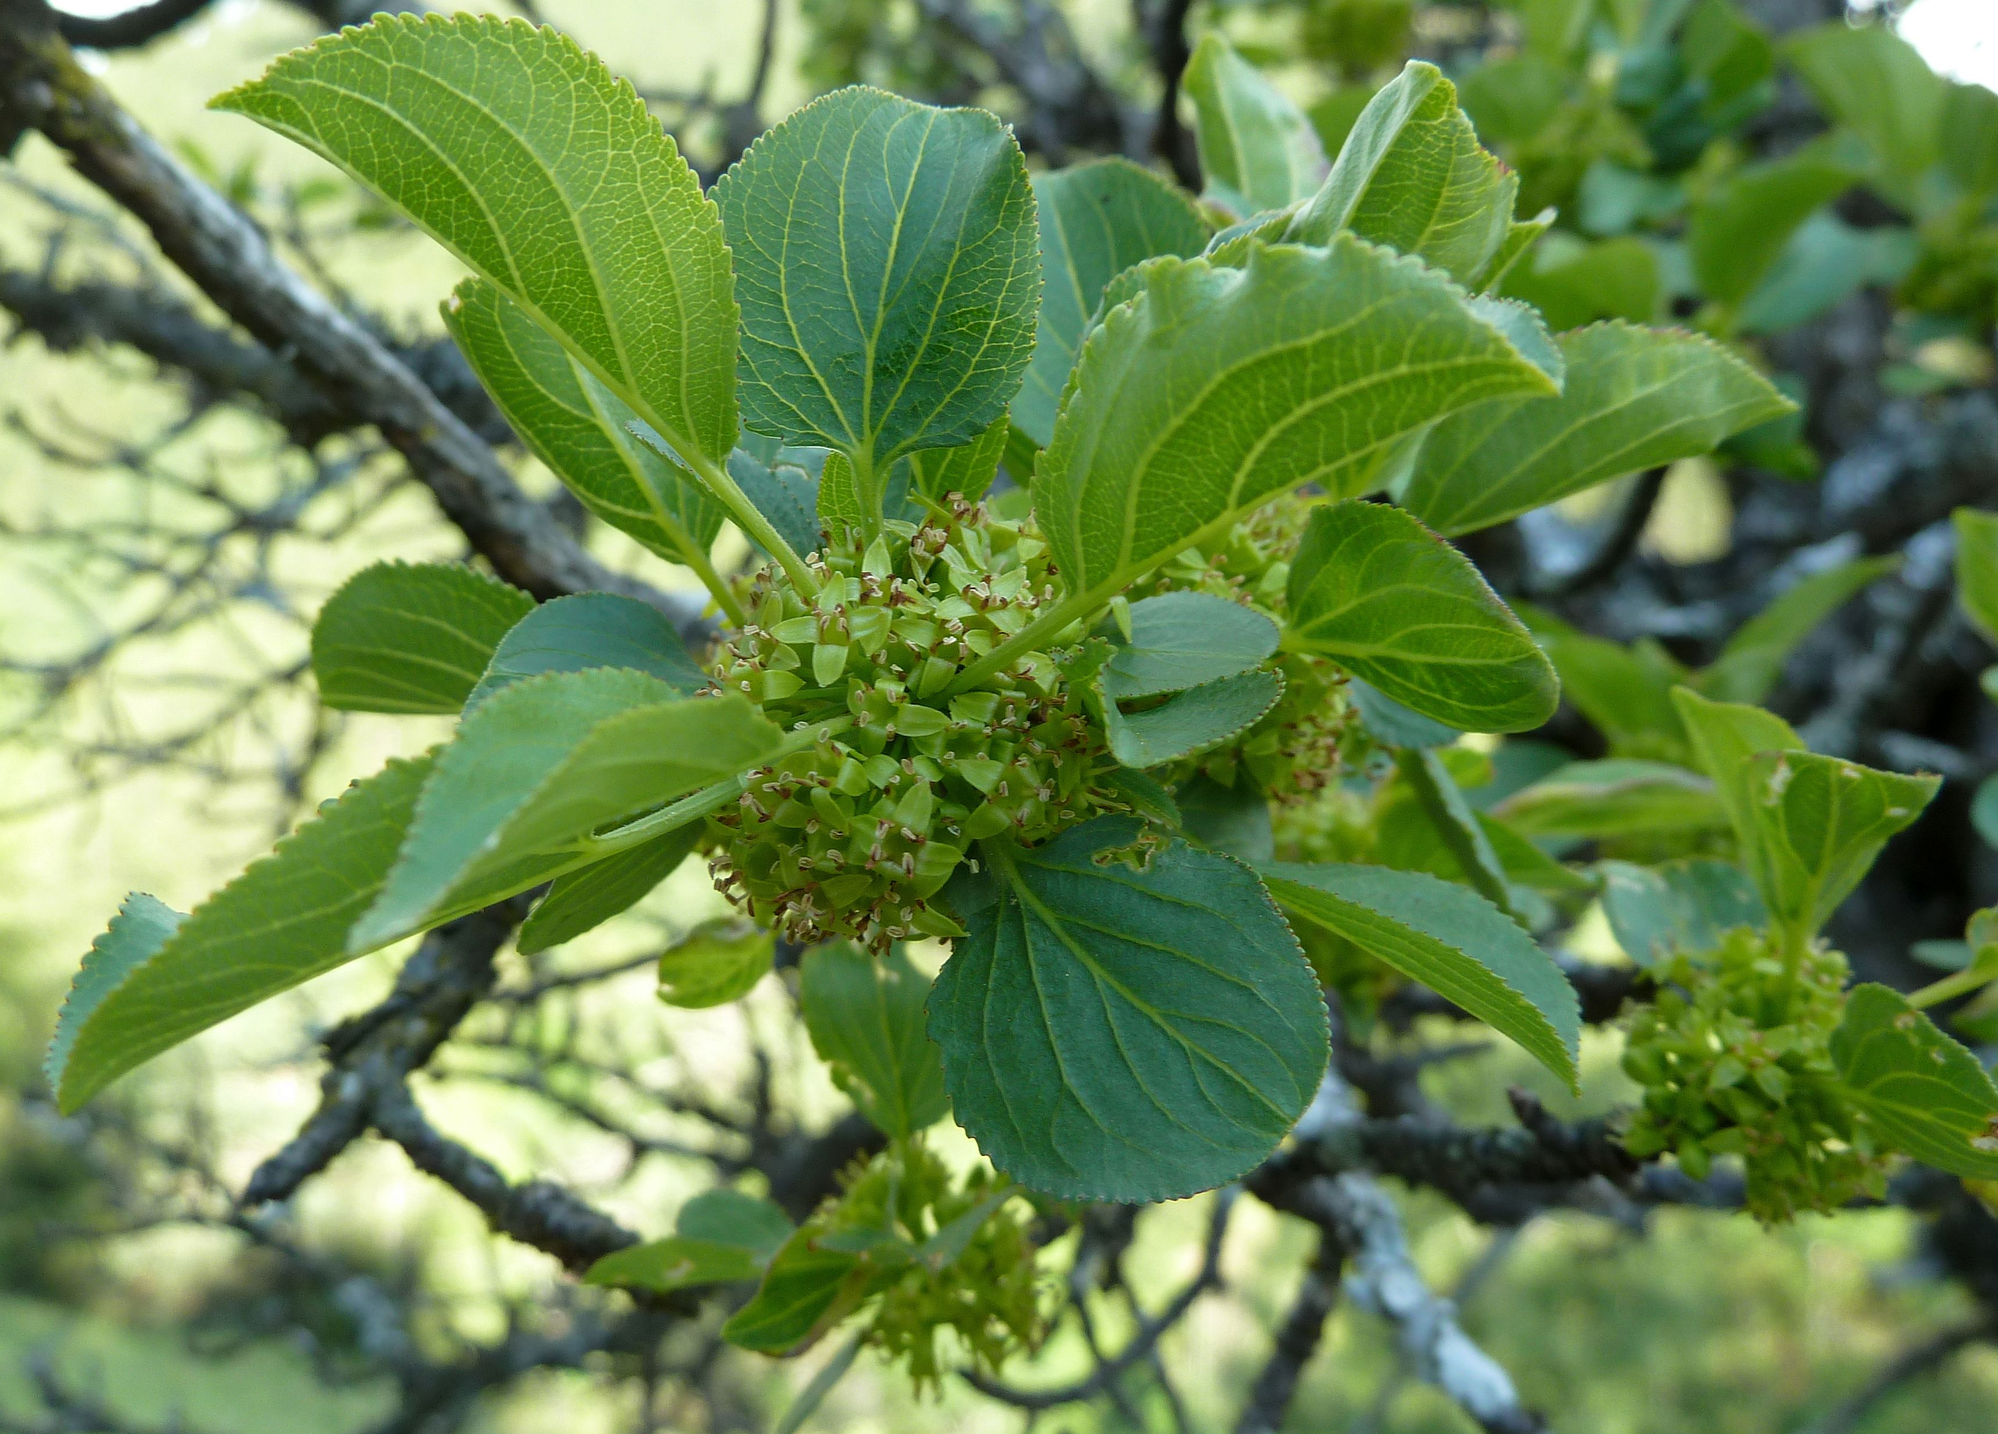
Thornbush
(14) Then all the trees said to the thornbush, ‘You come and reign over us.’
Lyceum - Box thorn Rhamnus - Buckthorn

Slide 13
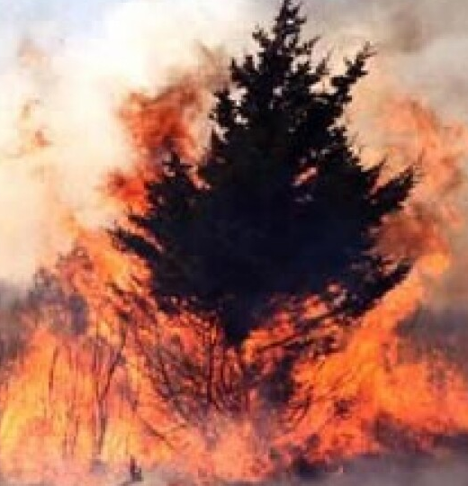
Beware of my Thorns
(15) And the thornbush said to the trees, ‘If you are acting honorably in anointing me king over you, come and take shelter in my shade; but if not, may fire issue from the thornbush and consume the cedars of Lebanon!’

Slide 14
Thorny Curse
(16) “Now then, if you acted honorably and loyally in making Abimelech king, if you have done right by Jerubbaal and his house and have requited him according to his deserts— (17) considering that my father fought for you and saved you from the Midianites at the risk of his life, (18) and now you have turned on my father’s household, killed his sons, seventy men on one stone, and set up Abimelech, the son of his handmaid, as king over the citizens of Shechem just because he is your kinsman— (19) if, I say, you have this day acted honorably and loyally toward Jerubbaal and his house, have joy in Abimelech and may he likewise have joy in you. (20) But if not, may fire issue from Abimelech and consume the citizens of Shechem and Beth-millo, and may fire issue from the citizens of Shechem and Beth-millo and consume Abimelech!”

Slide 15
Who was whom in the Parable
Rashi – Rabbi Shlomo Yitzchaki –
the olive represents Otniel,
the fig Devorah the Prophetess,
the grapevine is Gideon
Thorn is Avimelech

Slide 16
Downfall of Avimelech
G-d causes a split between Baalei - Shechem and Avimelech for Avimelech’s sins. And they become bandits on the highway and words makes its way to Avimelech (9:22-25)
Gaal the son of Eved drunkenly complains about Avimelech with other members of Shechem, Avimelech is true royalty, not descended from Shechem the son of Chamor, and sounds like he would like to start a rebellion. (9:26-29)
Zevul, the governor, overhears and brings word to Avimelech, encouraging him to set up an ambush. Avimelech sneaks under the cover of night (9:30-34)
Gaal sees the armies coming down the hills, and Zevul mocks him that it shadows, and then adds this is what you deserve. (35-38)

Slide 18
Cruelty of Avimelch
Gaal leads Shechem into battle against Avimelech and loses, retreating into the city before Zevul manages to kick out gaal and his supporters. (39-41)
Avimelech launches another campaign the next day, capturing the city and massacring all of those inside, and sowed it with salt. (42-45)
The residents of neighboring Migdal Shechem, Tower of Shechem, hide in the tunnel of Baal-Berith’s temple. Avimelech took an ax, chopped off a limb of a tree and placed it on his shoulder (Shechem), and burnt all of them (~1000 men and women) alive. (46-49)

Slide 19
The final battle
Avimelech attacks the nearby city of Thebez, sacking the city as the people flee the fortress of the city, Migdal Oz. (50-51)
As the Avimelech is about to set fire to the tower as he had done in Shechem, a woman throws a millstone gravely injuring him. He then turns and begs his servant to kill him so people won’t say a woman killed him and he died. (52-54)
With Avimelech dead, his supporters disappear and G-d has repaid everyone involved. (55-57)

Slide 20
Illustration of the woman of Thebez dropping the millstone on Abimelech
Charles Foster, The Story of the Bible, 1884

Slide 21
Death of Abimelech
Gustave Doré, The Death of Abimelech

Slide 22
Summary
Avimelech seizes power in a very not-Jewish fashion.
Primary supporters are Shechem, idolaters who he later turn on each other
Yotam’s parable – goes unheeded, but curse comes first circle
Avimelech and Shechem meet a most ignoble end, fitting for their dastardly deeds.
How not to be king
Shechem is a case in Tanach is a cautionary tale

