Slide 1
Artscroll Through the Ages: Yiddish & Tzenna uRenna
Rabbi Chaim Metzger
cmetzger@torontotorah.com

Slide 2
What is Ze’enah U-Re’enah?
Yiddish translation of stories Torah, Haftorah, and Megillot
Aimed at women
Lots of midrashim inside

Slide 3
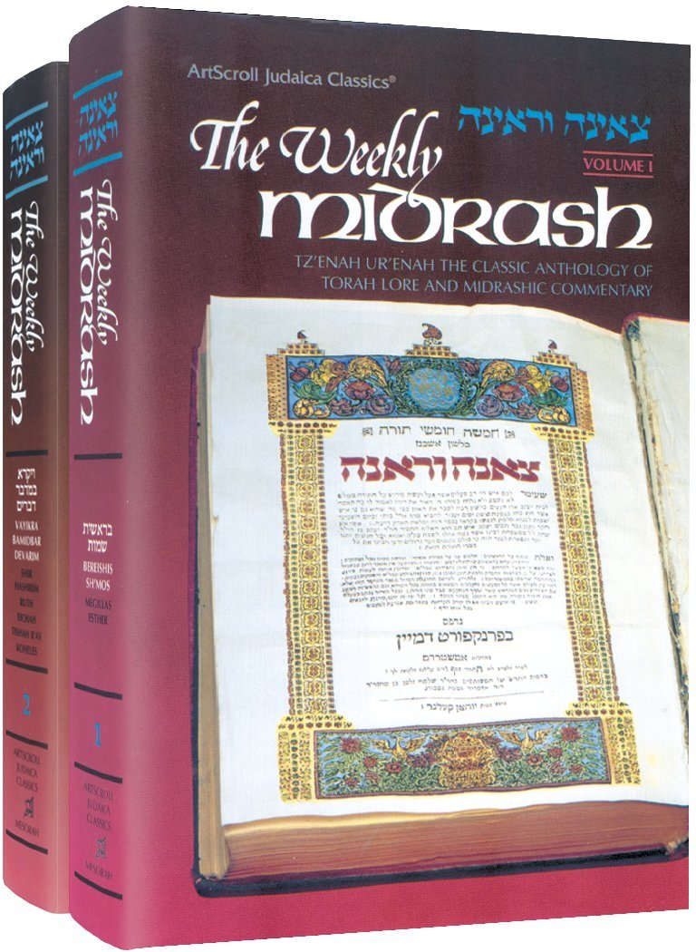

Slide 4
Rabbi Yaakov ben Yitzchak Rabbino (1550?-1623)
Born in Lublin Poland, moved Janova. Lectured on Parsha
Works
Ze’ena U-Re’ena (1602-1620)
Melitz Yosher (1622) – only on Chumash more sophisticated and philosophical
Sefer Shoresh Yaakov (1640 posthumously) – Halachic work
Sefer HaMagid- Yiddish translation of Nach (Neviim and Ketuvim)
but only used his name, he only translated until Iyov before he passed and publisher switched for a more Rashi based translation

Slide 5
Why was Tzena Re’ena written?
Written for Jewish women who could read and understand Yiddish
Give them something of substance and written by Jewish Source
The name derives from a verse of the Song of Songs that begins Ṣʼenā urʼenā bnoth Ṣiyyon (צְאֶנָה וּרְאֶינָה בְּנוֹת צִיּוֹן‎, "Go forth and see, O ye daughters of Zion", (Song 3:11)). The nature of the source of the name indicates that the book was intended for women, who would have been less versed than men in Hebrew, the Jewish liturgical language. (Wikipedia)

Slide 6
The Good Old Days
Letter of Chofetz Chaim About “Beis Yaakov”
There is a very pressing matter nowadays, when the stream of Kefira (heresy), G-d forbid, rule in full force… all of the doubts and hesitations about the prohibition to teach Torah to women has no substance to it nowadays… because our generation is unlike previous ones – where the House of Israel has the traditions of their mothers and fathers to walk on the path of Torah, and religiosity, reading Tzenna uRenna every Shabbat Kodesh. That we don’t have due to our great sins nowadays.
"עניין גדול ונחוץ הוא בימינו אלה, אשר זרם הכפירה רחמנא לצלן שורר בכל תקפו... וכל החששים והפקפוקים מאיסור ללמד את בתו תורה אין שום בית מיחוש לזה בימינו אלה... כי לא כדורות הראשונים דורותינו, אשר בדורות הקודמים היה לכל בית ישראל מסורת אבות ואימהות לילך בדרך התורה והדת ולקרות בספר צאינה וראינה בכל שבת קודש. מה שאין כן בעוונותינו הרבים בדורותינו אלה".

Slide 7
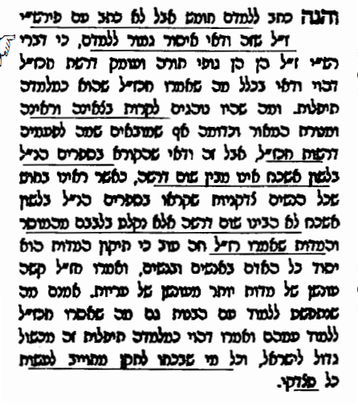
VaYoel Moshe (R’ Yoel Teitelbaum 1887-1979)
[The Satmar Rebbe] wrote to teach Chumash, but not with Rashi because this is definitely prohibited to teach them, because the words of Rashi are the body of Torah and delves into the Drashot of the Sages and which would definitely fall under the category of Tiflut, frivolity. The practice of read Zenna uRenna, Matarat HaMeor and the like even though they sometimes bring drashot of Chazal, but the ones who read it won’t understand any of the drashot as we have seen all of the virtuous women reading these books in Yiddish who didn’t understand any drashot but accepted onto their hearts the Mussar (ethical teachings) and Midot (praiseworthy traits) that our Rabbis said, and this is good because fixing ones’ Midot is the basics for men and women, and our Rabbis said that the punishment for incorrect Midot is worse than violating the Arayot (illicit relations)
(Maamar Lashon HaKodesh)

Slide 8
Rav Kook’s encouragement
One Sabbath day, visitors to the Rav’s home were taken by surprise: on his table lay the popular book entitled Tze’ena U’Re’ena. Written in Yiddish, this classic expounds upon the weekly Torah portion, blending the simple meaning of the text with Midrashim, homiletic interpretations, and more. In the world of Eastern European Jewry, the womenfolk traditionally read this book every Sabbath day.
That particular Sabbath, the Rav read the book aloud, embellishing its various interpretations with illustrative examples and down-to-earth parables. His words flowed spontaneously as they captivated his audience. The learned scholars who had come to visit were astounded, but the simple folk were uplifted and inspired. Their eyes lit up as they thought to themselves: The Torah was not given to scholars alone. Behold, our rabbi is standing in front of us explaining things so clearly, in such a comprehensible fashion. How wonderful is this book that our mothers and grandmothers read; how beautiful are its parables taken from the Midrash; how accurate are its interpretations.
The Rav used to do this every once in a while, and he was undoubtedly the only rabbi in Lithuania who taught Tze’ena U’Re’ena to his congregants. He simply wanted to make the uneducated Jews appreciate this book, so that they would not be embarrassed to read it at home, where it could be a source of blessing every Sabbath. (translation by R’ Moshe Lichtman)

Slide 9
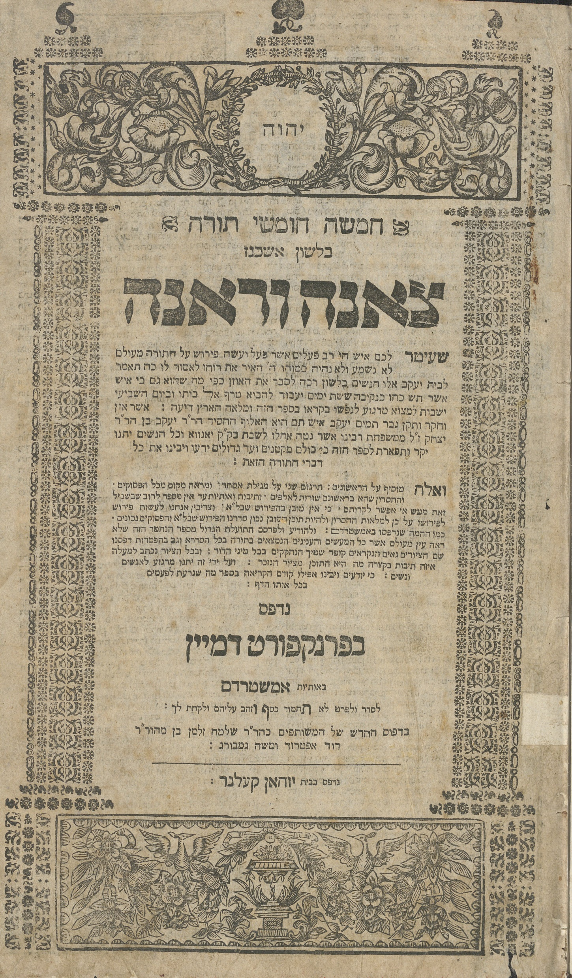
Title page printed in Frankfurt 5486 (1735)

Slide 11
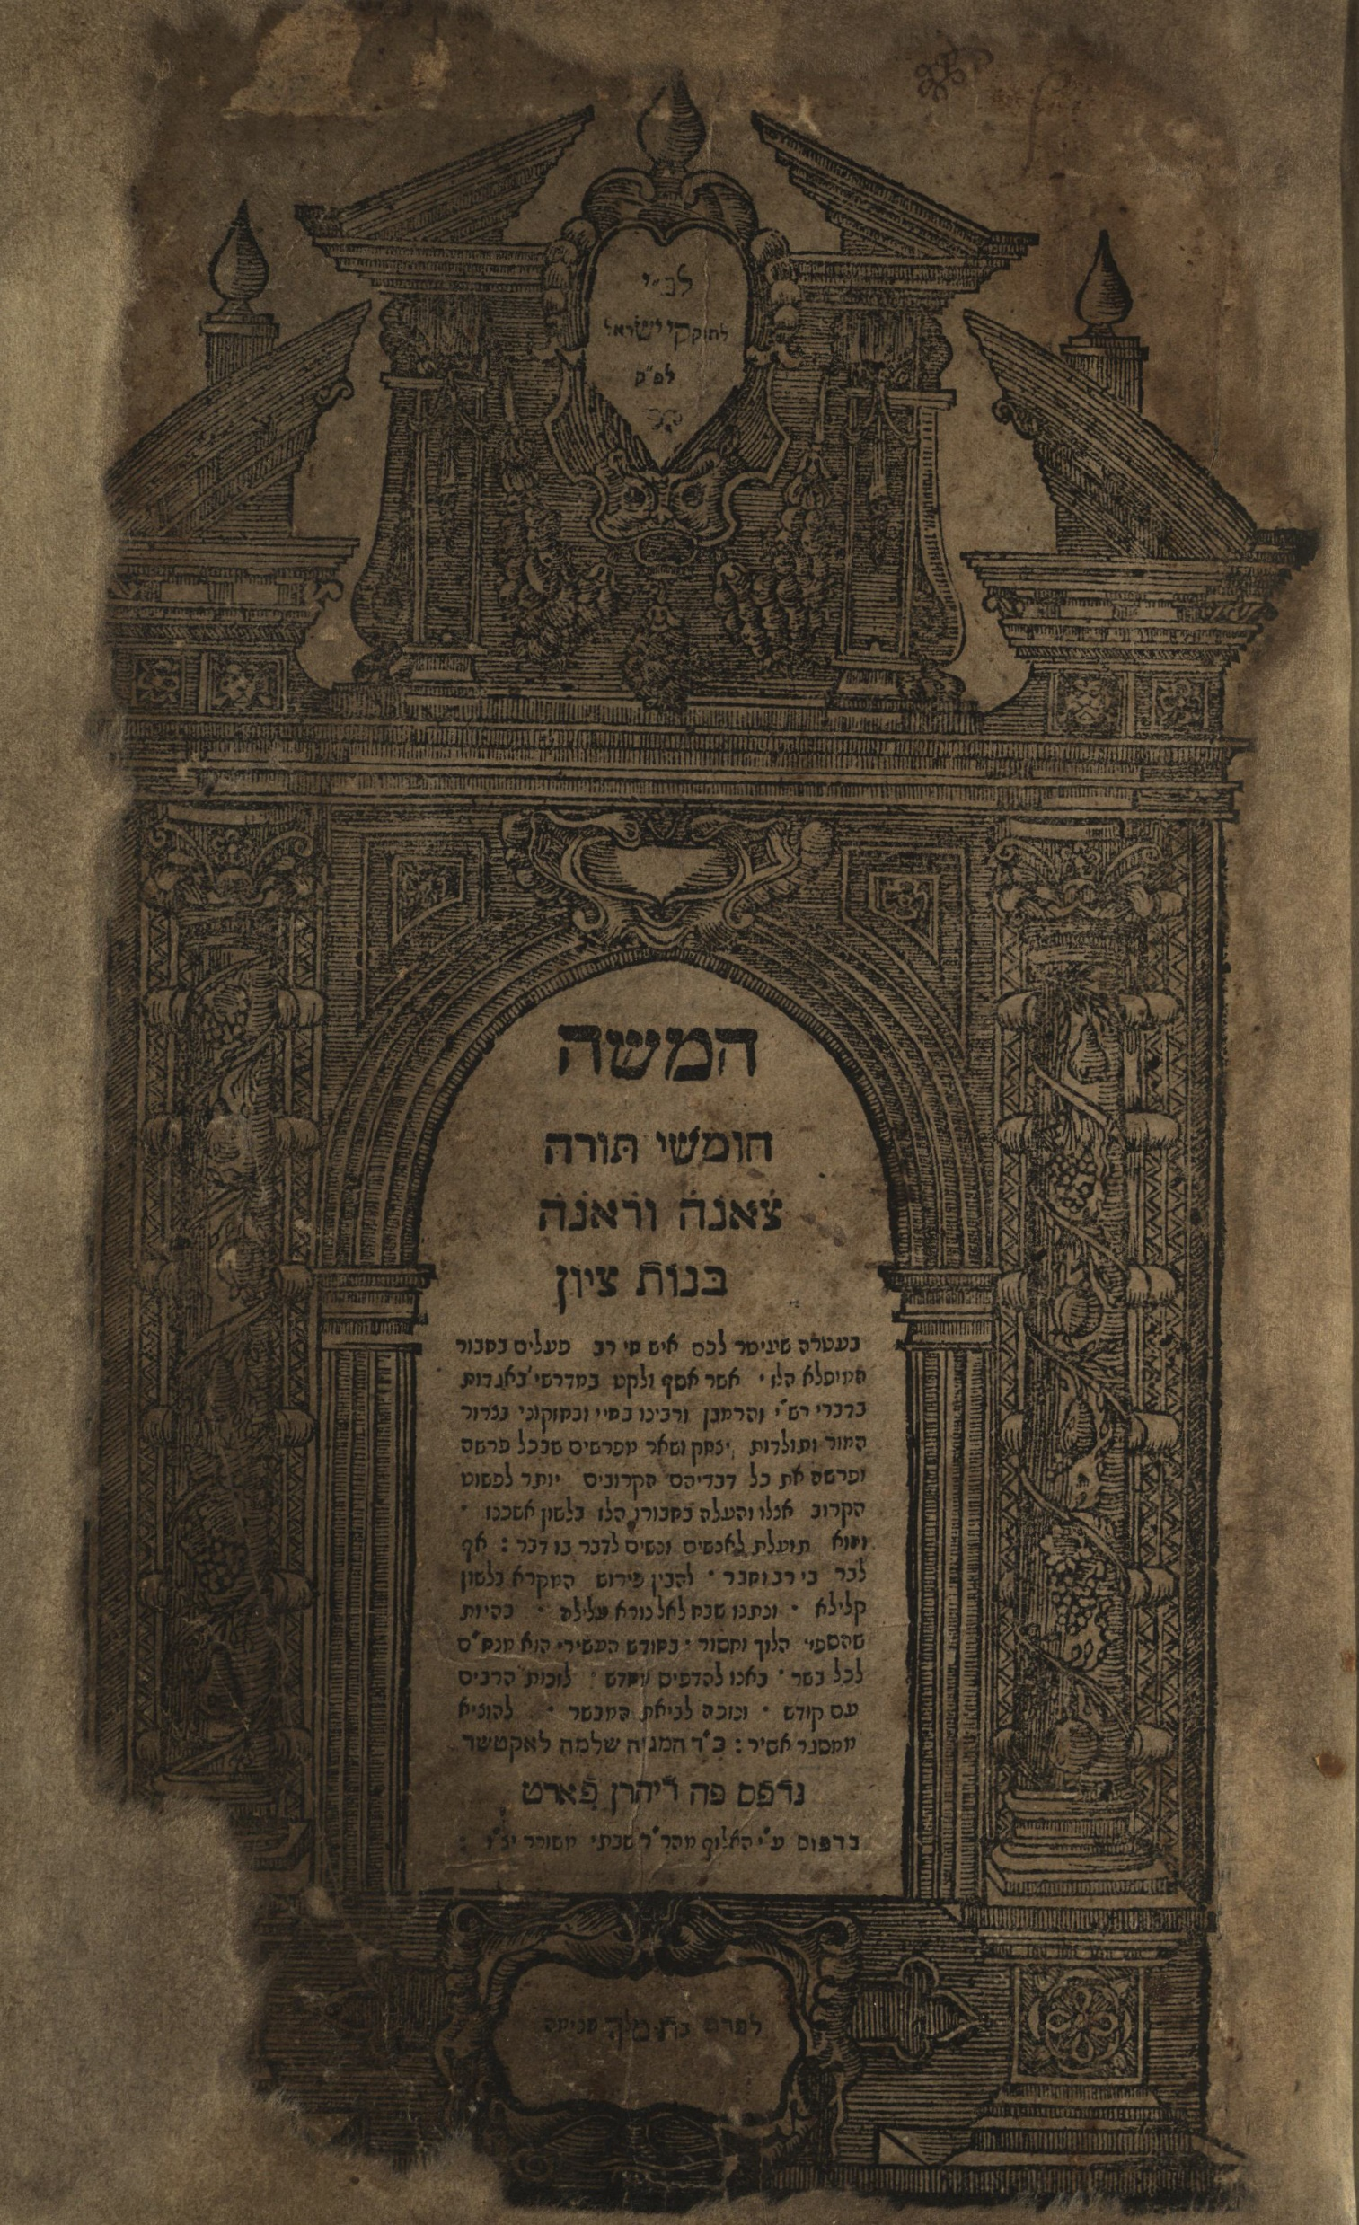
Notes:
1725

Slide 12
What R’ Yaakov Rabino meant (Basel/Hanau,1622)
Five Books Of The Torah In The Language Of Ashkenaz - Daughters Of Zion Go Out And See
With the crown that a living man of great deeds,¹has crowned you with this wondrous work.² He has gleaned among the sheaves behind the reapers³of grain, and collected after the gatherers, once up once down,⁴ one here and one therein the Midrashim, in the aggadot, in the words of Rashi, Ramban, Rabbenu Bahya, Hizkuni, Zeror ha-Mor, Toldot Yitzhak, and the other commentaries in every Torah portion, all of their words that are closest to the plain meaning of the text and brought them into this work in the language of Ashkenaz. Since the usefulness of this work for men and women who will find tranquility for themselves,⁵ a place of rest for their souls in order to understand the words of the living God,⁶ exceeding in rank and exceeding in honor,⁷ in the shameful language. Before this appeared,⁸ it was already famous.⁹ It was praised in the city where it circulated, saying that nothing like this book was seen, incorporating the above mentioned commentaries. Therefore, they shook out the bosom of their garment,¹⁰with the aid of the Lord among the warriors,¹¹in the holy community of Lublin to undertake the divine task,¹²bringing it to the divine work to reveal the hidden hoards,¹³and concealed wisdom of this book. Afterwards, it was printed twice in the holy community of Cracow. Nonetheless, it is cannot be found in the whole diaspora of Ashkenaz, except for one from a town and two from a clan.¹⁴This made it necessary to bring it to the craft of the press in the city of Basel.

Slide 13
Myths debunked - Dr. Morris M Faierstein
Intended audience
אנשים ונשים on title page of 1622 edition
Serious enough translation to be quoted by the Taz (R’ David ha-Levi Segal (1586 –1667) by name
Israel Zinberg - Being for women is because Wissenschaft des Judenstums or elitism of Maskilim
Real name – חמשה חומשי תורה בלשון אשכנז
צאינה וראינה was just added to make it look pretty,
Notes:
חמשה חומשי תורה מגילות והפטרות בלשון אשכנז (The five books of the Pentateuch, the Megillot and the Haftarot in Yiddish)
“This work aims to enable men and women … to understand the word of G-d in simple language,”

Slide 14
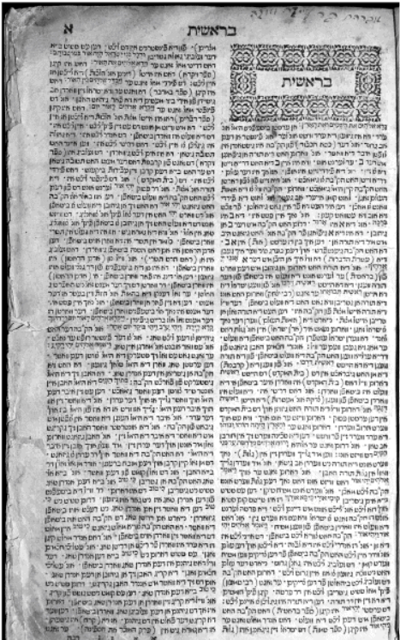

Slide 15
Type of translation
On Parshah, Haftorah, and Megilot
No Hebrew or Translation of Torah, nor references to verse numbers
Highlights of the verse on question
Starts with one or two words in Hebrew then dos iz teitsch
“In Yiddish this is” or “this means”, explanation of verse
Or starts with כלומר, that is to say,
Main text - quotes another source – commentary, Gemara or Midrash

Slide 16
Sources for Zenna URenna
Chumash - Commentary’s quoted- Rabeinu Bahya, Ramban, Rashi, Toldot Yitzchak, Hizkuni
Sometimes quotes, paraphrases excerpts
Haftorah
Rashi and Radak
3 stories from Yalkut Shimoni
Megillah
Rashi and Targum
Plenty of Gemara, Midrash

Slide 17
History and Changes
Initially written in Western Yiddish
Translated to Eastern European Yiddish in 1786
Eventually added twists to defend against Enlightenment, and added elements of Chassidut

Slide 18
“Pharaoh awoke and it was a dream”[41:7]. Pharaoh woke up and saw that the dream needed to be interpreted.
Hizkuni asks a question here. Why did the verse not say at the first dream, “Pharaoh awoke and it was a dream”? He should also have needed to interpret the first dream.
The explanation is that in the dream where the cows ate the other cows, this is not such a great novelty, since cows have mouths with which to eat. However, the seven ears eating the other seven ears is something novel. Therefore Pharaoh was frightened about the seven ears.⁵ (Morris M. Faierstein. Ze’enah U-Re’enah : A Critical Translation Into English. De Gruyter, 2017.)

Slide 19
Acceptance (Ta”z Orach Chaim 285:2)
Those who can understand Rashi properly can use it as a explanation of the text [for Shnayim Mikra v’Echad Targum], but those who aren’t so learned definitely can read the explanation of the Torah in Ashkenaz (Yiddish) in our days such as the Book Zenna Urenna and those like it to understand the ideas of the Parshah.
והיינו מי שיכול להבין בפירש"י כראוי פי' המקרא אבל מי שאינו בר הכי ודאי ראוי לקרות בפי' התור' שיש בל' אשכנז בזמנינו כגון ספר צאנה וראנ' וכיוצ' בו כדי שיבין ענין הפרש':

Slide 20
Summary
Written in Yiddish by R’ Yaakov Rabino so more people could access and understand Torah, Haftarah, and Megillot
Extremely popular throughout Europe
Became associated with Torah learning for women
Less popular after Holocaust as less people speaking Yiddish
Content
Assumed knowledge of basic story of Chumash, Haftorah, and Megilot
Draws upon Commentators, Midrash, Gemara as sources
Focuses on stories and messages

Slide 21
English Editions
Ze’enah U-Re’enah: A Critical Translation into English
https://books.google.ca/books?id=T2zNDgAAQBAJ&printsec=frontcover#v=onepage&q&f=false

Slide 22
Next Week English Translations
tiny.cc/translated @8:15pm

