Slide 1
Artscroll Through the Ages: Aramaic Targum Bavel and Israel
Rabbi Chaim Metzger
cmetzger@torontotorah.com

Slide 2
What is Targum?
Translation in Aramaic
Why do we have Targumim?
What Targumim are there?
Usage of Targum in Shul

Slide 3
Why do we have Targumim?
People no longer fluent in Hebrew
Tradition from Har Sinai
Melachim II 18:26
וַיֹּ֣אמֶר אֶלְיָקִ֣ים בֶּן־חִ֠לְקִיָּ֠הוּ וְשֶׁבְנָ֨ה וְיוֹאָ֜ח אֶל־רַבְשָׁקֵ֗ה דַּבֶּר־נָ֤א אֶל־עֲבָדֶ֙יךָ֙ אֲרָמִ֔ית כִּ֥י שֹׁמְעִ֖ים אֲנָ֑חְנוּ וְאַל־תְּדַבֵּ֤ר עִמָּ֙נוּ֙ יְהוּדִ֔ית בְּאׇזְנֵ֣י הָעָ֔ם אֲשֶׁ֖ר עַל־הַחֹמָֽה׃
Eliakim son of Hilkiah, Shebna, and Joah replied to the Rabshakeh, “Please, speak to your servants in Aramaic, for we understand it; do not speak to us in Judean in the hearing of the people on the wall.”
Nehemiah 13:24
וּבְנֵיהֶ֗ם חֲצִי֙ מְדַבֵּ֣ר אַשְׁדּוֹדִ֔ית וְאֵינָ֥ם מַכִּירִ֖ים לְדַבֵּ֣ר יְהוּדִ֑ית וְכִלְשׁ֖וֹן עַ֥ם וָעָֽם׃
a good number of their children spoke the language of Ashdod and the language of those various peoples, and did not know how to speak Judean.

Slide 4
What Aramaic Targumim are there?
Targum Onkelos
Gold Standard or Torah mentioned in Gemara
Targum Yonatan on Neviim
Targum Pseudo Yonatan/Yerushalmi
Targum Neofiti
Fragment Targums
Cairo Genizah Fragment Targums
Peshitta

Slide 5
Targum Onkelos – Bavli Megillah 3a
וְאָמַר רַבִּי יִרְמְיָה וְאִיתֵּימָא רַבִּי חִיָּיא בַּר אַבָּא: תַּרְגּוּם שֶׁל תּוֹרָה אוּנְקְלוֹס הַגֵּר אֲמָרוֹ מִפִּי רַבִּי אֱלִיעֶזֶר וְרַבִּי יְהוֹשֻׁעַ. תַּרְגּוּם שֶׁל נְבִיאִים יוֹנָתָן בֶּן עוּזִּיאֵל אֲמָרוֹ מִפִּי חַגַּי, זְכַרְיָה, וּמַלְאָכִי, וְנִזְדַּעְזְעָה אֶרֶץ יִשְׂרָאֵל אַרְבַּע מֵאוֹת פַּרְסָה עַל אַרְבַּע מֵאוֹת פַּרְסָה. יָצְתָה בַּת קוֹל וְאָמְרָה: "מִי הוּא זֶה שֶׁגִּילָּה סְתָרַיי לִבְנֵי אָדָם?" §
עָמַד יוֹנָתָן בֶּן עוּזִּיאֵל עַל רַגְלָיו וְאָמַר: "אֲנִי הוּא שֶׁגִּלִּיתִי סְתָרֶיךָ לִבְנֵי אָדָם גָּלוּי וְיָדוּעַ לְפָנֶיךָ שֶׁלֹּא לִכְבוֹדִי עָשִׂיתִי וְלֹא לִכְבוֹד בֵּית אַבָּא אֶלָּא לִכְבוֹדְךָ עָשִׂיתִי שֶׁלֹּא יִרְבּוּ מַחֲלוֹקֹת בְּיִשְׂרָאֵל." וְעוֹד בִּיקֵּשׁ לְגַלּוֹת תַּרְגּוּם שֶׁל כְּתוּבִים, יָצְתָה בַּת קוֹל וְאָמְרָה לוֹ דַּיֶּיךָּ. מַאי טַעְמָא? מִשּׁוּם דְּאִית בֵּיהּ קֵץ מָשִׁיחַ.
וְתַרְגּוּם שֶׁל תּוֹרָה אוּנְקְלוֹס הַגֵּר אֲמָרוֹ. וְהָא אָמַר רַב אִיקָא בַּר אָבִין אָמַר רַב חֲנַנְאֵל אָמַר רַב מַאי דִּכְתִיב וַיִּקְרְאוּ בְּסֵפֶר תּוֹרַת הָאֱלֹהִים מְפוֹרָשׁ וְשׂוֹם שֶׂכֶל וַיָּבִינוּ בַּמִּקְרָא וַיִּקְרְאוּ בְּסֵפֶר תּוֹרַת הָאֱלֹהִים זֶה מִקְרָא מְפוֹרָשׁ זֶה תַּרְגּוּם וְשׂוֹם שֶׂכֶל אֵלּוּ הַפְּסוּקִין וַיָּבִינוּ בַּמִּקְרָא אֵלּוּ פִּיסְקֵי טְעָמִים וְאָמְרִי לַהּ אֵלּוּ הַמָּסוֹרֹת? שְׁכָחוּם וְחָזְרוּ וְיִסְּדוּם
Rabbi Yirmeya said, and some say that it was Rabbi Ḥiyya bar Abba who said: The Aramaic translation of the Torah used in the synagogues was composed by Onkelos the convert based on the teachings of Rabbi Eliezer and Rabbi Yehoshua. The Aramaic translation of the Prophets was composed by Yonatan ben Uzziel based on a tradition going back to the last prophets, Haggai, Zechariah, and Malachi. The Gemara relates that when Yonatan ben Uzziel wrote his translation, Eretz Yisrael quaked over an area of four hundred parasangs [parsa] by four hundred parasangs, and a Divine Voice emerged and said: Who is this who has revealed My secrets to mankind?
Yonatan ben Uzziel stood up on his feet and said: I am the one who has revealed Your secrets to mankind through my translation. However, it is revealed and known to You that I did this not for my own honor, and not for the honor of the house of my father, but rather it was for Your honor that I did this, so that discord not increase among the Jewish people. In the absence of an accepted translation, people will disagree about the meaning of obscure verses, but with a translation, the meaning will be clear.
And Yonatan ben Uzziel also sought to reveal a translation of the Writings, but a Divine Voice emerged and said to him: It is enough for you that you translated the Prophets. The Gemara explains: What is the reason that he was denied permission to translate the Writings? Because it has in it a revelation of the end, when the Messiah will arrive. The end is foretold in a cryptic manner in the book of Daniel, and were the book of Daniel translated, the end would become manifestly revealed to all.
The Gemara asks: Was the translation of the Torah really composed by Onkelos the convert? Didn’t Rav Ika bar Avin say that Rav Ḥananel said that Rav said: What is the meaning of that which is written with respect to the days of Ezra: “And they read in the book, the Torah of God, distinctly; and they gave the sense, and they caused them to understand the reading” (Nehemiah 8:8)? The verse should be understood as follows: “And they read in the book, the Torah of God,” this is the scriptural text; “distinctly,” this is the translation, indicating that they immediately translated the text into Aramaic, as was customary during public Torah readings. “And they gave the sense,” these are the divisions of the text into separate verses. “And they caused them to understand the reading,” these are the cantillation notes, through which the meaning of the text is further clarified. And some say that these are the Masoretic traditions with regard to the manner in which each word is to be written. This indicates that the Aramaic translation already existed at the beginning of the Second Temple period, well before the time of Onkelos.
The Gemara answers: The ancient Aramaic translation was forgotten and then Onkelos came and reestablished it.

Slide 6
Who is Onkelos (Avodah Zarah 11a)
Onkelos bar Kelonimos converted to Judaism. The Roman emperor sent a troop [gunda] of Roman soldiers after him to seize Onkelos and bring him to the emperor. Onkelos drew them toward him with verses that he cited and learned with them, and they converted. The emperor then sent another troop of Roman soldiers after him, and said to them: Do not say anything to him, so that he cannot convince you with his arguments. The troops followed this instruction, and took Onkelos with them.
When they were walking, Onkelos said to the troop of soldiers: I will say a mere statement to you: A minor official [nifyora] holds a torch before a high official [apifyora], the high official holds a torch for a duke [dukasa], a duke for the governor, and the governor for the ruler [koma]. Does the ruler hold a torch before the common people? The soldiers said to Onkelos: No. Onkelos said to them: Yet the Holy One, Blessed be He, holds a torch before the Jewish people, as it is written: “And the Lord went before them by day in a pillar of cloud, to lead them the way, and by night in a pillar of fire, to give them light” (Exodus 13:21). They all converted.
The emperor then sent another troop of soldiers after him, to bring Onkelos, and said to them: Do not converse with him at all. The troops followed this instruction, and took Onkelos with them. While they grabbed him and were walking, Onkelos saw a mezuza that was placed on the doorway. He placed his hand upon it and said to the soldiers: What is this? They said to him: You tell us.
Onkelos said to them: The standard practice throughout the world is that a king of flesh and blood sits inside his palace, and his servants stand guard, protecting him outside; but with regard to the Holy One, Blessed be He, His servants, the Jewish people, sit inside their homes and He guards over them outside. As it is stated: “The Lord shall guard your going out and your coming in, from now and forever” (Psalms 121:8). Upon hearing this, those soldiers also converted to Judaism. After that, the emperor sent no more soldiers after him.
אונקלוס בר קלונימוס איגייר שדר קיסר גונדא דרומאי אבתריה משכינהו בקראי איגיור הדר שדר גונדא דרומאי [אחרינא] אבתריה אמר להו לא תימרו ליה ולא מידי §
כי הוו שקלו ואזלו אמר להו אימא לכו מילתא בעלמא ניפיורא נקט נורא קמי פיפיורא פיפיורא לדוכסא דוכסא להגמונא הגמונא לקומא קומא מי נקט נורא מקמי אינשי אמרי ליה לא אמר להו הקב"ה נקט נורא קמי ישראל דכתיב (שמות יג, כא) וה' הולך לפניהם יומם וגו' איגיור [כולהו]
הדר שדר גונדא אחרינא אבתריה אמר להו לא תשתעו מידי בהדיה כי נקטי ליה ואזלי חזא מזוזתא [דמנחא אפתחא] אותיב ידיה עלה ואמר להו מאי האי אמרו ליה אימא לן את
אמר להו מנהגו של עולם מלך בשר ודם יושב מבפנים ועבדיו משמרים אותו מבחוץ ואילו הקב"ה עבדיו מבפנים והוא משמרן מבחוץ שנאמר (תהלים קכא, ח) ה' ישמר צאתך ובואך מעתה ועד עולם איגיור תו לא שדר בתריה

Slide 7
Gittin 56b-57a
אוּנְקְלוֹס בַּר קְלוֹנִיקוּס בַּר אֲחָתֵיהּ דְּטִיטוּס הֲוָה בָּעֵי לְאִיגַּיּוֹרֵי אֲזַל אַסְּקֵיהּ לְטִיטוּס בִּנְגִידָא אֲמַר לֵיהּ מַאן חֲשִׁיב בְּהָהוּא עָלְמָא אֲמַר לֵיהּ יִשְׂרָאֵל מַהוּ לְאִידַּבּוֹקֵי בְּהוּ אֲמַר לֵיהּ מִילַּיְיהוּ נְפִישִׁין וְלָא מָצֵית לְקַיּוֹמִינְהוּ זִיל אִיגָּרִי בְּהוּ בְּהָהוּא עָלְמָא וְהָוֵית רֵישָׁא דִּכְתִיב הָיוּ צָרֶיהָ לְרֹאשׁ וְגוֹ׳ כׇּל הַמֵּיצַר לְיִשְׂרָאֵל נַעֲשָׂה רֹאשׁ אֲמַר לֵיהּ דִּינֵיהּ דְּהָהוּא גַּבְרָא בְּמַאי אֲמַר לֵיהּ §
בְּמַאי דִּפְסַיק אַנַּפְשֵׁיהּ כֹּל יוֹמָא מְכַנְּשִׁי לֵיהּ לְקִיטְמֵיהּ וְדָיְינִי לֵיהּ וְקָלוּ לֵיהּ וּמְבַדְּרוּ [לֵיהּ] אַשַּׁב יַמֵּי
אֲזַל אַסְּקֵיהּ לְבִלְעָם בִּנְגִידָא אֲמַר לֵיהּ מַאן חֲשִׁיב בְּהָהוּא עָלְמָא אֲמַר לֵיהּ יִשְׂרָאֵל מַהוּ לְאִידַּבּוֹקֵי בְּהוּ אֲמַר לֵיהּ לֹא תִדְרוֹשׁ שְׁלוֹמָם וְטוֹבָתָם כׇּל הַיָּמִים אֲמַר לֵיהּ דִּינֵיהּ דְּהָהוּא גַּבְרָא בְּמַאי אֲמַר לֵיהּ בְּשִׁכְבַת זֶרַע רוֹתַחַת
אֲזַל אַסְּקֵיהּ בִּנְגִידָא לְיֵשׁוּ הַנּוֹצְרִי אֲמַר לֵיהּ מַאן חֲשִׁיב בְּהָהוּא עָלְמָא אֲמַר לֵיהּ יִשְׂרָאֵל מַהוּ לְאִדַּבּוֹקֵי בְּהוּ אֲמַר לֵיהּ טוֹבָתָם דְּרוֹשׁ רָעָתָם לֹא תִּדְרוֹשׁ כׇּל הַנּוֹגֵעַ בָּהֶן כְּאִילּוּ נוֹגֵעַ בְּבָבַת עֵינוֹ
אֲמַר לֵיהּ דִּינֵיהּ דְּהָהוּא גַּבְרָא בְּמַאי אֲמַר לֵיהּ בְּצוֹאָה רוֹתַחַת דְּאָמַר מָר כׇּל הַמַּלְעִיג עַל דִּבְרֵי חֲכָמִים נִידּוֹן בְּצוֹאָה רוֹתַחַת תָּא חֲזִי מָה בֵּין פּוֹשְׁעֵי יִשְׂרָאֵל לִנְבִיאֵי אוּמּוֹת הָעוֹלָם
The Gemara relates: Onkelos bar Kalonikos, the son of Titus’s sister, wanted to convert to Judaism. He went and raised Titus from the grave through necromancy, and said to him: Who is most important in that world where you are now? Titus said to him: The Jewish people. Onkelos asked him: Should I then attach myself to them here in this world? Titus said to him: Their commandments are numerous, and you will not be able to fulfill them. It is best that you do as follows: Go out and battle against them in that world, and you will become the chief, as it is written: “Her adversaries [tzareha] have become the chief” (Lamentations 1:5), which means: Anyone who distresses [meitzer] Israel will become the chief. Onkelos said to him: What is the punishment of that man, a euphemism for Titus himself, in the next world? Titus said to him:
That which he decreed against himself, as he undergoes the following: Every day his ashes are gathered, and they judge him, and they burn him, and they scatter him over the seven seas.
Onkelos then went and raised Balaam from the grave through necromancy. He said to him: Who is most important in that world where you are now? Balaam said to him: The Jewish people. Onkelos asked him: Should I then attach myself to them here in this world? Balaam said to him: You shall not seek their peace or their welfare all the days (see Deuteronomy 23:7). Onkelos said to him: What is the punishment of that man, a euphemism for Balaam himself, in the next world? Balaam said to him: He is cooked in boiling semen, as he caused Israel to engage in licentious behavior with the daughters of Moab.
Onkelos then went and raised Jesus the Nazarene from the grave through necromancy. Onkelos said to him: Who is most important in that world where you are now? Jesus said to him: The Jewish people. Onkelos asked him: Should I then attach myself to them in this world? Jesus said to him: Their welfare you shall seek, their misfortune you shall not seek, for anyone who touches them is regarded as if he were touching the apple of his eye (see Zechariah 2:12).
Onkelos said to him: What is the punishment of that man, a euphemism for Jesus himself, in the next world? Jesus said to him: He is punished with boiling excrement. As the Master said: Anyone who mocks the words of the Sages will be sentenced to boiling excrement. And this was his sin, as he mocked the words of the Sages. The Gemara comments: Come and see the difference between the sinners of Israel and the prophets of the nations of the world. As Balaam, who was a prophet, wished Israel harm, whereas Jesus the Nazarene, who was a Jewish sinner, sought their well-being. (WDT)

Slide 8
Who is Onkelos? Talmud Yerushalmi Megillah 1:9
Rabbi Yirmiyah said in the name of Rabbi Chiya Bar Ba that Aquilas the Convert translated the Torah before Rabbi Eliezer and Rabbi Yehoshua and they praised him. As it says in psalms 45: Beautiful things have come from man. (Yerushalmi)
Bavli Megilla 3a - Rabbi Yirmeya said, and some say that it was Rabbi Ḥiyya bar Abba who said: The Aramaic translation of the Torah used in the synagogues was composed by Onkelos the convert based on the teachings of Rabbi Eliezer and Rabbi Yehoshua.
רַבִּי יִרְמְיָה אמר בְּשֵׁם רַבִּי חִיָּיה בַּר בָּא, תִירְגֵם עָקִילֵס הַגֵּר הַתּוֹרָה לִפְנֵי רַבִּי אֱלִיעֶזֶר וְלִפְנֵי רַבִּי יְהוֹשֻׁעַ וְקִילְסוּ אוֹתוֹ. אָמְרוּ לוֹ (תהלים מה) יָפְיָפִיתָ מִבְּנֵי אָדָם
ְואָמַר רַבִּי יִרְמְיָה וְאִיתֵּימָא רַבִּי חִיָּיא בַּר אַבָּא: תַּרְגּוּם שֶׁל תּוֹרָה אוּנְקְלוֹס הַגֵּר אֲמָרוֹ מִפִּי רַבִּי אֱלִיעֶזֶר וְרַבִּי יְהוֹשֻׁעַ.

Slide 9
Targum Onkelos
Jastrow, M., ed. (2006), Dictionary of the Targumim, the Talmud Babli and Yerushalmi, and the Midrashic Literature, Peabody, Mass.: Hendrickson Publishers, OCLC 614562238, s.v. עקילס. There, he writes: "Aḳilas, Aquila, the alleged translator of the Bible into Greek, frequ. surnamed הַגֵּר, the proselyte, and identified with אונקלוס." Others who hold that Aquilas and Onkelos are names representing the same individual are Moses Margolies, author of P'nei Moshe ; Elijah of Fulda, author of a commentary on the Jerusalem Talmud; the author of Korban Ha-Edah , Heinrich Graetz, S.D. Luzzatto, Eliyahu of Vilna . Shmuel Yaffe Ashkenazi, who wrote a commentary on Midrash Rabba, entitled Yafeh To'ar, opined that Aquilas and Onkelos were two separate individuals. (Wikipedia)
Standard Aramaic translation in Bavel
Avoids anthropomorphizing G-d
Very literal
Dated to 2nd century CE
Quoted as Targum Didan, our Targum in Talmud Bavli
Probably also wrote a Greek translation before he converted

Slide 10
Targum Yonotan (Pseudo Jonathan) (TJ1)
Written in Israel
Mistakenly called Targum Yonatan, because was abbreviated ת"י
Often contains long midrashic additions, mixture of types of Aramaic
Written in Galilean Aramaic like that of Talmud Yerushalmi (4th century CE)
Most likely final edits in 12th century

Slide 11
Fragment Targum (TJ2) and Cairo Geniza (CG) Fragments
Fragment Targum
Fragments of other Targumim were found in Cairo Geniza (earliest 7th century CE)
Similar style to PsJ

Slide 12
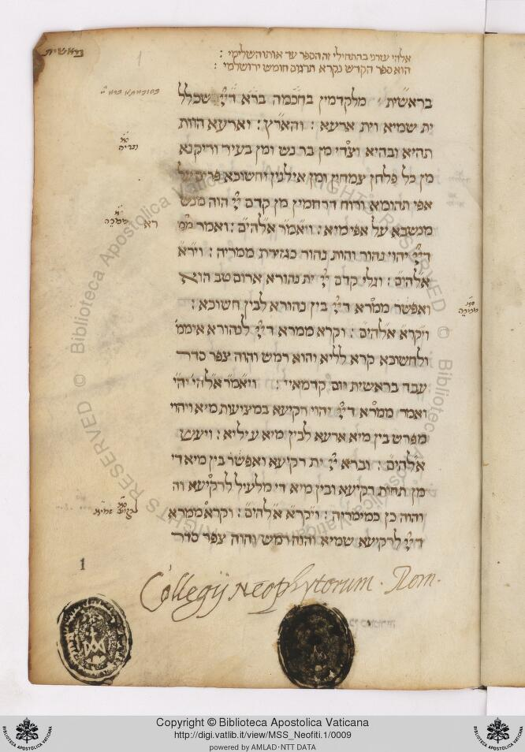
Neofiti
Discovered in Vatican in 1950’s having been mislabeled as Onkelos but was actually a complete Targum from Israel
Dating between 1-4th century CE

Slide 13
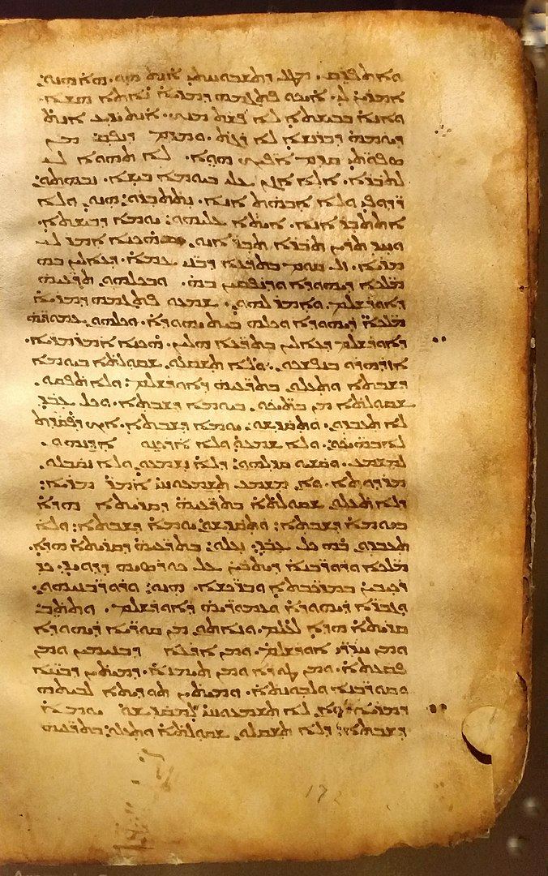
Peshitta
Translated by Jews into Syriac Aramaic from Hebrew
Translated 2nd century CE
Often has Midrashic interpolations
Adopted and canonized by Syriac Church for Old Testament
Commentary on it by R’ Chaim Heller (1879-1960) and R’ Ezer Diena

Slide 14
Thank you R’ Jeremy Wieder for annotation and teaching me Targum, and R’ Ezer Diena for Peshitaa

Slide 15
Usage of Targum in Shul
Starting when?
How?
Why?
Why’d we stop? (Besides Yemenites Jews)

Slide 16
Since When
Yerushalmi Megillah 4:1 (74d)
[What is the biblical source for this custom?] Rabbi Zeirah [said] in the name of Rav Hananel — “And they read from the Book of the Law of God” [Neh. 8:8], this is the Bible; “clearly” — this is the Targum; “and they gave the sense” — these are the diacritical marks; “so that the people understood the reading” — this is tradition. Others say that these are the [halakhic] decisions. Others say that these are the beginnings of the verses. (Translation Z. Safrai)
מִנַּיִין לַתַּרְגּוּם? רַבִּי זְעִירָה אמר בְּשֵׁם רַב חֲנַנְאֵל (נחמיה ח) ‘וַיִּקְרְאוּ בַסֵּפֶר בְּתוֹרַת ה'’, זֶה הַמִּקְרָא. ‘מְפוֹרָשׁ’, זֶה תַּרְגּוּם. ‘וְשׁוּם שֵׂכֶל’, אֵלּוּ הַטְּעָמִים. ‘וְיָבִינוּ בַּמִּקְרָא’, זֶה הַמָּסוֹרֶת. וְיֵשׁ אוֹמְרִים אֵלּוּ הַהֵכְרֵיעִים. וְיֵשׁ אוֹמְרִים אֵלּוּ רָאשֵׁי פְּסוּקִים

Slide 17
Why’d we stop? Tur Orach Chaim 145
In the time of the Talmud they used to translate using Targum in order that the people would understand because they only spoke Aramaic…
Rabbi Natronai Gaon (Sura, Babylonia d. 858CE) said that those who don’t read Targum during Torah reading, saying ‘we don’t need the Targum of our Sages, rather we want one in our language that we understand’ are not fulfilling their obligation [of Targum] and are required to use Targum. But if they refused to use Targum rebelliously they are sinners, and if they don’t know how to Targum they should learn how, and if they need someone to explain the Targum they can have another person explain the Targum.
But Tosafot (12th century) write on the Gemara that discusses Targum …. It appears that even in the time of the Sages of the Talmud there were places that did not use Targum, and from here he supports our custom to not typically read Targum. And in the Yerushalmi we see that on fast days they read from the Torah and did not use Targum, it is not required.
It appears that they used to explain to the masses who spoke Aramaic, but for us what is the point of Targum when we don’t understand it?!? And we shouldn’t explain it to the people in a language they understand because one can say that Targum is different as it was written with Ruach HaKodesh.
בימי חכמי התלמוד היו רגילין לתרגם כדי שיבינו העם כי לשונם היה ארמי. ...
כתב רב נטרונאי אלו שאין מתרגמין ואומרים ג)אין אנו צריכים ד)תרגום דרבנן אלא בלשון שלנו בלשון שהציבור מבינין אין יוצאים י"ח אלא חייבים לתרגם. אבל אם אינן מתרגמין להכעיס בני עבירה הם ואם מפני שאינן יודעין לתרגמו ילמדו ויתרגמו ואם יש מקום שרוצים לפרש להם יעמוד אחר חוץ מן המתרגם ויפרש להם כרצונם
אבל התוספות כתבו על הא דתניא ר' חלפתא בן שאול אומר ה)ל"ש ו)אלא במקום שאין תורגמן אבל במקום ז)שיש תורגמן פוסק משמע שגם בימי חכמי התלמוד היו מקומות שלא היו מתרגמין, מכאן סעד למנהג שלנו שאין אנו רגילין לתרגם. ואמרינן נמי בירוש' ממה דאנן חמי רבנן תפקי לתעניתא וקראו ולא מתרגמין הדא אמרה שאין התרגום מעכב. ונראה שהם היו רגילין לפרש להמון העם שהיו מדברים ארמית אבל לדידן מה תועלת בתרגום כיון שאין אנו מבינין אותו. ואין לומר נלמוד מהם לפרש לעם בלשון שיבינו די"ל תרגום שאני שנתקן ברוח הקדש:

Slide 18
Next Week Arabic Tafsir of Rabbi Saadia Gaon
tiny.cc/translated @8:15pm

