Slide 1
Artscroll Through the Ages: Arabic Tafsir & Rabbi Saadia Gaon
Rabbi Chaim Metzger
cmetzger@torontotorah.com

Slide 2
Why did the Torah get translated into Arabic?
Most Jews spoke Arabic
Muslim Arab conquest beginning in 632 CE by Rashidun caliphate
Battle of Babylon 636 CE – Sasanian (Persian Empire) lost to Rashidun
Part of Christian-Muslim-Jewish debates over scripture
So people wouldn’t use bootleg Karaite, Christian or Muslim translations

Slide 3
The Need for an Arabic Translation
Rabbi Natronai Gaon (Sura, Babylonia d. 858CE) said that those who don’t read Targum during Torah reading, saying ‘we don’t need the Targum of our Sages, rather we want one in our language that we understand’ are not fulfilling their obligation [of Targum] and are required to use Targum. But if they refused to use Targum rebelliously they are sinners, and if they don’t know how to Targum they should learn how, and if they need someone to explain the Targum they can have another (3rd) person explain the text into vernacular.
כתב רב נטרונאי אלו שאין מתרגמין ואומרים ג)אין אנו צריכים ד)תרגום דרבנן אלא בלשון שלנו בלשון שהציבור מבינין אין יוצאים י"ח אלא חייבים לתרגם. אבל אם אינן מתרגמין להכעיס בני עבירה הם ואם מפני שאינן יודעין לתרגמו ילמדו ויתרגמו ואם יש מקום שרוצים לפרש להם יעמוד אחר חוץ מן המתרגם ויפרש להם כרצונם.

Slide 4
Rabbi Saadia Gaon
At the start of the ninth century, the primary Jewish authorities outside of Israel were the political Exilarch, and the Gaonim who headed Babylon’s central yeshivot. Now, contact with Islam and anti-rabbinic Karaism, economic strain between farmers and merchants, unrest due to the Jewish community’s internal taxes, and tension between Jewish leaders in Baghdad and Jerusalem, all challenged the structure of the Diaspora Jewish community.
Into this world came Said al-Fayyumi, born in Egypt in 892. He used his birth name, Said, in his introduction to the Agron Hebrew dictionary he wrote at the age of 20, but later he switched to Saadia. “Al-Fayyumi” refers to his birthplace, Fayum, in northern Egypt.
His family claimed descent from the biblical Yehudah, as well as Rabbi Chanina ben Dosa, a miracle-working sage from the period of the Mishnah. Rabbi Saadia Gaon’s lifelong mission was to end Jewish ignorance of Judaism, and to lead with absolute integrity; both pitted him against powerful opponents.
At the age of 23, Rabbi Saadia began his battle against Karaism, with a published polemic. In 921, at the age of 29, Rabbi Saadia -living in Aleppo, and not yet a Gaon -was the primary voice against a calendar coup led by Aharon ben Meir in Israel. Rabbi Saadia became aware that Aharon ben Meir intended to shift Rosh HaShanah by a day. Rabbi Saadia published numerous scrolls arguing for the authority and accuracy of Babylonian calculations. After a two-year battle, Rabbi Saadia was victorious.
Rabbi Saadia gained the title of Gaon when he became head of the yeshiva in Sura, Babylon, in 928. However, in 930 he became involved in a dispute with the exilarch, David ben Zakkai, refusing to authorize a probate document he felt was illict. David ben Zakkai replaced Rabbi Saadia Gaon; only in 937 was Rabbi Saadia Gaon officially reinstated. He continued to serve as Gaon until his death of illness in 942.
Aside from his dictionary, Rabbi Saadia Gaon’s writings include Hebrew and Arabic polemics defending Judaism from intellectual challenges; his great Emunot v’Deiot philosophical work; an Arabic translation of and commentary to Tanach; a work on the legal principles of the Talmud; a siddur; religious poetry, and more. Rabbi Saadia Gaon’s yahrtzeit is the 26th of Iyar.
(by R’ Mordechai Torzcyner)

Slide 5
Why did R’ Saadia Gaon write it?
My only motivation for composing this work is the personal request of one of the students, who asked for a book dedicated to the simple meaning of the Torah, without integrating any element of linguistic flourishes, metaphors, synonymy, or antonymy. I will cite neither the questions of the heretics nor my answers to them. I will not explore the intellectual mitzvot, nor will I delve into the performance of the pragmatic mitzvot. Rather, I will translate the simple meaning of the verses of the Torah only. I note that what I have been asked to do has a purpose: that the readers will understand and comprehend the issues of the Torah — the narrative, the command and the reward — in sequence and with concision…
It may be that a reader will afterwards seek to understand the fundamentals of the intellectual mitzvot and the commission of the pragmatic ones, as well as how to refute the claims of those who challenge the portions of the Torah; let him satisfy all of these ends in my other book. This brief one may inspire him to this end and lead him to his object.
Bearing all this in mind, I have written this book as a simple translation of the verses of the Torah only, exacting in its logic and following tradition. (from into to Tafsir Translation VBM)
For a long time, in my hometown, I dwelled constantly on my desire, which was to have a translation of the Torah composed by me in use among the people of the true religion, a proper translation that would not be refuted by speculative knowledge or rebutted by tradition; but I refrained from taking that on … because I thought that in the lands far from my hometown there were translations that were clear and formulated precisely. (translated by Richard Steiner)

Slide 6
Perush
Perush HaKatzar The Short Commentary– the Tafsir –
This is the translation of Tanakh into Arabic and it includes some brief explanations — beyond the literal translation — designated for the wider community (Jews and non-Jews).
On all of Tanach
Perush HaArokh
Peirush Ha-arokh (The Long Commentary): This is also written in Arabic, but it is designated for educated readers. This commentary includes an analysis of different topics in the disciplines of linguistics, Halakha, and philosophy.
Only parts of Breishit and Shemot survived
Written in Arabic, either with Judeo-Arabic or Arabic letters
Richard Steiner – RSG commissioned both in his lifetime

Slide 7
Features of the Perush HaKatzar (Dr. Avigail Rock)
A) Avoiding anthropomorphization: Rasag will avoid translating and explaining in a literal way those verses in which there is an attribution of physical phenomena to God. For example, in 17:22, the verse states, “And God went up,” and the Rasag renders, “And the glory of God went up”.
B) Commentative elucidations: For example, the Torah explains Chava’s name by saying (3:20), “For she was the mother of all living things,” and the Rasag changes this to, “of all living speaking things,” since Chava was not the mother of the animals.
C) The identification of places, nations, objects and animals: Rasag customarily identifies different nations mentioned in Tanakh, as well as locations, various flora and fauna, etc. For example, Rasag identifies the sites mentioned in the first eight verses of chapter 14 by describing the places known to him in his era. Similarly, Rasag uses the names of precious stones known in his time to identify the stones of the breastplate.
D) Clarifications in the sphere of faith and philosophy: For example, Malki-Tzedek declares (14:15), “Blessed be Avram to High God,” while Rasag translates, “to the High God,” to eliminate the possibility that the verse refers to numerous gods, of whom Avraham’s God is the chief of the pantheon.
E) Alterations to prevent the desecration of God’s name: For example, the Torah reports (12:17), “And God plagued Pharaoh and his house with great plagues because of the matter of Sarai, Avram's wife,” but Rasag renders this, “And God informed Pharaoh that he would bring on him and his house great plagues on Sarai’s account.” This is in order to avoid the claim that God punishes Pharaoh even though Pharaoh does not yet know that Sarai is a married woman.

Slide 8
Characteristic of the Peirush HaArukh
It is fitting for every thinking person to always take hold of the Torah according to the simple meaning of the words, what is most common among those who speak his language and the most useful… unless sense or logic contradicts this expression, or if the simple meaning of the expression contradicts a different verse or contradicts the prophetic tradition. (R’ Saadia Gaon introduction to Peirush HaArukh, Translation VBM)
A) The sense (our sensory perception of the world) refutes the peshat.
B) The intellect refutes the peshat.
C) There are verses which contradict each other.
D) The Sages’ tradition refutes the peshat.

Slide 9
Against the Karaites (quoted by Ibn Ezra)
An eye for an eye, a tooth for a tooth, a hand for a hand, a foot for a foot. A burn for a burn, an injury for an injury, a bruise for a bruise. (Shemot 21:24-25)
Rasag engaged in a debate with Ben Zuta (prominent Karaite) concerning the question of whether the verse really means that the assailant should lose a limb or merely requires him to compensate his victim monetarily:
R. Saadia said: We cannot explain the verse as it sounds. For if a man will strike the eye of his fellow, reducing the latter’s vision by one-third, how can it be that he will be struck to just such a degree, no more and no less? Perhaps he will be rendered totally blind! The burn, injury and bruise are even more difficult [to reproduce]; if they are in a critical place, [the assailant] may die, and this is ludicrous.
Ben Zuta said to him: But is it not written in another place (Vayikra 24:20): “As he puts a blemish in a person, so must be put in him”?
The Gaon answered him: The term “in” sometimes mean “upon.” It means to say: so must a punishment be put upon him.
Ben Zuta responded to him [with the verse]: “As he has done, so must be done to him” (ibid. v. 19).
The Gaon responded: Did not Shimshon say [of the Philistines] (Shoftim 15:11), “As they have done to me, so have I done to them”? Now, Shimshon did not take their wives and give them to others [which the Philistines had done with Shimshon’s wife]; he simply meant that he had dealt them a deserved punishment.
Ben Zuta responded: If the assailant is indigent, what shall his punishment be?
The Gaon responded: If a blind man puts out the eye of a seeing man, what shall be done to him? On the contrary, it is conceivable that the poor man may become wealthy one day and pay, but the blind man will never be able to “pay”!
In all of his debates with the Karaites, Rasag cites only verses from Tanakh and logical argument, not the tradition of the Sages, as the Karaites did not accept the mesora. (Source Dr. Avigail Rock z”l)
דוגמא לכך[13] נמצאת בשמות, פרק כ"א, פסוק כ"ד, בפסוק "עין תחת עין...". רס"ג מרחיב בתיאור ויכוח בינו לבין בן זוטא[14] , בנוגע לשאלה האם כוונת הפסוק היא להוצאת עין ממש או לתשלום ממון:
אמר רב סעדיה: לא נוכל לפרש זה הפסוק כמשמעו. כי אם אדם הכה עין חבירו, וסרה שלישית אור עיניו, איך יתכן שיוכה כזאת בלי תוספת ומגרעת? אולי יחשיך אור עינו כולו?! ויותר קשה הכויה והפצע והחבורה. כי אם היו במקום מסוכן אולי ימות, ואין הדעת סובלת.
אמר לו בן זוטא: והלא כתוב במקום אחר "כאשר יתן מום באדם כן ינתן בו" (ויקרא, פרק כ"ד, פסוק כ')
והגאון השיב לו: יש לנו בי"ת תחת 'על'[15]. והנה טעמו כן ינתן עליו עונש.
ובן זוטא השיב לו כאשר עשה כן יעשה לו (ויקרא, פרק כ"ד, פסוק י"ט)
והגאון השיב: הנה שמשון אמר כאשר עשו לי כן עשיתי להם (שופטים, פרק ט"ו, פסוק י"א) ושמשון לא לקח נשותיהם ונתנם לאחרים, רק גמולם השיב להם.
ובן זוטא השיב: אם היה הנכה עני מה עונשו?
והגאון השיב: אם עיוור יעוור עין פיקח מה יעשה לו? כי העני יתכן שיעשיר וישלם, רק העיוור לא יוכל לשלם לעולם.

Slide 10
Poem Esa Meshali Against Karaites
דת אלוקינו חלפו לנתר
המותר לאסור והאסור להתר
בלי יראה ובלי אימה
אורך הסכה אמות כמה
ורחבה כמה באמה
וגבהה וקצב התכונה
גרגרים כמה הוא הפרט
האחת מאלה חקוקה בחרט?
או במקרא צפונה?
דבק ציצית מאין ידענו היות
כמה חוטים וכמה חוליות
אם עשרה אם שמונה...
כל אלה וכמוהם רבים
אשאל לכל קורא כתובים
היש בם פירוש אחת מהנה?
לולי המשנה והתלמוד
אשר כל זה בם למוד
וכהנה וכהנה
Our God’s law is swapped as they hop
To forbid the licit, while prohibitions drop
Without fear and without hesitation.
How many cubits must my hut measure?
How long and how wide, for holiday pleasure?
And what of its height, to plan it straight?
How many grapes for the poor must be saved?
Is any of these with a chisel engraved?
Or does Scripture insinuate?
As we affix our fringes to four-cornered things
How many coils and how many strings?
Do you know if it is ten or eight…
All of these, and like them so many
I ask the verse-readers if they can find any
To lay out for us a fine explanation?
But Mishna and Talmud continue to reach us
And derive all of these plainly to teach us
And so many more, beyond enumeration.

Slide 11
Impact of Tafsir
Defacto Arabic translation of Torah
Used by Arabic speaking Christian churches in Islamic lands (Copts)
Quoted extensively by Shmuel ben Hofni Gaon, Yonah ibn Janah, Moshe ibn Ezra, Avraham ibn Ezra, Maimonides, and Rabbi Dovid Kimchi

Slide 12
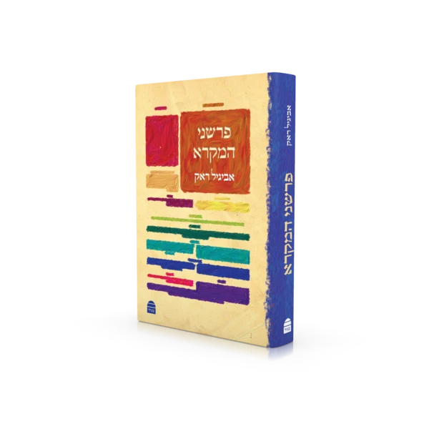
Dr. Avigail Rock z”l
https://etzion.org.il/en/tanakh/studies-tanakh/biblical-commentaries/r-saadia-gaon-commentator
https://korenpub.co.il/en/collections/%D7%97%D7%93%D7%A9/products/parshaney-hamikra

Slide 13
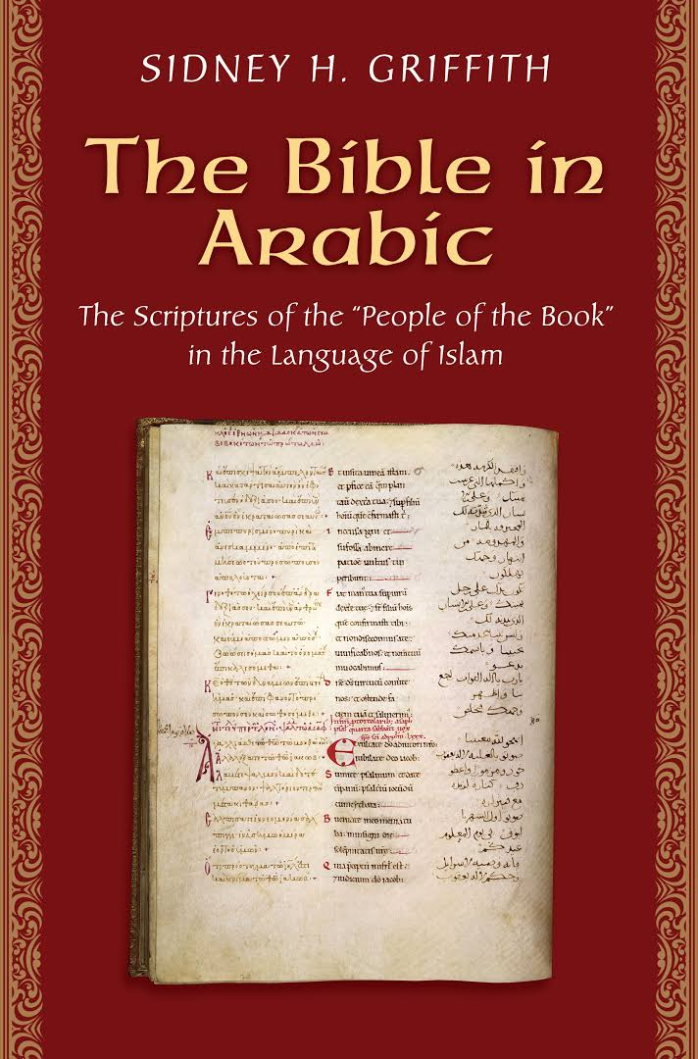
https://www.amazon.com/Bible-Arabic-Scriptures-Language-Christians/dp/0691168083

Slide 14
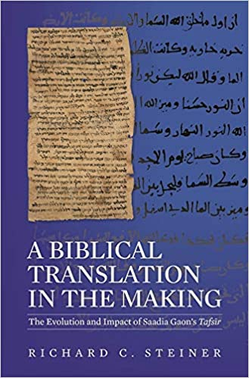
https://www.amazon.com/Biblical-Translation-Making-Evolution-Hardcover/dp/0674033353

Slide 15
Translation into Hebrew
Rabbi Yosef Kapach
Can be found in standalone work with both Peirush Hakatzar and Peirush HaArukh published by Mossad Harav Kook
In the Torat Chaim Chumash
Critical editions of Peirush HaArukh translated into Hebrew with English Summary by Moshe Zucker, can be found on alhatorah.org
“My first work in this case was to collect from our master’s translation all of the words and the alterations which have in them some sort of commentary and to turn them into Hebrew, and this selection demanded great attention from two perspectives: one, that I will not translate the translation, making this a superfluous, onerous act for the lone reader, because is not Scripture which lies before us, and what does it avail us to change Scripture — words of the living God in Hebrew, in the style given to Moshe at Sinai — into my inferior Hebrew?” – R’ Kapach

Slide 16
Next Week German Translations of Moses Mendelssohn and R’ Shimshon Raphael Hirsch
tiny.cc/translated @8:15pm

