Slide 1
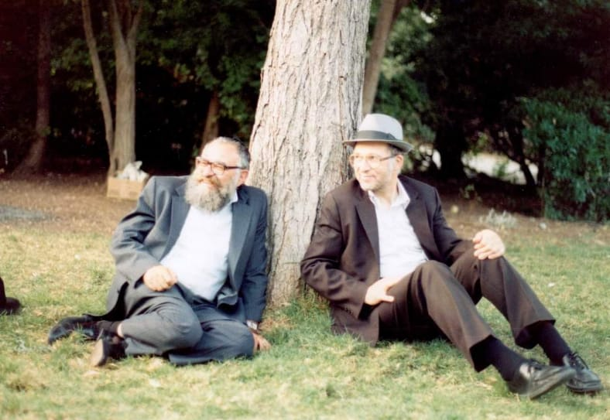
Rav Yehuda Amital:
Natural Morality
R’ Yair Lichtman
06/05/2023

Slide 2
In this Shiur, we will…
Study the biography of Rabbi Yehuda Amital, touching on a few major ideas which animated his thought
Explore his approach to the role of natural morality in religious life

Slide 3
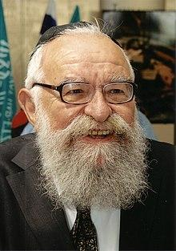
Biography - Pre-Aliyah
Born Yehuda Klein in 1924 in Transylvania
Studied in his hometown under R’ Chaim Yehuda Levi, grandson of R’ Shmuel Glasner
Sent to a labor camp in 1944, where he survived for 8 months before being liberated by the Soviets and moving to Israel. His family was taken to Auschwitz.

Slide 4
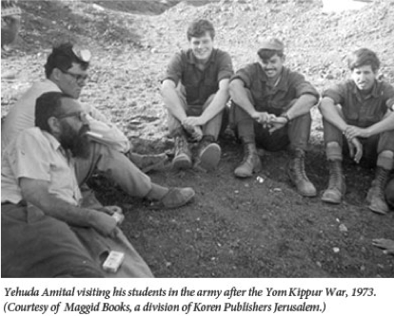
Biography - Post-Aliyah
Continued his studies in the Chevron and Kletsk Yeshivot
Received Semikha from R’ Isser Zalman Meltzer
Served in Tzahal in 1948 in the War of Independence
Taught in Yeshivat HaDarom, where he developed the idea of Yeshivot Hesder

Slide 5
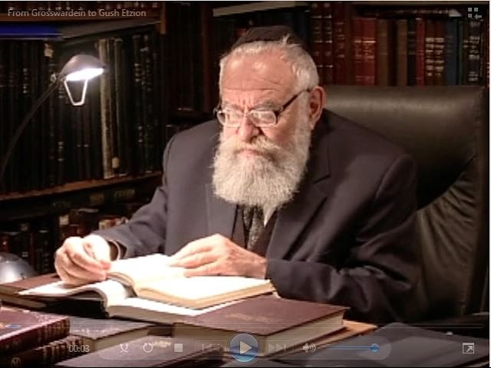
Biography - Founding the Yeshiva
After the Six Day War, R’ Amital was invited to serve as Rosh Yeshiva of Yeshivat Har Etzion in Kfar Etzion.
Invited R’ Aharon Lichtenstein to serve as co-Rosh Yeshiva in 1971
Supported the founding of Michlelet Herzog, an academic college which specializes in advanced study of Tanakh

Slide 6
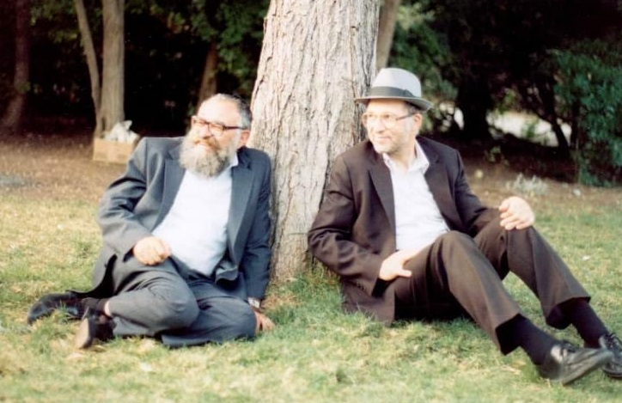
Biography - Political Positions
Supported, in principle, trading land for peace
Served as a minister in the Israeli government under Shimon Peres
Founded the moderate Religious Zionist political party, Meimad, in 1988

Slide 7
The Crying Baby Story
There was a story of the elder Admo”r, the Ba’al HaTanya [R’ Shneur Zalman of Liadi, author of the “Tanya” and first Rebbe of Chabad] who was sitting and learning in his room. Suddenly, he heard a baby crying in its crib. The Admo”r closed his Gemara, went to the room of the baby, and calmed him down. Afterwards, the Admo”r went to the adjacent room and found his grandson sitting, entrenched in his learning. The Admo”r challenged his grandson: why did you not get up to calm down the crying baby? The confused grandson raised his gaze and answered his grandfather: I was so entrenched in learning that I didn’t heard the sound of crying at all. His grandfather pointed out to him: if a person is learning Torah and doesn’t hear the crying of a Jewish baby, something is flawed in the learning.
מעשה באדמו"ר הזקן בעל התניא, שישב ולמד בחדרו. לפתע שמע תינוק בוכה בעריסתו. סגר האדמו"ר את הגמרא, ניגש לחדרו של התינוק והרגיעו. לאחר מכן הלך האדמו"ר לחדר הסמוך, ומצא שם את נכדו, כשהוא יושב שקוע בלימודו. האדמו"ר תמה על נכדו: מדוע לא קמת להרגיע את התינוק הבוכה? הנכד הנבוך הרים את מבטו וענה לסבו: הייתי כל כך שקוע בלימוד, עד שלא שמעתי כלל את קול הבכי. העיר לו סבו: אם אדם לומד תורה ואיננו שומע קול של תינוק יהודי בוכה, משהו פגום בלימוד זה.

Slide 8
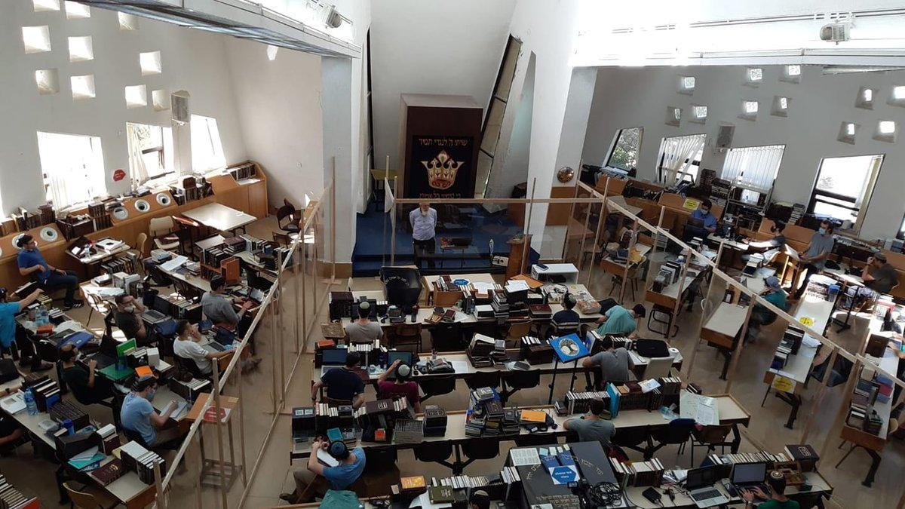

Slide 9
Rav Amital’s Presentation on Natural Morality
(Source: R’ Yehuda Amital, Jewish Values in a Changing World, ch. 2)

Slide 10
Key Questions:
Is there such a thing as “natural morality”?
What is the relationship between morality and Torah?

Slide 11
Is There Such a Thing as Natural Morality? (Eiruvin 100b)
Rabbi Yoḥanan said: Even if the Torah had not been given, we would nonetheless have learned modesty from the cat, which covers its excrement, and that stealing is objectionable from the ant, which does not take grain from another ant, and forbidden relations from the dove, which is faithful to its partner, and proper relations from the rooster, which first appeases the hen and then mates with it.
אָמַר רַבִּי יוֹחָנָן: אִילְמָלֵא לֹא נִיתְּנָה תּוֹרָה, הָיִינוּ לְמֵידִין צְנִיעוּת מֵחָתוּל, וְגָזֵל מִנְּמָלָה, וַעֲרָיוֹת מִיּוֹנָה. דֶּרֶךְ אֶרֶץ מִתַּרְנְגוֹל — שֶׁמְּפַיֵּיס וְאַחַר כָּךְ בּוֹעֵל.

Slide 12
Is Natural Morality Binding Absent a Divine Command? (Devarim 23:4-5)
(4) An Ammonite or a Moabite shall not enter into the assembly of Hashem; even to the tenth generation none belonging to them shall enter into the assembly of Hashem forever,
(5) because they didn't meet you with bread and with water on the way, when you came forth out of Egypt, and because they hired against you Balaam the son of Beor from Pethor of Mesopotamia, to curse you.
(ד) לֹא יָבֹא עַמּוֹנִי וּמוֹאָבִי בִּקְהַל י"י גַּם דּוֹר עֲשִׂירִי לֹא יָבֹא לָהֶם בִּקְהַל י"י עַד עוֹלָם.
(ה) עַל דְּבַר אֲשֶׁר לֹא קִדְּמוּ אֶתְכֶם בַּלֶּחֶם וּבַמַּיִם בַּדֶּרֶךְ בְּצֵאתְכֶם מִמִּצְרָיִם וַאֲשֶׁר שָׂכַר עָלֶיךָ אֶת בִּלְעָם בֶּן בְּעוֹר מִפְּתוֹר אֲרַם נַהֲרַיִם לְקַלְלֶךָּ.

Slide 13
Does Natural Morality Still Bind Us Once We’ve Gotten the Torah? (R’ Amital)
According to one commonly held opinion, after the Torah was given, natural morality lost its validity, so that nothing in the world has binding force other than Torah. This approach assumes that allowing room for natural morality diminishes the importance of Torah, in that it recognizes an additional source of obligation alongside the Torah. According to this point of view, which zealously tries to defend the honor of the Torah, there is no connection between God, Creator of man, and God, Giver of the Torah, as if that which God implanted in man's heart does not belong to God. What Rambam says in The Guide of the Perplexed (III, 31) may fittingly be applied to this attitude:

Slide 14
Does Natural Morality Still Bind Us Once We’ve Gotten the Torah? (R’ Amital, cont.)
There is a group of human beings who consider it a grievous thing that causes should be given for any law; what would please them most is that the intellect would not find a meaning for the commandments and prohibitions. What compels them to feel thus is a sickness that they find in their souls, a sickness to which they are unable to give utterance and of which they cannot furnish a satisfactory account. For they think that if those laws were useful in this existence and had been given to us for this or that reason, it would be as if they derived from the reflection and the understanding of some intelligent being. If, however, there is a thing for which the intellect could not find any meaning at all and that does not lead to something useful, it indubitably derives from God; for the reflection of man would not lead to such a thing.

Slide 15
Does Natural Morality Still Bind Us Once We’ve Gotten the Torah? (R’ Amital, cont.)
Even after the Torah was given, natural morality retains its special role of guiding man in all his paths. Elsewhere, Rabbi Kook writes as follows (Orot ha-Torah, chap. 12, 2-3):
Morality in its natural state, with all its profound splendor and might, must be fixed in the soul, so that it may serve as a substratum for the great effects emanating from the strength of Torah… Every element of Torah must be preceded by derekh eretz [= natural ethical behavior]. If it is something agreeable to natural reason and uprightness, it must pass in a straight path, with the inclination of the heart and consent of the pure will implanted in man, like theft, illicit sexual relations, and modesty which are learned from the ant, the dove, and the cat, and all the more so those things which are derived from the internal cognition of man himself and his spiritual sense…

Slide 16
Are We Obligated to Be Moral? (Guide for the Perplexed 3:17)
For Him, may He be exalted, justice is necessary and obligatory; namely, that an obedient individual receives compensation for all the pious and righteous actions he has accomplished, even if he was not ordered by a prophet to do them, and that he is punished for all evil acts committed by him, even if he was not forbidden by a prophet to do them; this being forbidden by the inborn disposition – I refer to the prohibition against wrongdoing and injustice.

Slide 17
Morality as Divine Conduct (Sotah 14a)
Rabbi Chama son of Rabbi Chanina said: What is the meaning of the verse, "You shall walk after the Lord your God" (Devarim 13:5)? Is it possible for a human being to walk after the Shekhina? Surely it has been said: "For the Lord your God is a devouring fire" (Devarim 4:24)!
Rather [the meaning is] to walk after the attributes of the Holy One, blessed be He. Just as He clothes the naked, so to you shall clothe the naked. Just as He visits the sick, so to you shall visit the sick. Just as He comforts mourners, so to you shall comfort mourners. Just as He buries the dead, so to you shall bury the dead.
וְאָמַר רַבִּי חָמָא בְּרַבִּי חֲנִינָא, מַאי דִּכְתִיב: ״אַחֲרֵי ה׳ אֱלֹהֵיכֶם תֵּלֵכוּ״, וְכִי אֶפְשָׁר לוֹ לְאָדָם לְהַלֵּךְ אַחַר שְׁכִינָה? וַהֲלֹא כְּבָר נֶאֱמַר ״כִּי ה׳ אֱלֹהֶיךָ אֵשׁ אוֹכְלָה הוּא״!
אֶלָּא, לְהַלֵּךְ אַחַר מִדּוֹתָיו שֶׁל הַקָּדוֹשׁ בָּרוּךְ הוּא: מָה הוּא מַלְבִּישׁ עֲרוּמִּים… אַף אַתָּה הַלְבֵּשׁ עֲרוּמִּים. הַקָּדוֹשׁ בָּרוּךְ הוּא בִּיקֵּר חוֹלִים… אַף אַתָּה בַּקֵּר חוֹלִים. הַקָּדוֹשׁ בָּרוּךְ הוּא נִיחֵם אֲבֵלִים… אַף אַתָּה נַחֵם אֲבֵלִים. הַקָּדוֹשׁ בָּרוּךְ הוּא קָבַר מֵתִים… אַף אַתָּה קְבוֹר מֵתִים.

Slide 18
Why Aren’t Ethics Legislated by the Torah? (Alan Brill, “Worlds Destroyed, Worlds Rebuilt: The Religious Thought of Rabbi Yehudah Amital”)
If the virtues of the soul are more important than the regular commandments, one might ask, “Why are they not commanded?” In answering this question R. Amital reveals the core of his theory that we must act from internal motivation. We need to cultivate the self toward moral perfection, which the mitsvot do not accomplish.
He formulates this end in several ways. First, we must emulate the actions of the patriarchs through being individually inspired by their exemplary, true moral behavior. Second, we should go beyond their actions and personally act out of natural morality based on internal motivation, as did the patriarchs. Third, we need to understand that to be voluntarily ethical is greater than being commanded to be ethical. Therefore, in contrast to the halakhic hierarchy where those who are commanded receive greater reward than those who are not commanded, the ethical realm provides rewards for volunteerism.

Slide 19
Dealing with Conflicts between Halakha and Morality (R’ Amital)
We occasionally encounter mitzvot and halakhot that cannot easily be reconciled with our natural moral sensitivities. At times, we come across biblical stories that cause us the same difficulty.
In all such cases, we must first examine what is stated in the Oral Law. For example, the mitzva to destroy the seven Canaanite nations and the mitzva to wipe out Amalek seem to involve collective punishment that ignores the fact that we are dealing here with human beings who were created in the image of God. When, however, we examine what Rambam says on the matter, things look entirely different…
If the seven [Canaanite] nations or Amalek do not accept peace, not one of them is spared…

Slide 20
Dealing with Conflicts between Halakha and Morality (R’ Amital, cont.)
Second, there are certains things that are God's prerogative to do: God gives life and takes it away, and He can demand of man to take the life of his fellow. Therefore, even when the Torah commands us to act contrary to our natural morality, this does not mean that we are supposed to modify our moral outlook so that it should be in keeping with the Torah's commands. Our sensitivity should remain as is, but we must recognize that at certain times God commands us to do things that cannot be reconciled with our natural morality.
We learn the same thing from the story of the akeida, the binding of Yitzchak. Were man required to bend his natural sensitivities to accord with a command that he cannot reconcile with morality, then surely Avraham should have bound his son Yitzchak on the altar joyfully and full-heartedly. The picture painted by Chazal is, however, very different. On the contrary, from God's perspective the real test was when He drew out His command saying, "Take now your son, your only son Yitzchak, whom you love" (Bereishit 22:2). And from Avraham's perspective, Chazal describe at length the emotional suffering which Avraham experienced as he prepared himself to fulfill the mitzva

Slide 21
The Desert Island Dilemmas

Slide 22
R’ Amital’s Approach
But what is the law in a case where a person is faced with a choice between a food forbidden by the Torah and human flesh? According to most opinions, the Torah does not forbid human flesh by a negative precept; at most, there is an issur aseh – a prohibition that is not stated in the Torah in the form of a negative commandment, but merely inferred from a positive commandment. Others believe it is forbidden only by way of a rabbinic decree. This being the case, human flesh should be considered the less severe prohibition! But is it really true that the sick person should partake of human flesh and not from foods proscribed by Torah law, like untithed produce or the flesh of an improperly slaughtered animal?

Slide 23
R’ Amital’s Precedent
This idea is stated explicitly in Dor Revi'i on Chullin, written by Rabbi Moshe Shemuel Glasner, great-grandson of the Chatam Sofer, who was a great Torah scholar and grandfather of my revered teacher, Rabbi Chayyim Yehuda Halevi, Hy"d. This is what he writes regarding the matter under discussion (General Introduction, 2):
But tell me now, a dangerously ill patient having to choose between meat from an improperly slaughtered or congenitally defective animal and human flesh – which should he eat? Do we say that he should eat the human flesh, which is not forbidden by a Torah prohibition – even though it is forbidden by the moral code accepted by civilized man, so that anyone eating or feeding another person human flesh is cast out from the community of men – rather than eat meat which the Torah forbids with a negative commandment? Would it enter your mind that we, the chosen people, a wise and understanding people, should violate this moral code in order to save ourselves from violating a Torah prohibition?

Slide 24
Review and Questions

