Slide 1
Artscroll Through the Ages: German Translations Mendelssohn and R’ Hirsch
Rabbi Chaim Metzger
cmetzger@torontotorah.com

Slide 2
Why did they translate into German?

Slide 3
What German translations are there?
Martin Luther (yimach shmo) 16th century
Moses Mendelssohn
נתיבות שלום
Netivot Shalom
1783
Rabbi Sussmann Glogua 1785
Rabbi Shimshon Raphael Hirsch
1867

Slide 4
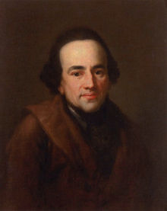
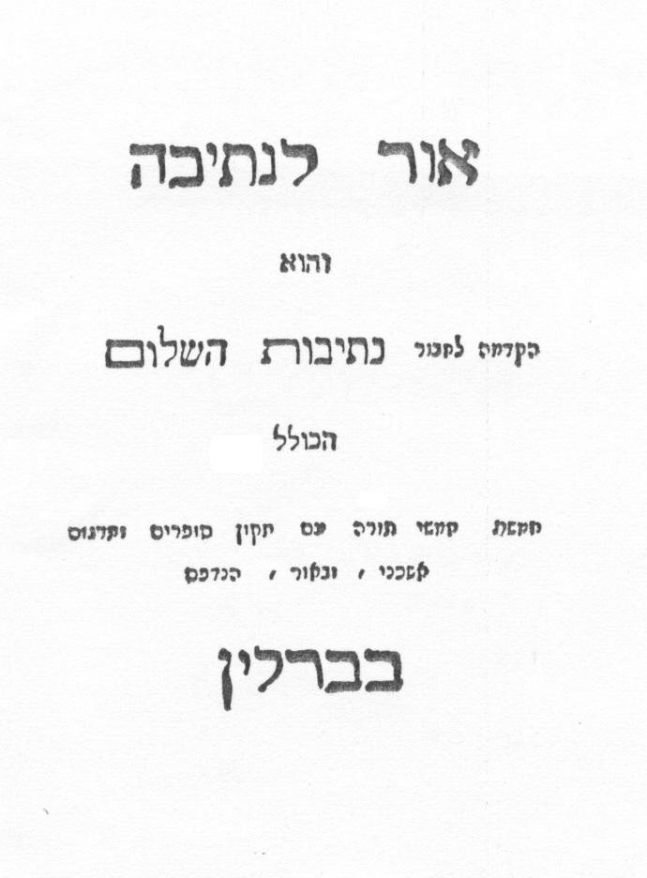
Moses Mendelssohn
(6 September 1729 – 4 January 1786) German-Jewish philosopher
to whose ideas the Haskalah, the 'Jewish Enlightenment' of the eighteenth and nineteenth centuries, is indebted. (Wikipedia)

Slide 5
Features of Netivot haShalom
Very high level German translation - High German
German transcribed in Hebrew letters
commentary called Biur below (mostly not by Mendelssohn)
Tikkun Sofrim – Scribal notes

Slide 6
Why did he write it?
His detractors– to Germanize and assimilate Jews
No indication of this from Biur
Language he used is difficult
Not a good textbook
For his children’s and others who don’t know Hebrew fluently
his own words in the intro Or leNetiva Introduction to Netivot Shalom
Notes:
Leviticus32 — it is stated that German was understood among Jews and that the translation was to promote further the comprehension of Scriptures for them. This opinion is strengthened by the fact which all three bring as an example for the deplorable status quo, that Jewish students of the Bible must seek help from Christian, i.e. German translat

Slide 7
Why was it rejected?
Lasted for about a century
Hard to use – written in High German in Hebrew characters, not in the Judeo-German (Western Yiddish) people actually typically spoke
Rabbinic Responses
His posthumous association with Reform movement
Notes:
Summing up, the criticism of Mendelssohn's German deals with following areas: (1) His "Hebraisms," i.e. his rendering proper and words for unknown objects, animals, etc. in the original Hebrew, and his joining German morphemes to Hebrew roots; (2) the allegation that he never fully overcame his Judeo-German language background; (3) grammatical flaws; (4) literalisms; (5) use of overly sophisticated words.

Slide 8
Rabbi Yechezkel Landau – Nodeh Beyehuda
For the translator deeply immersed himself in the language, using as he did an extremely difficult German that presupposes expertise in its grammar. Now, since the children will find it hard to under stand it, the teacher will have to spend most of the time in explaining German grammar (and thus the day will pass and the boy remains ignorant of the principles of the Torah)... It induces the young to spend their time reading Gentile books, in order to become sufficiently familiar with refined German to be able to understand this translation. Our Torah is thereby reduced to the role of a maidservant for the German tongue (to simplify it).
Rabbi Ezechiel Landau of Prague, https://www.hebrewbooks.org/pdfpager.aspx?req=22413&st=&pgnum=266
It is worth noting that Rabbi Landau wrote these words in an approbation (haskamah) for a different German translation of the Pentateuch and the Five Scrolls by Rabbi Sussmann Glogau, about which he says "is literal . . . German without mistake, yet not difficult, so that everyone can understand it. In this way the boy succeeds in properly learning Hebrew as well as German, right in his youth.” (1785)
(Dr. Werner Weinberg translation )
Language Questions Relating to Moses Mendelssohn's Pentateuch Translation https://www.jstor.org/stable/23507615

Slide 9
R’ Shimshon Raphael Hirsch (1808-88)
German Orthodox rabbi best known as the intellectual founder of the Torah im Derech Eretz school of contemporary Orthodox Judaism
Hirsch was rabbi in Oldenburg, Emden, and was subsequently appointed chief rabbi of Moravia. From 1851 until his death, Hirsch led the secessionist Orthodox community in Frankfurt am Main.
He wrote a number of influential books (Horeb, Nineteen Letters, German commentary on Siddur) and for a number of years published the monthly journal Jeschurun, in which he outlined his philosophy of Judaism.
He was a vocal opponent of Reform Judaism, and similarly opposed early forms of Conservative Judaism. (Wikipedia)

Slide 10
R’ Hirsch’s Translation of Torah
Uebersetzung und Erklärung des Pentateuchs,
"Translation and explanation of the Pentateuch";
5 volumes published 1867-78
Modern Standard German
German Commentary below

Slide 11
Why did RSRH write it?
I seek to explain the biblical verses on their own, to draw this explanation from the literal expression through all of its facets, to pull the explanation of the words from the treasury of the language of the Holy Writ, to draw and to describe by way of linguistic research. I will draw from the traditions of law and lore, which have been transmitted to us from the days of our predecessors, together with the biblical text, those truths upon which is based the worldview of Jewish life. These they are the laws of Israel’s life forever and ever — behold, this is the burden of his soul of the author, and so long as he does not miss the target totally in this commentary, then this author will not have worked for naught. He hopes to make some small contribution to recognizing the full unity of the spirit which reverberates through the Holy Writ of God’s word. Thereby, we may realize that this spirit is not the inheritance of days of yore, now obsolescent; rather, it lives with us in the present, and in it is the future hope of all human aspirations. (His Introduction to Breishit Translation VBM)

Slide 12
Amram and Yocheved
שמות ב: (א) וַיֵּ֥לֶךְ אִ֖ישׁ מִבֵּ֣ית לֵוִ֑י וַיִּקַּ֖ח אֶת־בַּת־לֵוִֽי:
“A certain man of the house of Levi went and married a Levite woman” (Exodus 2:1, JPS).
Mendelssohn added three words to the beginning of that verse, “Vor einiger Zeit” “some time before.”
Biur - According to the peshat (simple meaning), the order of events in the parasha is not definitive, for this occurred before Pharaoh’s decree, and Miriam and Aaron were born [before the decree], and afterwards, Pharaoh decreed (Exod 1:22): “Every boy that is born you shall throw into the Nile,” and then this beautiful boy was born. This is also the way it was rendered in the German. (Translated by Dr. Abigail Gillman)

Slide 13
R’ Hirsch Version
(כב) וַיְצַ֣ו פַּרְעֹ֔ה לְכָל־עַמּ֖וֹ לֵאמֹ֑ר כָּל־הַבֵּ֣ן הַיִּלּ֗וֹד הַיְאֹ֙רָה֙ תַּשְׁלִיכֻ֔הוּ וְכָל־הַבַּ֖ת תְּחַיּֽוּן: (א) וַיֵּ֥לֶךְ אִ֖ישׁ מִבֵּ֣ית לֵוִ֑י וַיִּקַּ֖ח אֶת־בַּת־לֵוִֽי:
1:22 That pharaoh commanded all his people [saying]: “Every son that is born you shall throw into the river and every daughter you shall allow to live. 2:1 And there went a man from the house of Levi and took to wife a daughter of Levi.
…At a time such as this it took courage to become a father or a mother. For this reason the text does not read “and there was a man of the house of Levi and he took..” but וילך [“And there went…”]. The verb וילך indicates the determination required for such a step in those days. Also, the text does not read ויקח בת לוי [and took … a daughter of Levi] but את בת לוי […the daughter of Levi”] ie a women predestined for this marriage. The narrative which follows indicates that when this marriage took place the couple already had a daughter and another son. This would confirm what our sages have noted: Moses was not a child of his parents’ original marriage. The man had departed from his wife following the King’s decree to kill all male infants, but had then decided to return to her in order to defy the decree

Slide 14
Why did Esav kiss Yaakov? (Breishit 33:4)
וַיָּ֨רׇץ עֵשָׂ֤ו לִקְרָאתוֹ֙ וַֽיְחַבְּקֵ֔הוּ וַיִּפֹּ֥ל עַל־צַוָּארָ֖ו וַׄיִּׄשָּׁׄקֵ֑ׄהׄוּׄ וַיִּבְכּֽוּ׃
Esau ran to meet him and embraced him, fell upon his neck, he kissed him; and they wept.
That here purely humane feelings overcame Esau is warranted for by the little word וַיִּבְכּֽוּ, they wept. A kiss can be false but not tears that flow at such moments. Tears are drops from one’s innermost soul. This kiss, and these tears show us that Esau was also a descendent of Abraham. In Esau there must have been something more than just the wild hunter. Otherwise how could he have had the ability to domineer the whole development of mankind (which the Romans actually did IL)
The sword alone, simply raw force, is not able to do that. But Esau also, gradually more and more lays the sword aside, turns gradually more and more towards humaneness, and it is just Jacob on whom Esau has most opportunity to show, that, and how, the principle of humaneness begins to affect him. When the strong respect the right of the strong it may well be wisdom. It is only when the strong, as here Esau, fall around the necks of the weak and cast the sword of violence away, only then does it show that right and humaneness have made a conquest. (translation by Dr. Isaac Levy)

Slide 15
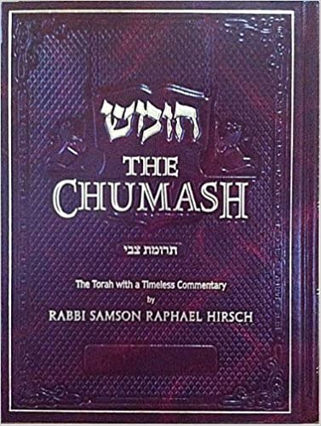
Sources
R’ Hirsch in Hebrew online (Translated by R’ Yosef and R’ Mordechai Breuer)
R’ Hirsch on Sefaria in Original German
The Pentateuch - English translated by Dr. Isaac Levy R’ Hirsch’s Grandson
Abbreviated excerpts in Trumat Zvi

Slide 16
https://www.etzion.org.il/en/tanakh/studies-tanakh/biblical-commentaries/r-hirschs-commentary

Slide 17
Next Week - Orit of Ethiopian Jews
tiny.cc/translated @8:15pm

Slide 18
32:8 We can easily put ourselves in Jacob's place and we must especially do so, as the meeting was so important that as a consequence of it, a revelation was made to Jacob, an eternal reminder of which, the Torah has interwoven in the daily food of the People of Jacob.
As Jacob and Esau opposed each other here, so, right up to the present day do Jacob and Esau stand one against the other. Jacob: a pater familias blessed with children, serving, working, filled with care, Esau a “finished made man”. What Jacob had achieved after struggling for it for twenty toilsome years, in spite of the blessing he had received and the first-born right he had obtained, and which now he brought home as the great prize he had won, viz. to be able to be an independent father of a household, that, others have as their natural expectation from the cradle, that, Esau ''the finished made” man, had already had in full measure when Jacob left home; and while Jacob by the labour of his hands had succeeded in attaining the happiness of being a father of a family, Esau had become in the meantime, a political personality, a leader of an army, an Aluf with large troops. Thus, the external contrast between the "holder-on to the heels" and the "made" man.
There are two principles of life which meet in Jacob and Esau and the fight and victory between them is what the history of the world consists in. Family life which is happy and dispenses happiness in Jacob, and the glitter of political power and greatness in Esau. For thousands of years the battle has raged; whether it suffices just to be human beings, and all social, political power and organisation have only importance means for ensuring this goal of all human endeavours to be reached, or whether all that is humane in mankind, all family and home life, has only importance as trophies of politics etc. to serve as a background.
And how different is Jacob's attitude to Esau to what it was to Laban . We can recognise what strength the consciousness of innocence gives, and what an oppressive feeling even an appearance of guilt awakens.
Twenty years endurance of a fight against wrong which innocently have to bear do not have such a depressing effect as one minute’s feeling towards somebody whom we know feels hurt by us, and who may not see the motive which, though it may not justify our action can at least excuse it.
Jacob was afraid, although he had been guided by the protection which G-d had promised him. מכאן, our sages teach שאין הבטחה לצדיקים בעולם הזה, that there can be no unconditional assurance to the righteous in this life. Every such assurance is implicitly conditional on continued blamelessness, it can be forfeited at any minute by a false step. · E.v ery sub e fo rf e1. te d at any aunthue breas t of the most se ec, t rightPt,h .. •v1q ness, 1t can th t never leaves d it comes from ii , not froin that is the worry b tlJe form of the ;.: ' lty and trouble. -,r, ( a stron ,o,nse s - '' is: u!'ual expression for. : form. All forming is a eorn8. or ,,s, th b'nd) means to f ashioh, These concepts are so related f of io" to 1 d ired s ape.onn. f aterial into the 1 expressed by ,,i : t,in~ ,n,i “’” Pr: ~:;1 that we find fornun~ a }~rm. Perhaps there is a difference t(o E x. XXXII ,4 ) and :,iis mde abnys ,,s1e or ,41•P , · ,s is the external limitation hether trouble is expresse t move freely. It leaves us untouched w th t we can no . h to our sphere, so a . . us space. But ,i, 1s sue a narrowing internally, the reverse 1·5 :in~th g1v1ngh ave . . . 00 power to oppose its restrictions. of circumstances that we feel atthw: it can do what it likes with us. 'fhat It ob ta1•n s h pow.e r oJvaecro bu sf elt at owards Esau, an d t h at t·s t he condi·t i·o n is the condition w~ich d elves through the centuries towards the Esau- . h'ch we have ioun ours h Gal . 10 w 1 . d't' which in the prophesy of t e ut, 1s called nations It 1S that con 1 ion ' ,, th h . · Lev't XXVI 28) ''the fury of chance ; at our app1ness, our ,,P ni,n ( 1 • ' · • • b t h b . li rogress is never the definite intention, u as to su m1t to thvee s,p uorupor sePs of everything else, and, w1' th out ri·g hts , h as t o be satI·S f 1·e d with such crumbs that, "by chance", fall from the table of happiness of other nations. Accordingly ,, ,i,, would say Jacob felt that he was entirely at the mercy of an armed force headed by Esau, coming against him, but still, to save something he split up his camp. The same thing has been the means of our salvation and continued existence throughout the Galut.
Nowhere, and at no time, has the sword of Esau been able to reach all of us at one swoop. When we bled on the Rhine our brethren in the Slavonic lands were safe, and vice versa. 1it1)1t' ,~w,, ;,":ip;r ;rn npiJ nii,itet r:i, (Peshachim 87b) Jacob did the same when pressed by necessity .
. V. 9 .. Here, there is one little word, that shows the whole delicacy of feeling, which otherwise would be missed. /Tl~, as a rule, is masculine,~er:•-~~-appears as such in "'lltVll.i, and in i,,::,m. But when Jacobo i ing destroyed he calls it feminine : nmr., i1lMt)i'I ,ac ,w, a0' cN;in this nnM we can hear the deep sigh that is forced out of Jacob's breast : if Esau comes to the one "poor weak" camp.
10: in me is the heritage of that which Abraham and Isaac had become through Thee, and Thou hast approached me also, if I am now coming home, I am obeying Thy instructions.
V. 11. I am not praying and begging anything for myself, I have already received so much from Thee that I can not possible have paid
the debt of gratitude that I already owe Thee. By the abundance of what
Thou hast already done for me, I feel quite small and too hwnble to
approach Thee. For the greatness of a man is not measured by the actual
amount of what he accomplishes or gives but by the relative proportion
to what he has received. We all run the danger of being too small, the
greater our possessions are : -
V. 12.-13. Nevertheless, I pray Thee, save me from my brother,
who perhaps has some claim against me, from Esau, who, in accordance
with his character, perhaps plans revenge, which perhaps, after all, I do
not deserve, save me for the sake of my children, on whom Thou hast
promised to build such a great future.
. To this cry of anguish Jacob is given no reply, that is given to
hun by an experience which he is about to undergo.
V. 10. ··in me is the heritage of that which Abraham and Isaac.
had become through Thee, and Thou hast approached me also, if I am
now coming home, I am obeying Thy instructions.
V. 11. I am not praying and begging anything

Slide 19
His Translation
According to Hirsch, the goal of the commentary was to expound the text by ascertaining the exact meaning of the words, their etymology, philology, and origin, and, this achieved, "to establish, on the basis of halakhic and aggadic interpretations, the Jewish Weltanschauung". ^{[7]}

